Slide 1
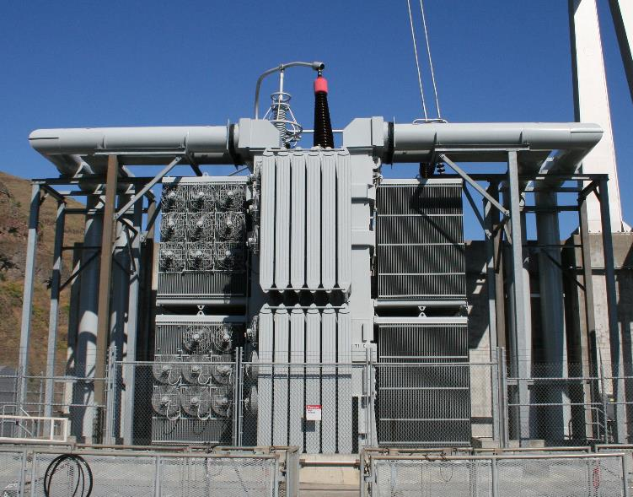
What happens in a Doble Outage
Greg Brooks, P.E.
Chief of maintenance Engineering
Hydropower Test and Evaluation
(formerly 8 years as test engineer)
Walla Walla District
Date: 8 October 2020

Slide 2
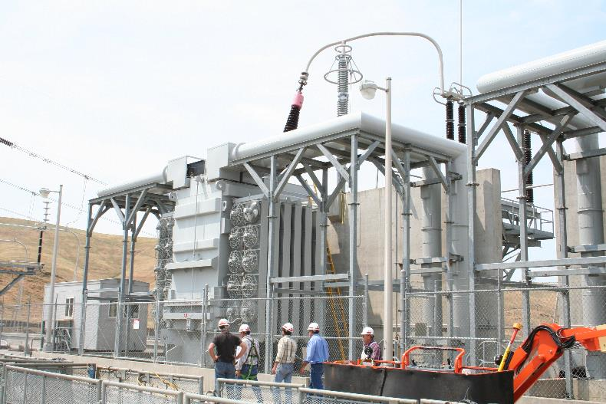
Conditions
Fully exposed to weather
22’ to top work area
Lots of trip hazards
Requires fall protection
High Voltage bushing 35’ high
Requires a man lift
Single phase transformers
Three combine to make T1 or T2
Each phase has 4 doghouses where electrical connections are made
One Phase of Three
35’ High
HV Bushing
Doghouse
22’ High

Slide 3
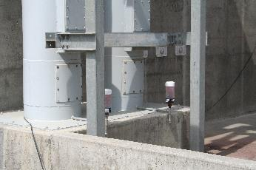
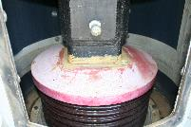
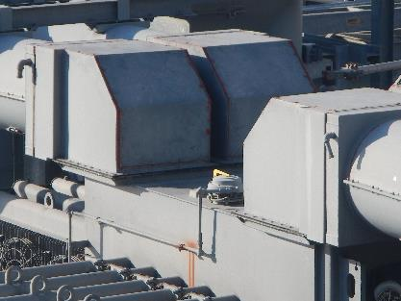
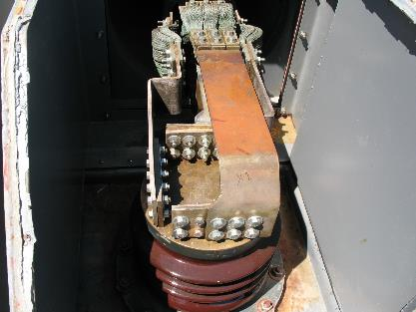
Outage sequence HIGHLIGHTS
Day 1 – SETUP CLEARANCES & ISOLATE
Open BPA line breaker
Open bus at deck level and connect grounds
Open each doghouse (12 x 22 bolts)
In each doghouse, unbolt all the flex leads (12 x 48 bolts)
Tie back or remove the leads depending on the design
Connect Ground Cables
Unbolt and remove doghouse covers
Unbolt and remove connections

Slide 4
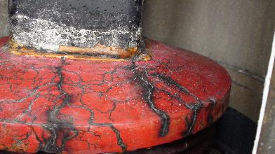
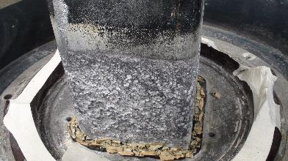
Outage sequence HIGHLIGHTS
Day 2 & 3 – PERFORM TESTS
14 rearrangements of test leads
Power Factor Tests
Winding Resistance Tests
Turns Ratio Tests
Corrective Maintenance
Day 4 – RESTORE
Reconnect
Seal up covers
Remove safe clearance
Reenergize
Tracking
Failure in service from undetected water and tracking

Slide 5
Why every 3 years?
Lower Snake have less redundancy
Only two transformers, T1 and T2 (3 single phases combine to make one transformer)
As seen at Little Goose, one failure can force a plant onto diesel
Oil filled transformers (10,000 gallons per phase)
We don’t what them to catastrophically fail
500KV high side -> higher risk
History of frequent bushing problems in low side bus
Advanced age
Management risk-based decision

Slide 6
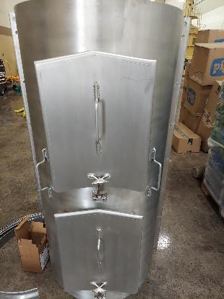
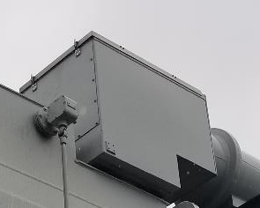
Improvements – what we’ve been up to
Upgraded Doble Test Set (Doble M7100)
Combines power factor, turns ratio, winding resistance
Less setup and take down time
Faster operation
Improved doghouse covers
Hinged and latched - No more bolts!
Drip lips for better weather protection
New deck level bus access covers
No bolts
Faster inspections
Better weather seals
Keep water out
Better drains
Let water out
Walkways at the top
Little Goose is soon to pilot

Slide 7
Discussion

