Slide 1
The Dalles Dam Emergancy AWS Backup Water Supply P&S
FFDRWG Meeting, 4 Feb. 2015
Pat Duyck
Project Manager

Slide 2
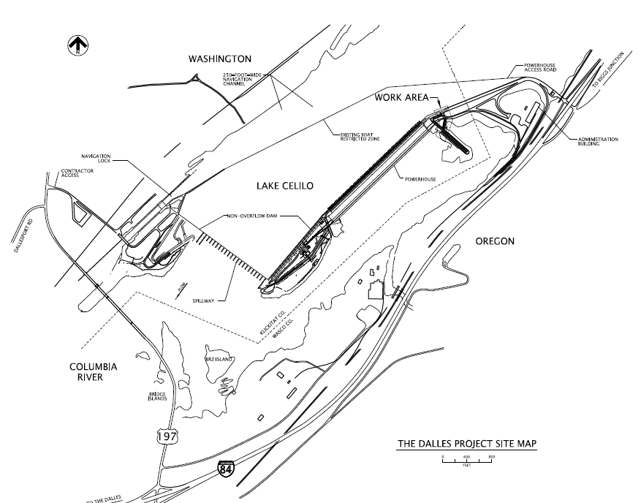
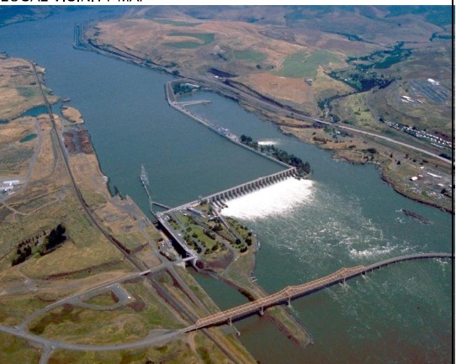

Slide 3
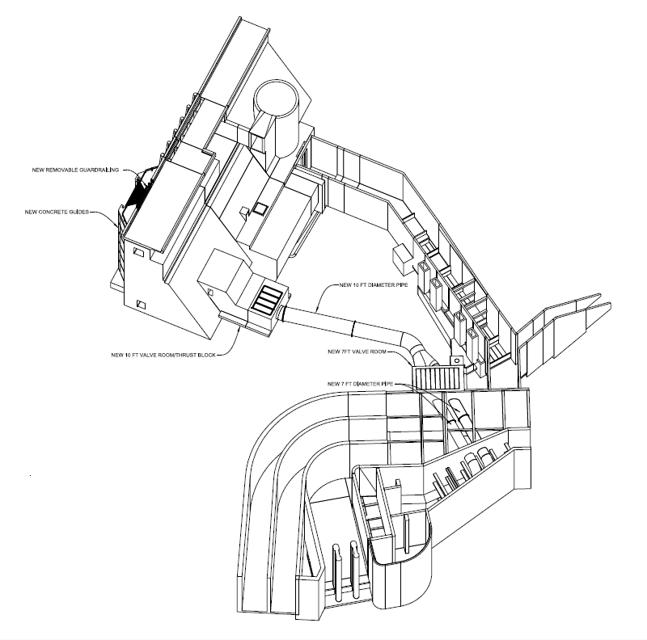

Slide 4
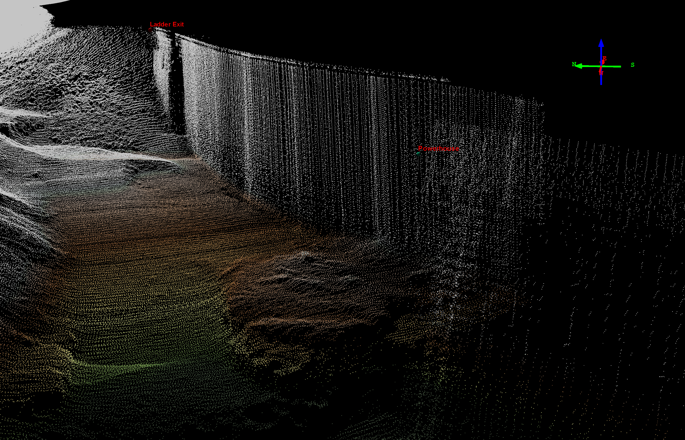

Slide 5
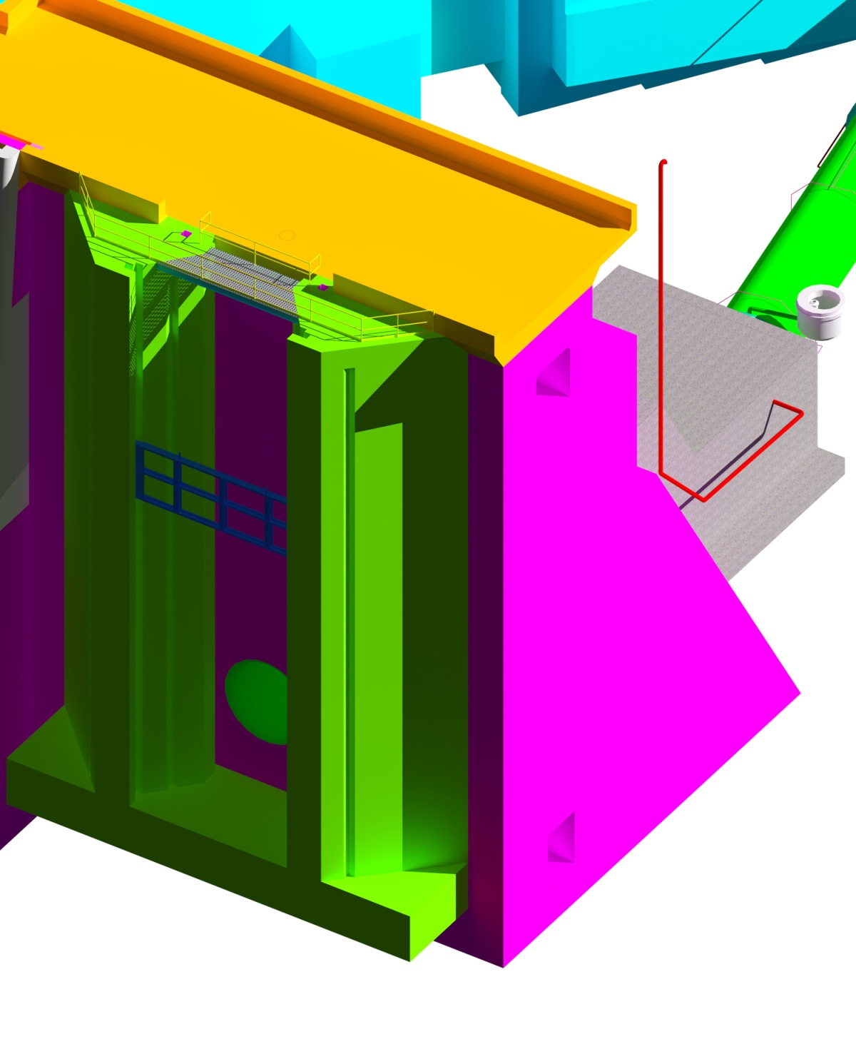

Slide 6
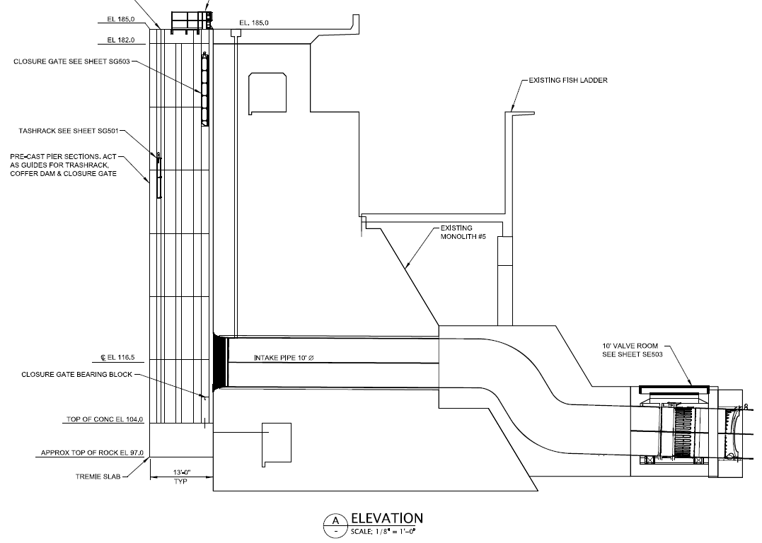

Slide 7
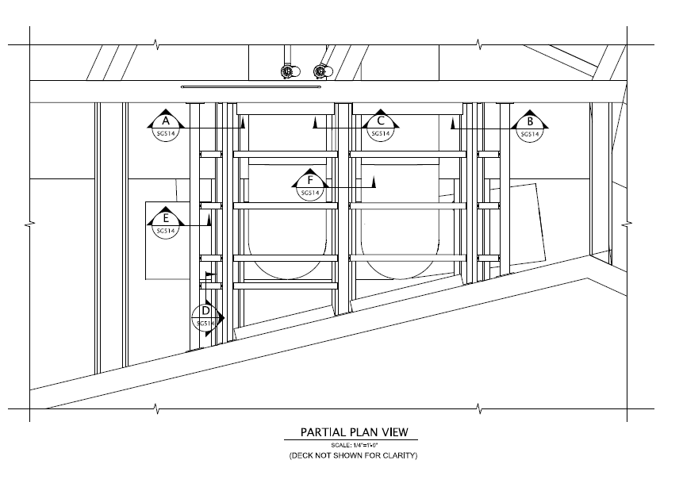
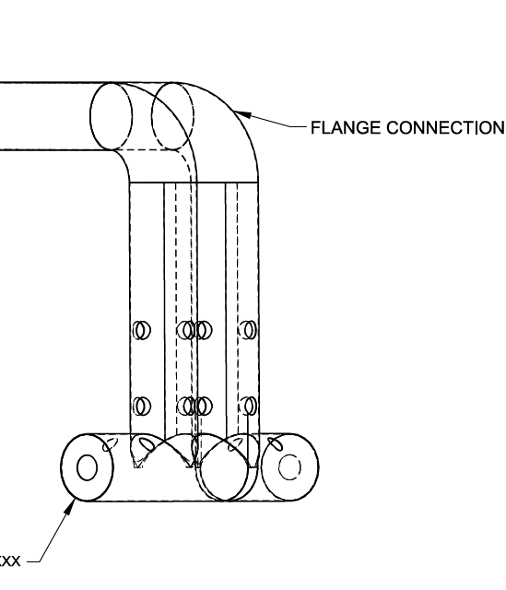

Slide 8

The Dalles Dam Emergancy AWS Backup Water Supply
 |  | Schedule: 90% P&S Review; - 2 Feb 2015 100% P&S Review; - 30 Mar 2015 Contract Award (Construction); ~ 15 Aug 2015 Notice to Proceed (Construction); ~ 30 Aug 2015 Start of 1st In-Water-Work; - 1 Dec 2015 Start of 2nd In-Water-Work; - 1 Dec 2016 *Tunnel likely will need to start prior to Dec. possibly ~ Oct. Cost: DDR estimates construction cost at ~$13.0 Million. Currently revising cost data based on more detailed design.
®
®

