Slide 1
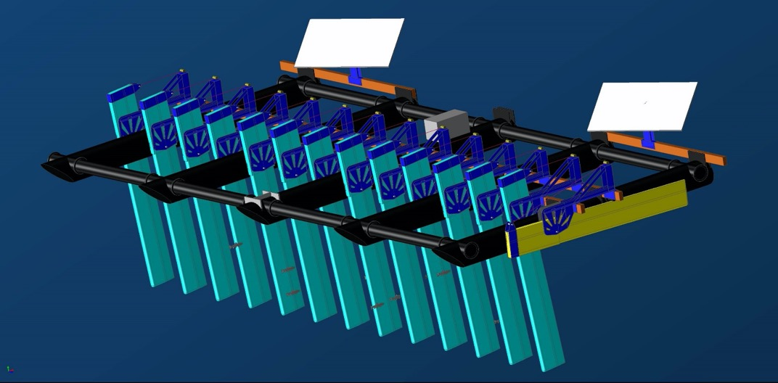
Columbia Class PIT Barge
Gabriel Brooks
NMFS/NWFSC/FE
206.334.6824
gabriel.brooks@noaa.gov

Slide 2
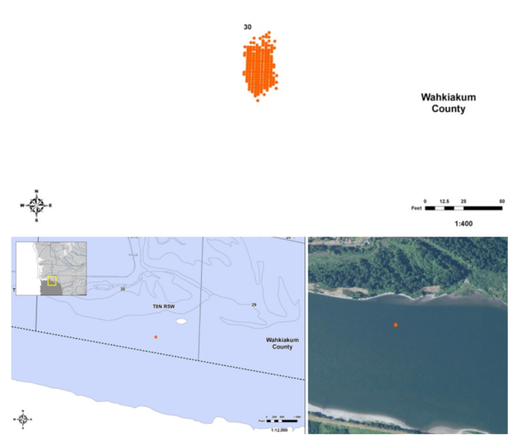
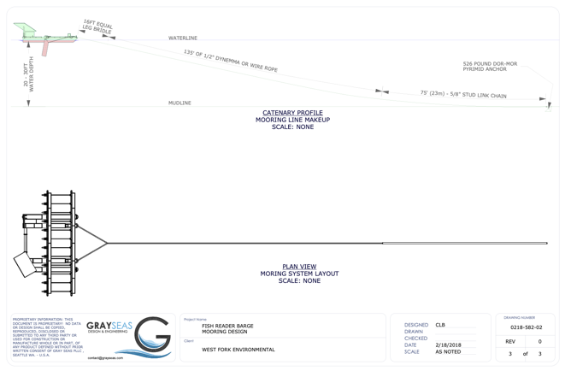
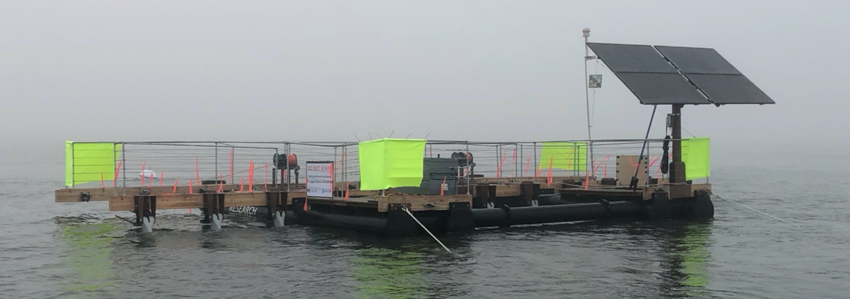
Columbia Class PIT Barge
2018 – Feasibility Test
Installation procedures
Anchoring and drift
Pinniped exclusion (fencing)
Basic operations and maintenance

Slide 3
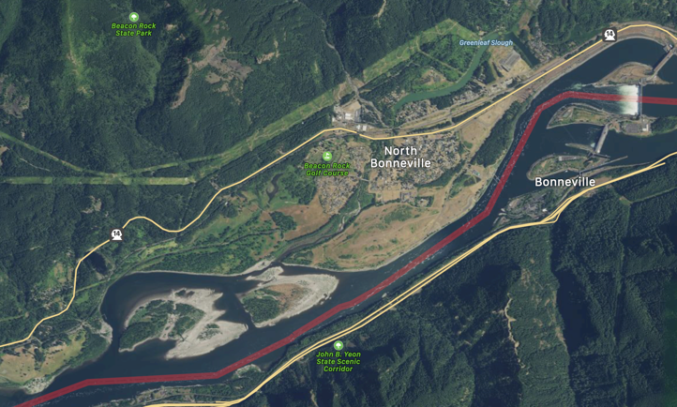
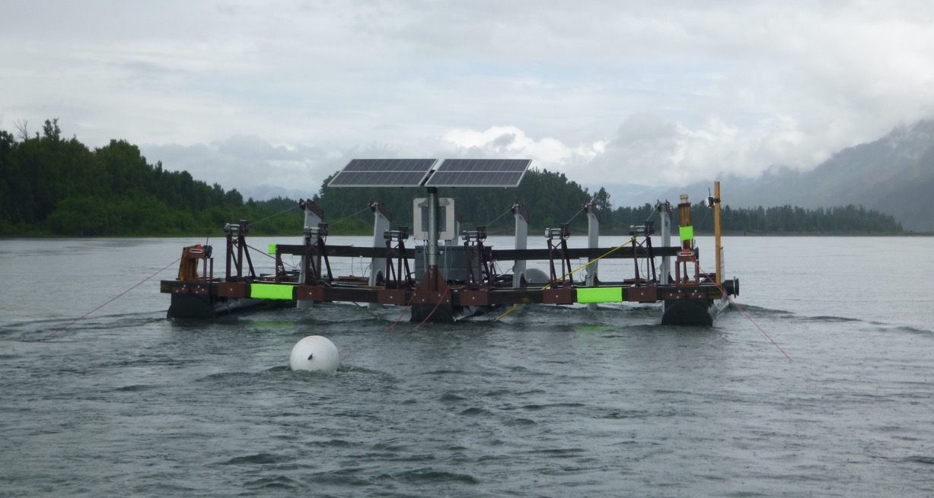
Columbia Class PIT Barge
2019 – Velocity and Debris Test
(6/27/19 – 9/16/19)
Automated debris shedding
Longer fins (12’ deep)
Slightly higher velocity water
Hull design for pinniped exclusion
Anchored below Pierce Island

Slide 4

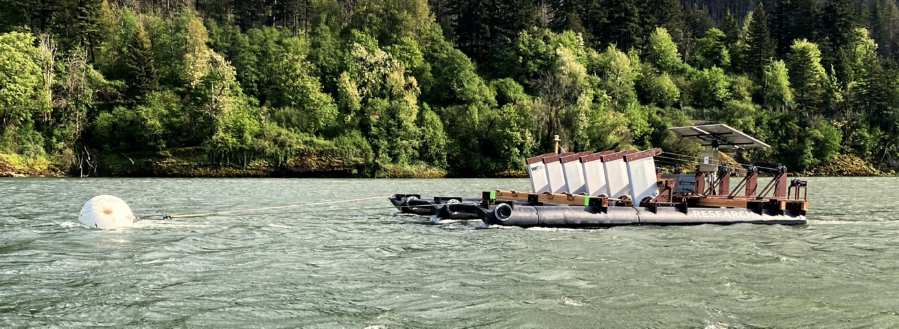
Columbia Class PIT Barge
2020 – Detection and Hull Test
(4/27/20 – 7/22/20)
Hull modification
High velocity water
Full season of sampling

Slide 5
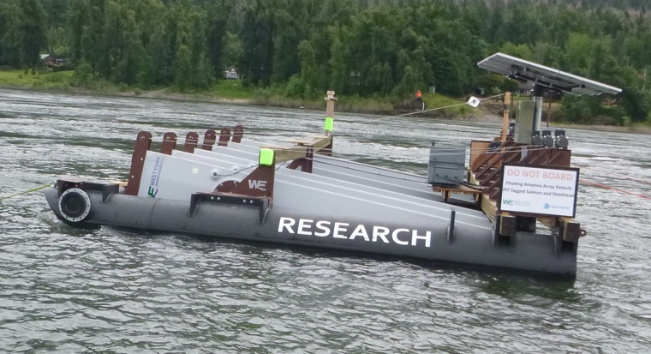
Columbia Class PIT Barge
2020
2019
Hull modified to reduce “wandering” in higher water velocities

Slide 6
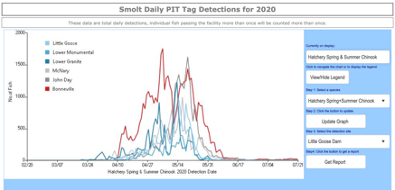
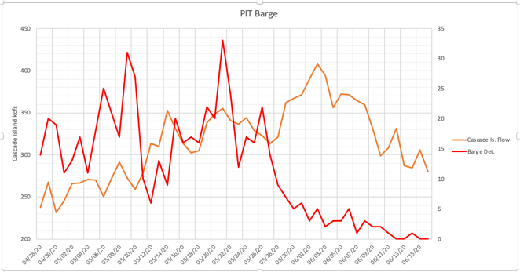
Columbia Class PIT Barge
2020 Results –
Captured ~3/4’s of the season
(4/27/20 - 7/22/20)
Max flow (Cascade Is.) – 408.23 kcfs
Water velocity – 11.7 fps
(measured by contractor)
May 8th the barge carried anchor 2 miles downstream
May 11th barge was reset with 6 klb anchor

Slide 7
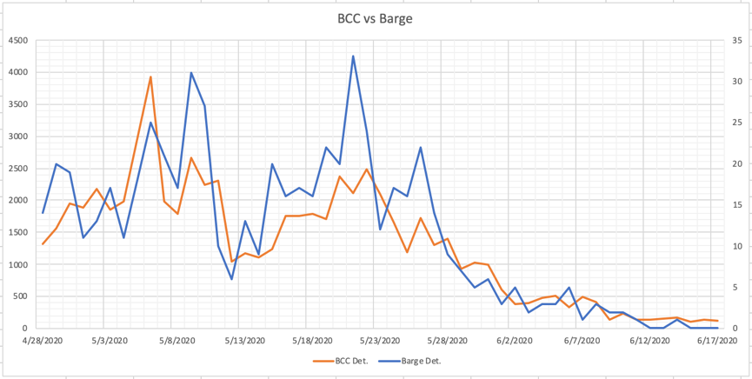
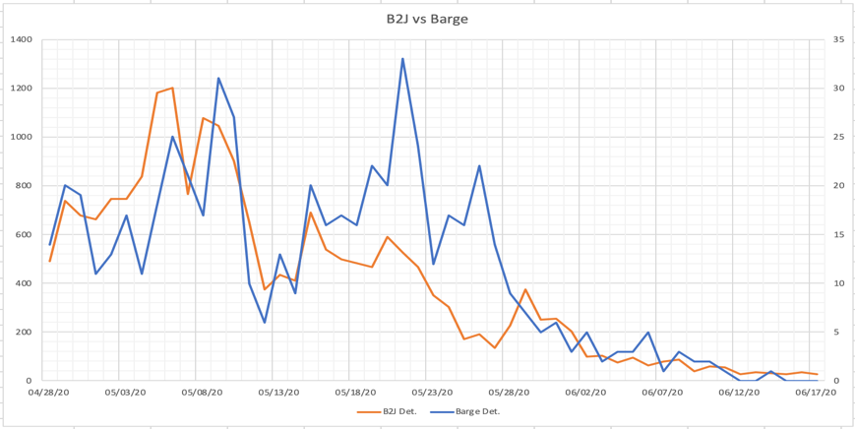
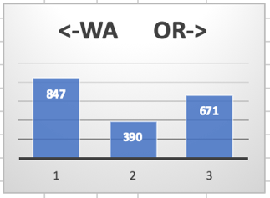
Columbia Class PIT Barge
2020 Results –
625 Unique Detections total (4/27/20 - 7/22/20)
Trawl ~11,240 mean det. (17,18,19)

Slide 8
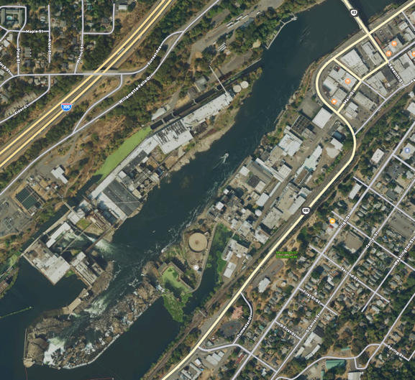
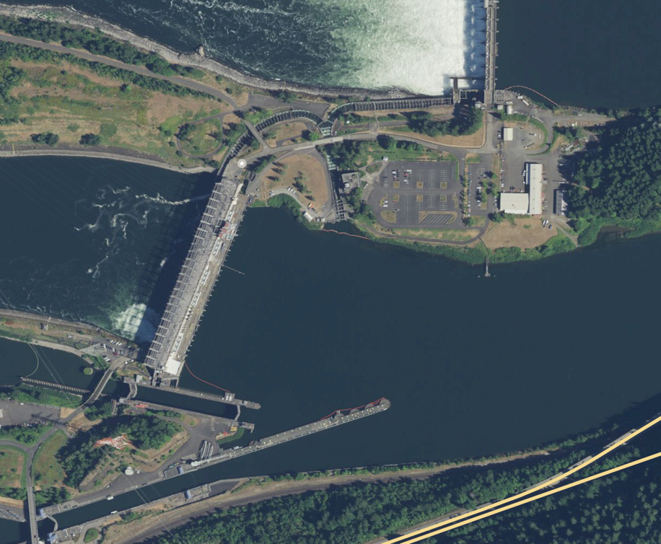
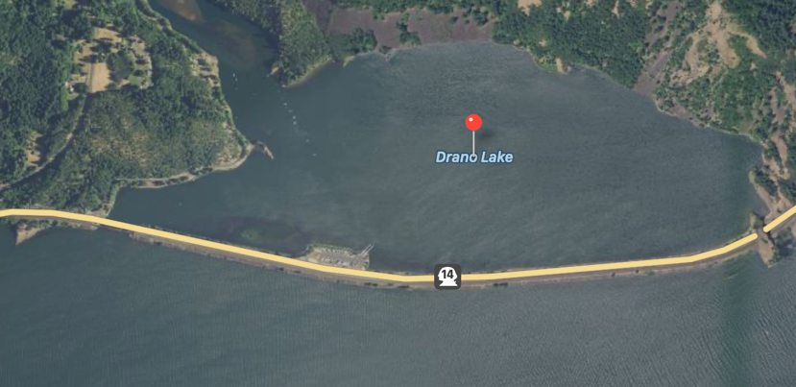
Columbia Class PIT Barge
Possible future deployment sites
Bonneville forebay (PH1)
Drano lake (cw refugia)
Willamette

