Slide 1
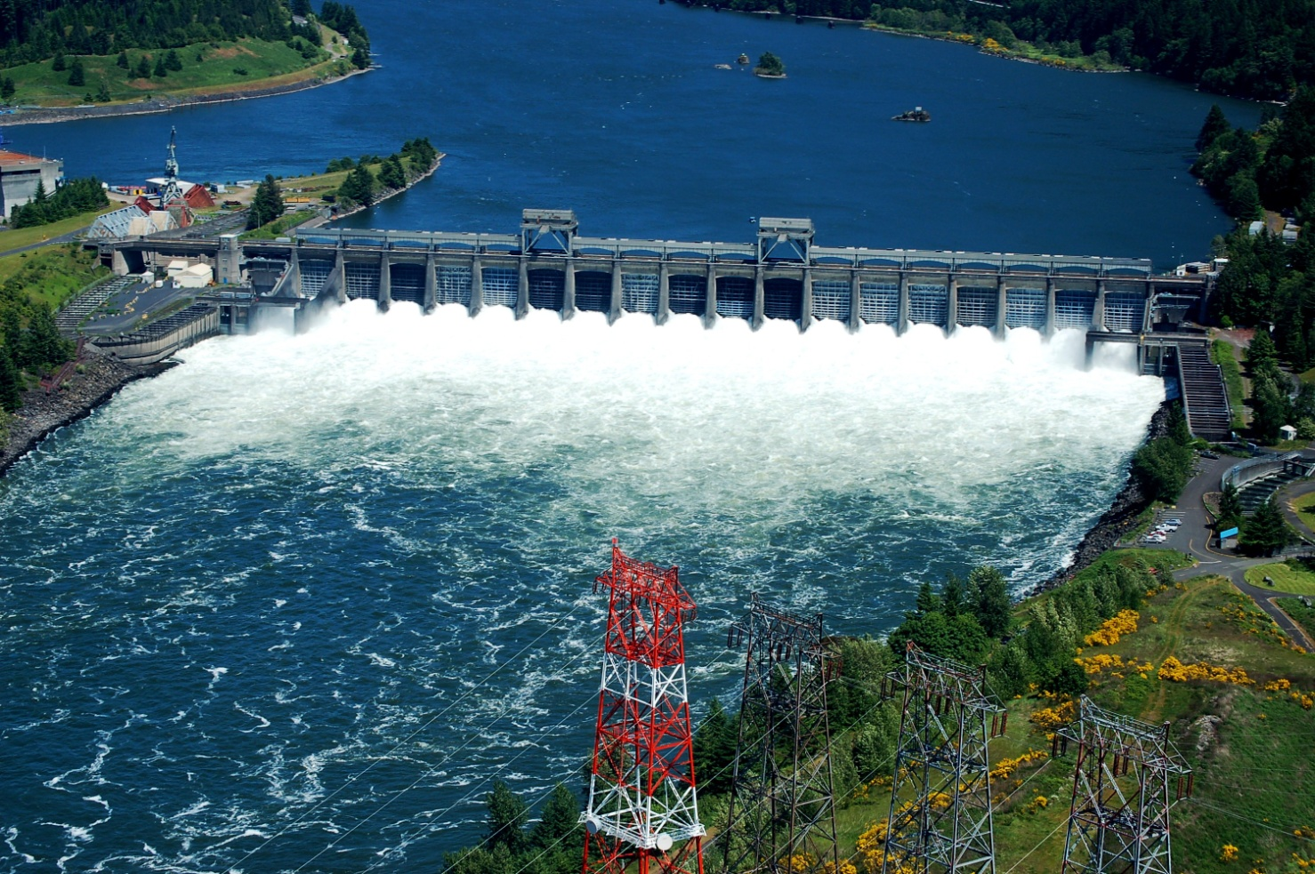
Bonneville spillway rock removal (BONSRR) alternatives
FFDRWG Presentation
Date: August 6th, 2020

Slide 2
Project brief
Project is to determine if a structural alternative can be identified to prevent rocks from moving into the stilling basin. The structural alternative will be compared to doing an emergency contract to physically remove rocks from the stilling basin. Emergency contracts to be executed prior to start of spill season (April 10).
Since 2011, an emergency contract has been issued to remove rocks from the stilling basin at Bonneville Dam on 4 or 5 occasions and we anticipate needing a contract after the 2020 season.
THIS IS NOT A STRUCTURAL FIX TO THE SPILLWAY. Larger O&M issues associated with the spillway (gate rehabilitation, rough concrete for juvenile fish, etc) will not be addressed through this effort.

Slide 3
Project Background
Project built in the 1930’s
Largest Flood 1948
South half of spillway repaired in 1954
14 foot (elevation) flow deflectors added in the 1970’s (Bays 4-15); 7 foot (elevation) flow deflectors added in 2002 (Bays 1-3, 16-18)
Flow deflectors de-gas the spillway but cause flow to move upstream and carry rocks with it
Ball milling occurs when foreign debris enters a stilling basin and continually “churns up” the concrete as it sees flow
Major problem at many dams although not likely to cause a failure unless damage remains unchecked
Rock Source Hypothesis
1948 flood pushed material downstream but not out of the Bonneville Spillway Channel
Flows since then have been causing the material to move upstream along the edges
Survey results suggest about 3000 cubic yards of loose material on either side that could continue to move upstream (we have removed approximately 1000 cubic yards so far)

Slide 4
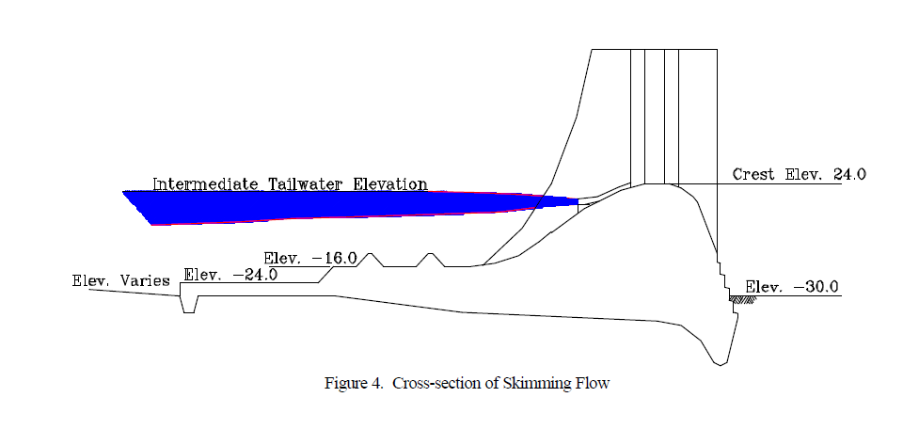
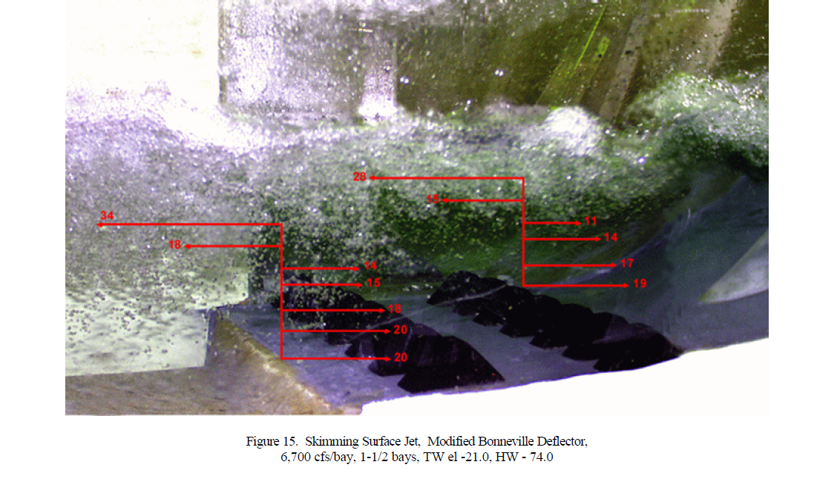
hydraulics
Flow Deflectors Cause
Flow to Move Upstream
In 2011 flows were
almost 20,000 cfs per bay.
Don’t override until
25,000 cfs per bay

Slide 5
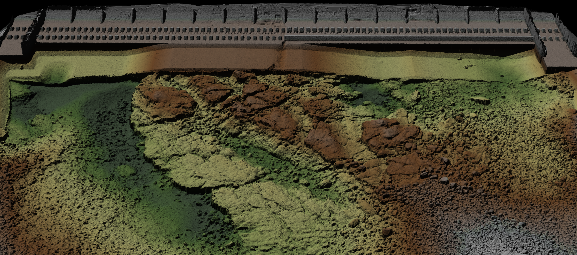
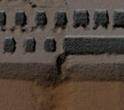
BONNEVILLE SPILLWAY
Stilling
Basin
Bay
1
2
3
4
5
6
7
8
9
10
11
12
13
14
15
16
17
18
Apron/Ramp
Baffle Blocks
Stilling Basin Irregularity
Continuous Baffle Block
E
Rock Movement
Rock Movement
N
S
W

Slide 6
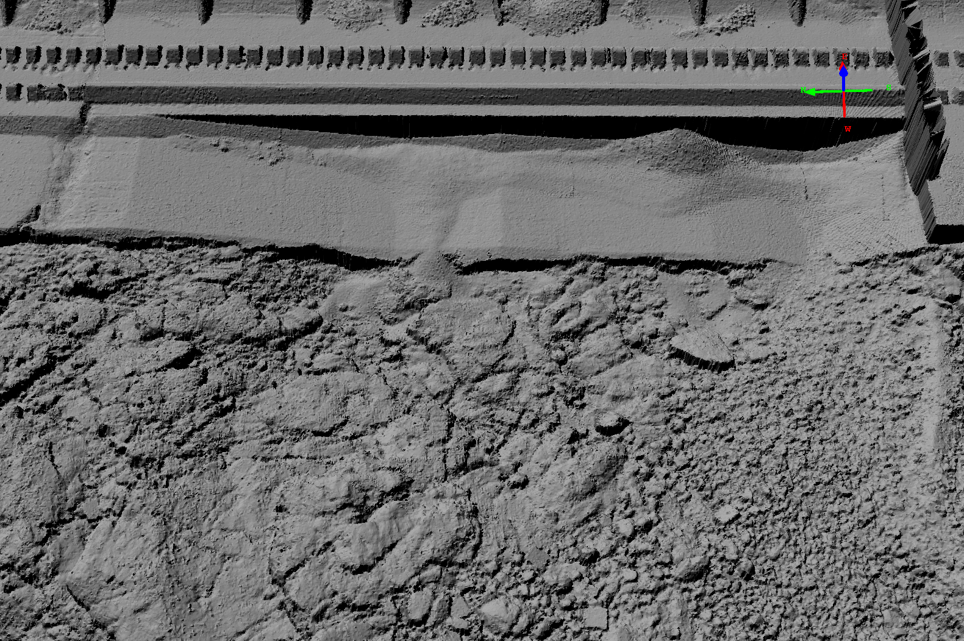
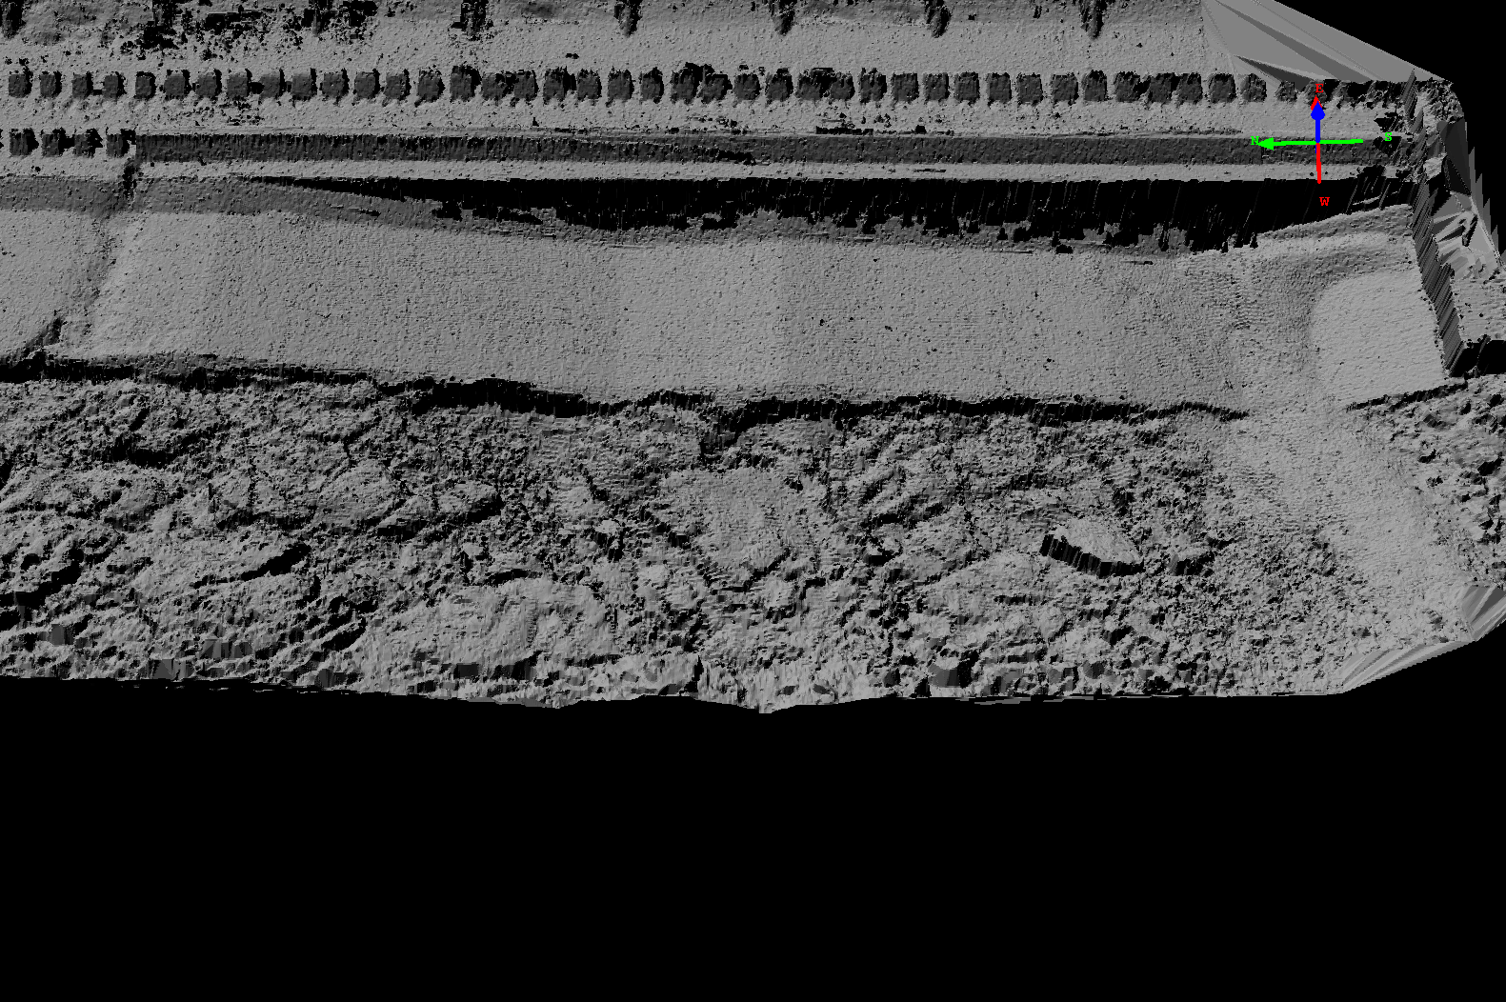
Current operations: Flushing Spill
Before
After

Slide 7
Preliminary Criteria & constraints
Criteria
Capacity of the spillway cannot be diminished over existing condition.
In-water-work windows will need to be followed.
Cannot negatively impact the adult movement of fish.
Cannot negatively impact the juvenile movement of fish.
Do not create any additional O&M requirements on the project.
Baseline condition will assume an annual contract to remove rocks and no longer assume it is an emergency contract.
Design must be capable of withstanding the 100-yr (500 Kcfs) flood event.
Constraints
Spill volumes when spilling for fish are on the edge of rock-moving spill levels (150 Kcfs). Since BON spills for fish, rocks moving into the stilling basin are likely to occur every year.
In a perfect world, Bonneville would not spill above 150 Kcfs to minimize rock movement. But spill volumes regularly exceed 150 Kcfs.
Minimum under-keel clearance of vessels that need access to the area.
All recommended alternatives need to be executed in the wet. No cofferdam is proposed. Construction will take place in the wet.

Slide 8
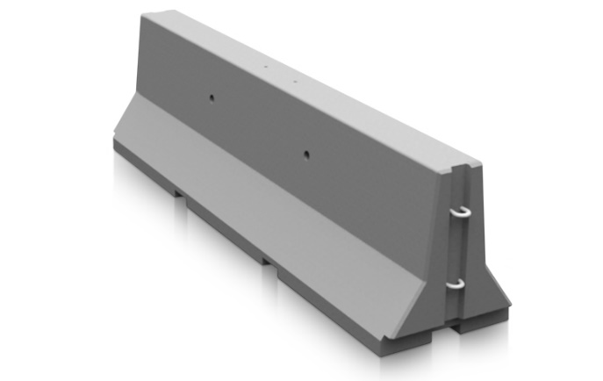
ALTERNATIVE 1: “Roadblocks”
Install “roadblocks” to prevent rocks from moving up the apron
Rock Movement
Rock Movement
Initial
Design Shape?

Slide 9
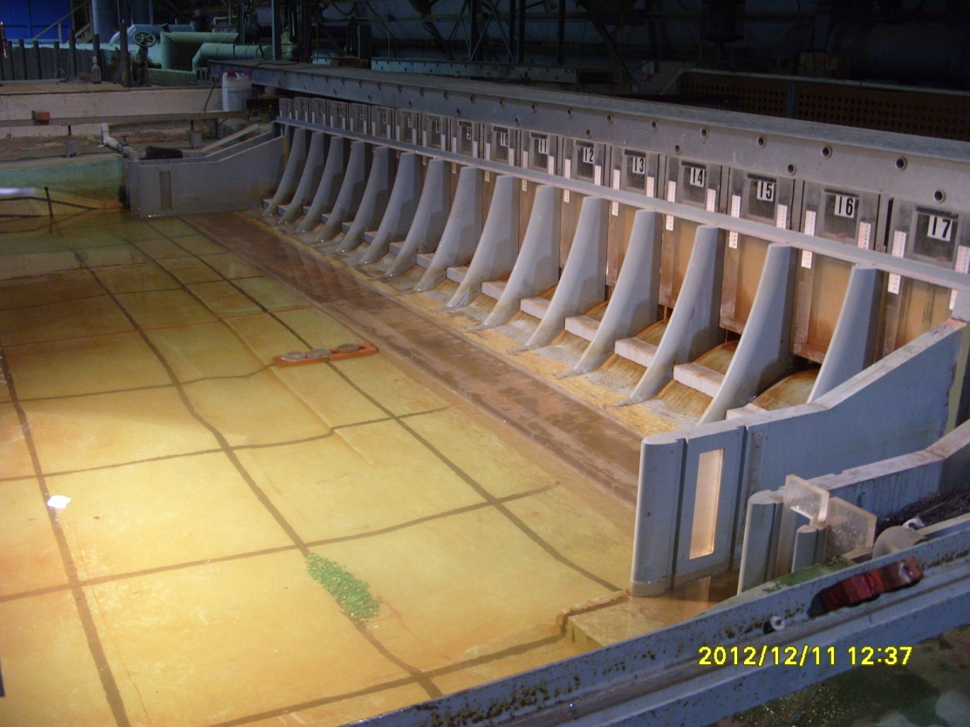
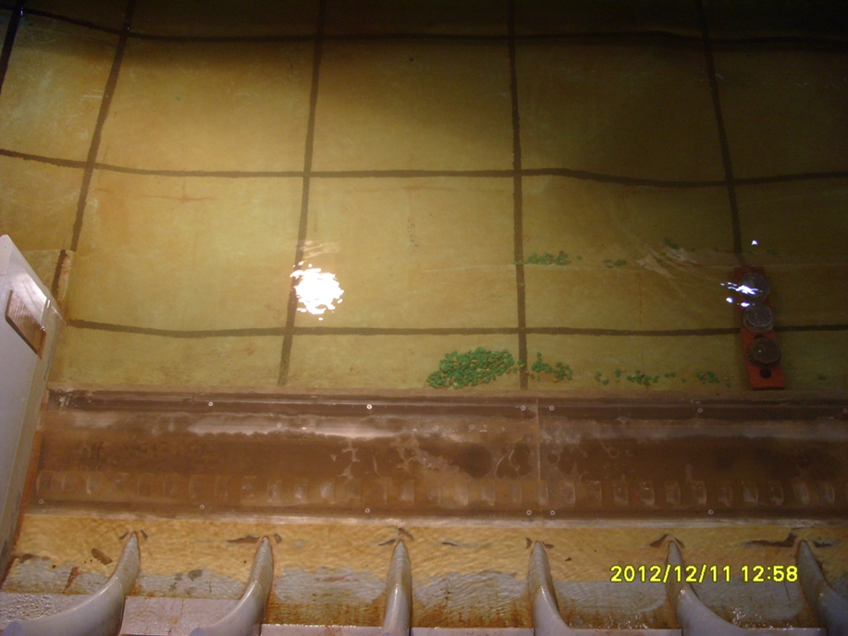
ALT 1: physical model

Slide 10
ALTERNATIVE 2: Extend continuous baffle
Extended continuous baffle block to prevent rocks from jumping into stilling basin
Rock Movement
Rock Movement

Slide 11
ALTERNATIVE 3: raise the apron
Raise low sections of apron to prevent rocks from jumping onto the apron
Rock Movement
Rock Movement

Slide 12
Questions

