Slide 1

Early Progress on Fifteenmile Creek and Hood River Lamprey Projects
Andrew Wildbill
Confederated Tribes of the Warm Springs

Slide 2
Overview
Hood River
  Recolonization Since Dam Removal
  Larval Population Monitoring
  Adult Population Monitoring
Fifteenmile Creek
  Adult and Larval Monitoring

Slide 3
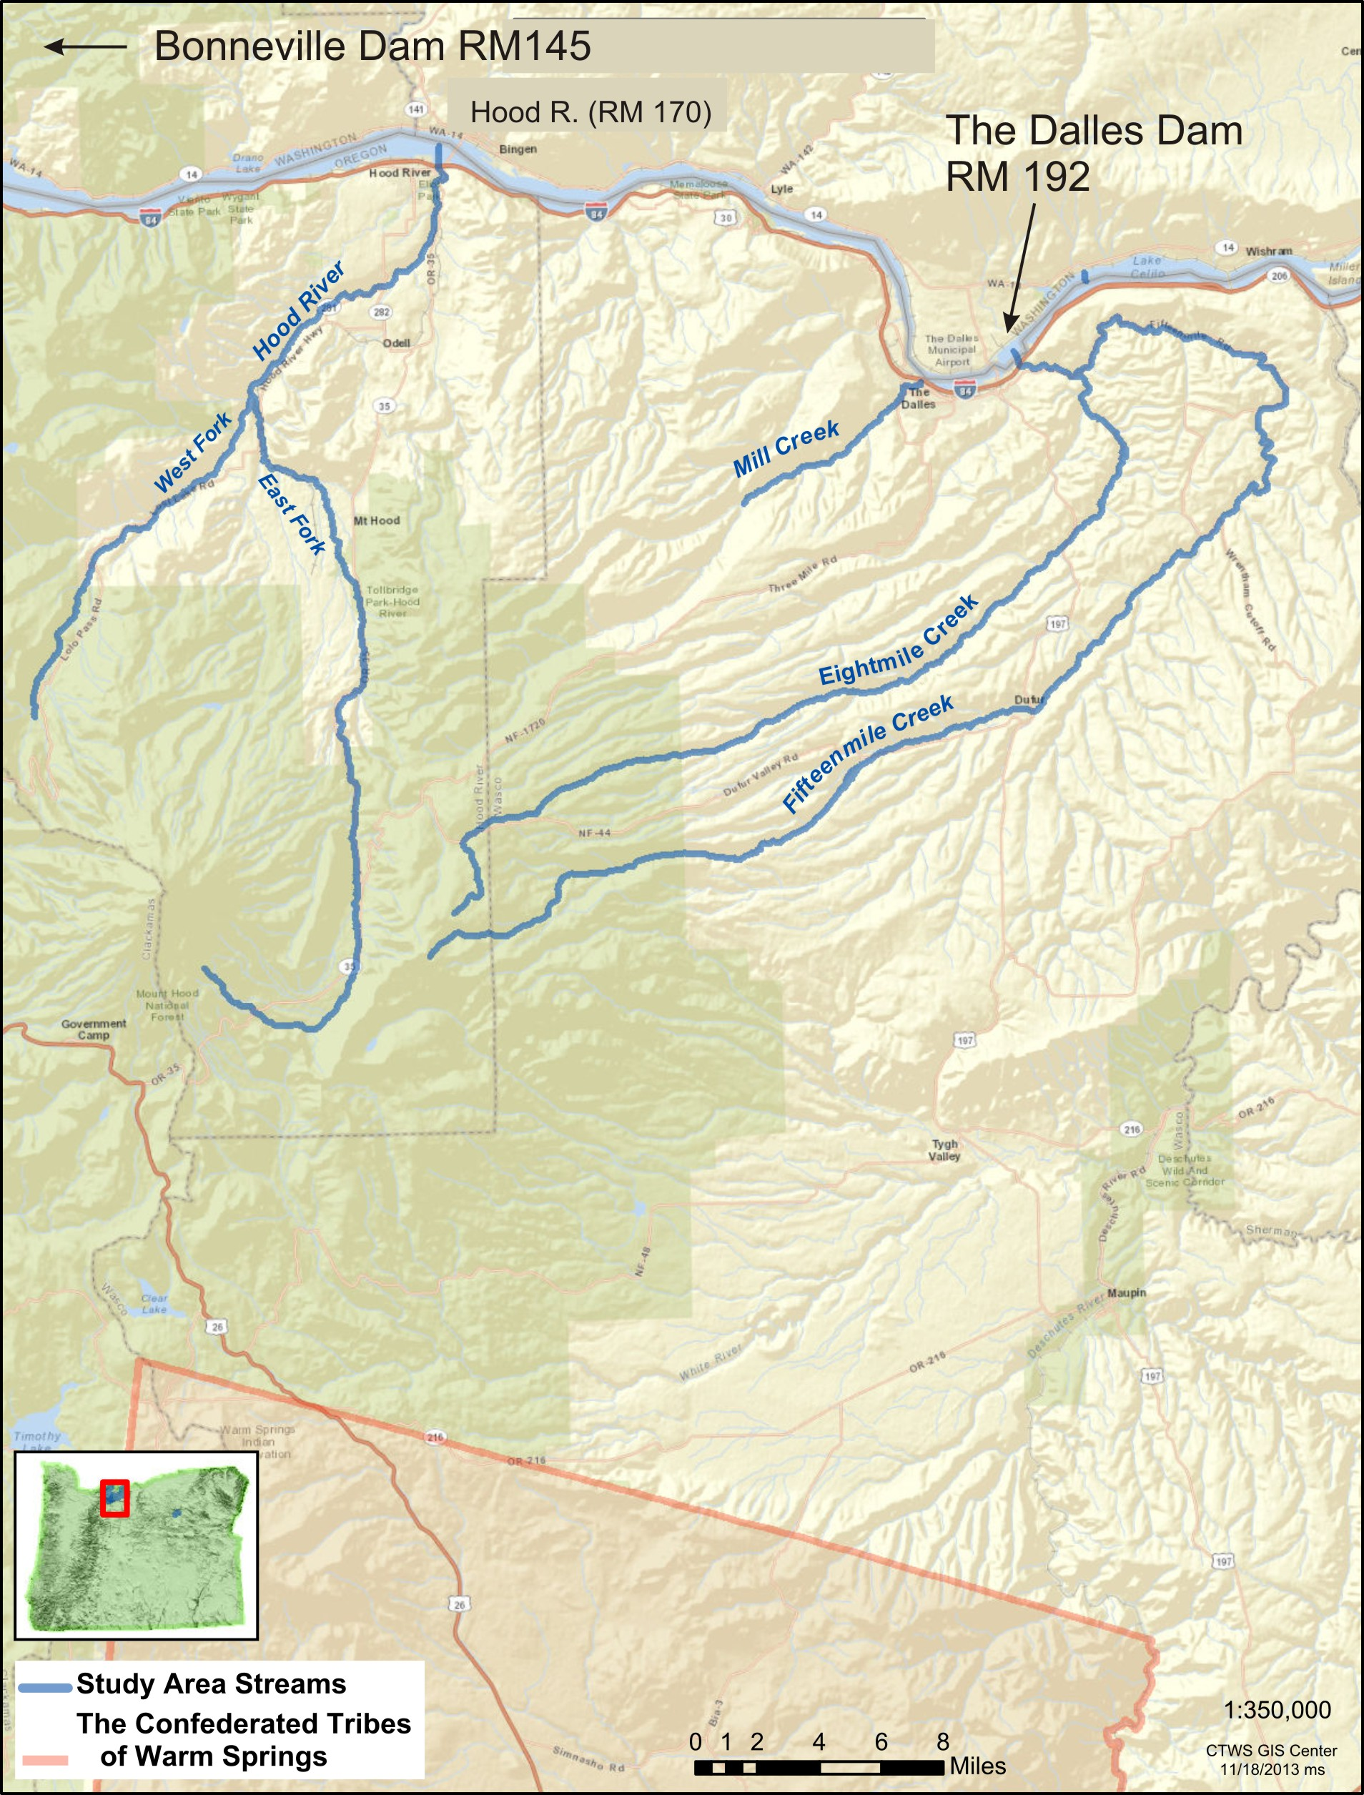
Study Area

Slide 4
Hood River&15mile- Methods
Larval Abundance & Distribution
  Electrofishing Surveys
  Abundance Estimate
14 Operating Half Duplex Sites (HDX)
  Monitor Fish Movement
Creel/ Night Monitor 15mi
Notes:
Our scope of work is expanding in the Hood as we learn more…

Slide 5
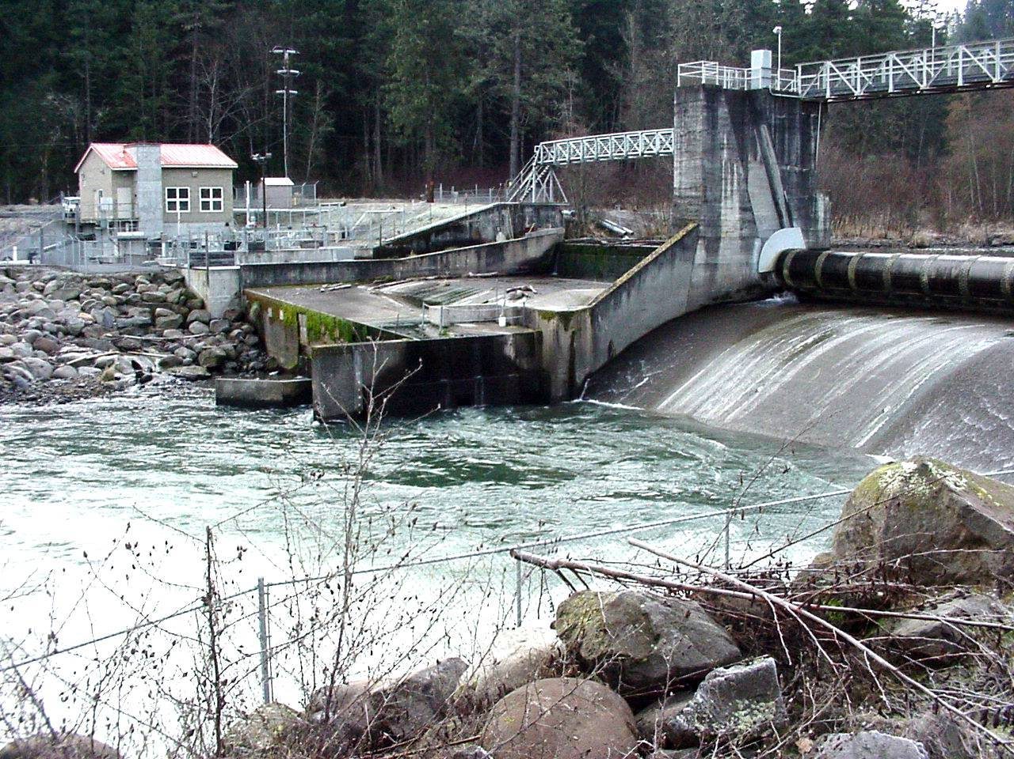
Powerdale Dam 1923-2010
Notes:
Extirpated lamprey colonies above the dam. Adult observations were observed at the base during routine maintenance, but no info on ammo’s or adults above the dam from other agencies either through screwtrap data or efishing.

Slide 6
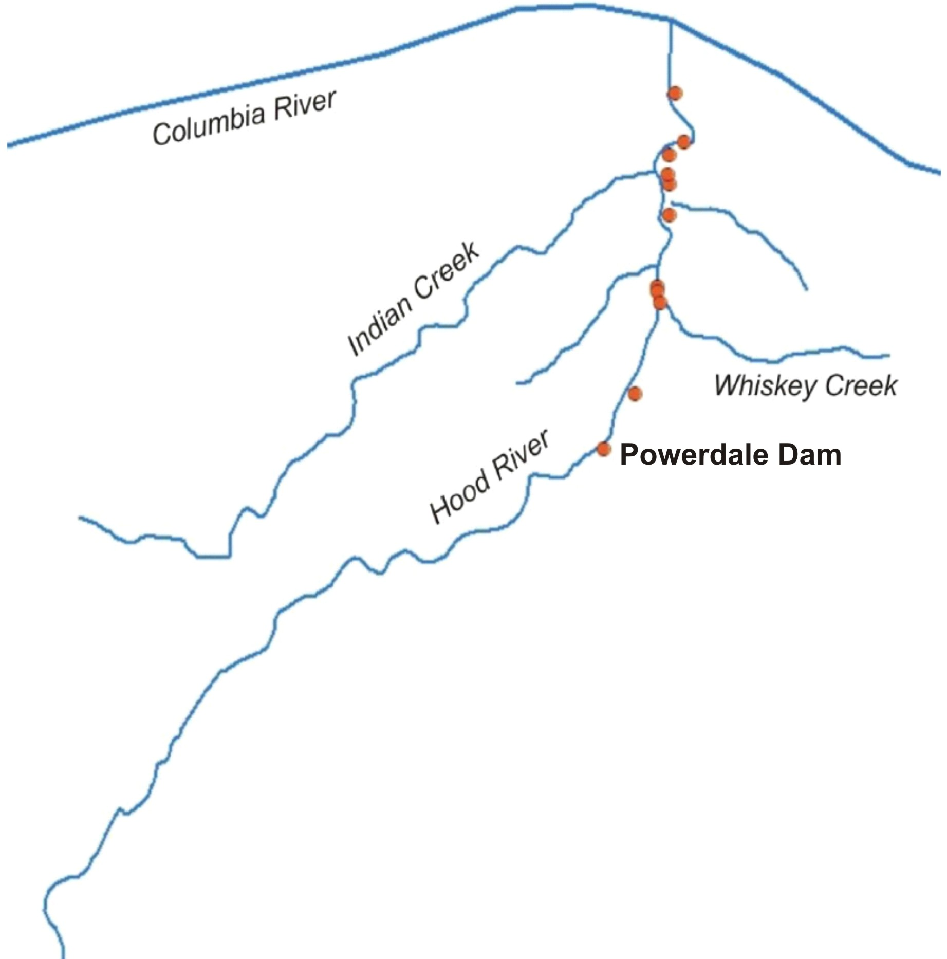
Hood River Subbasin
Notes:
The Hood. This contract started in 2012, but in 2009 a crew from CTWS shocked from the mouth up to Powerdale Dam. They found all age classes from the mouth up to about Rm 2.5. Brown dots represent shocking locations in 2009.

Slide 7
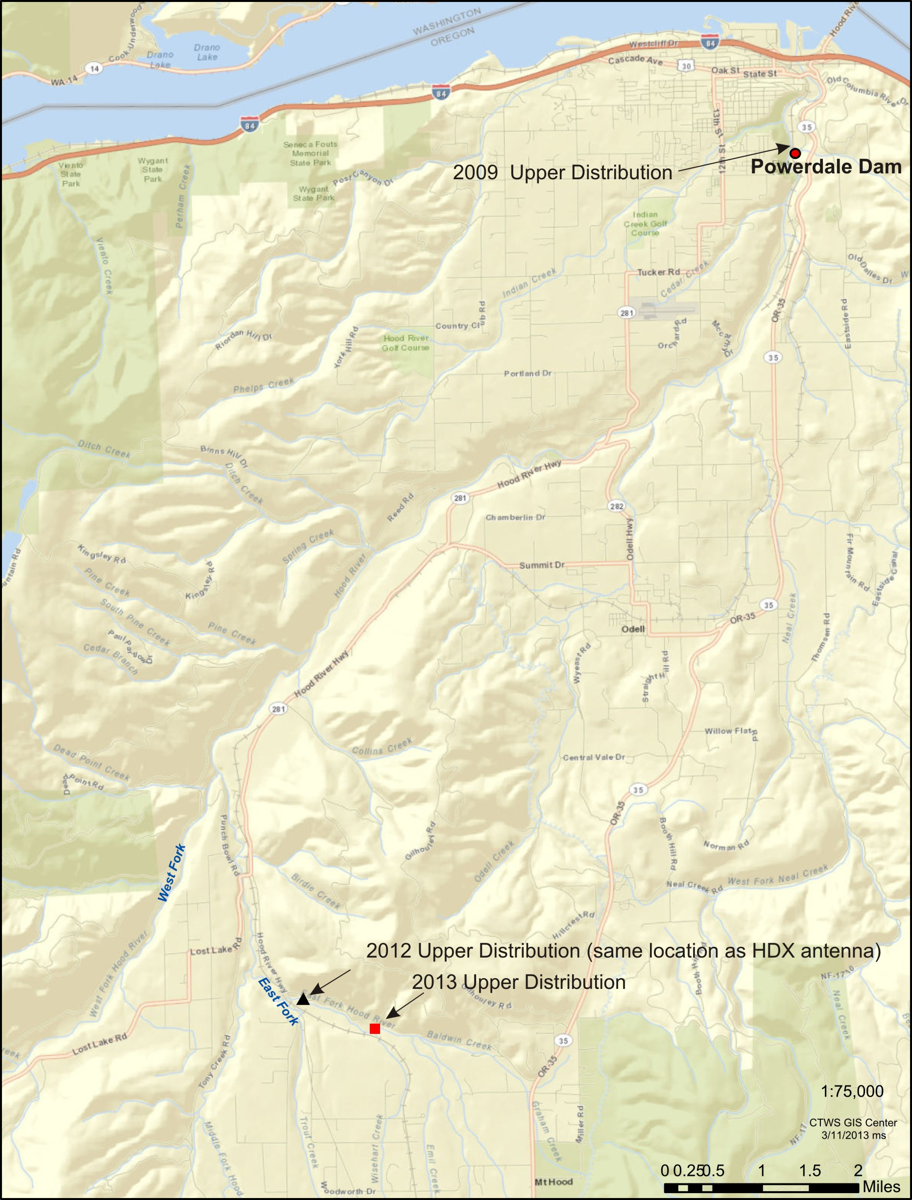
Larval Distribution

Slide 8
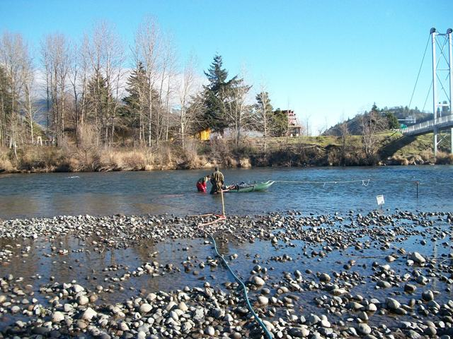
HDX Install January 2013
160ft

Slide 9
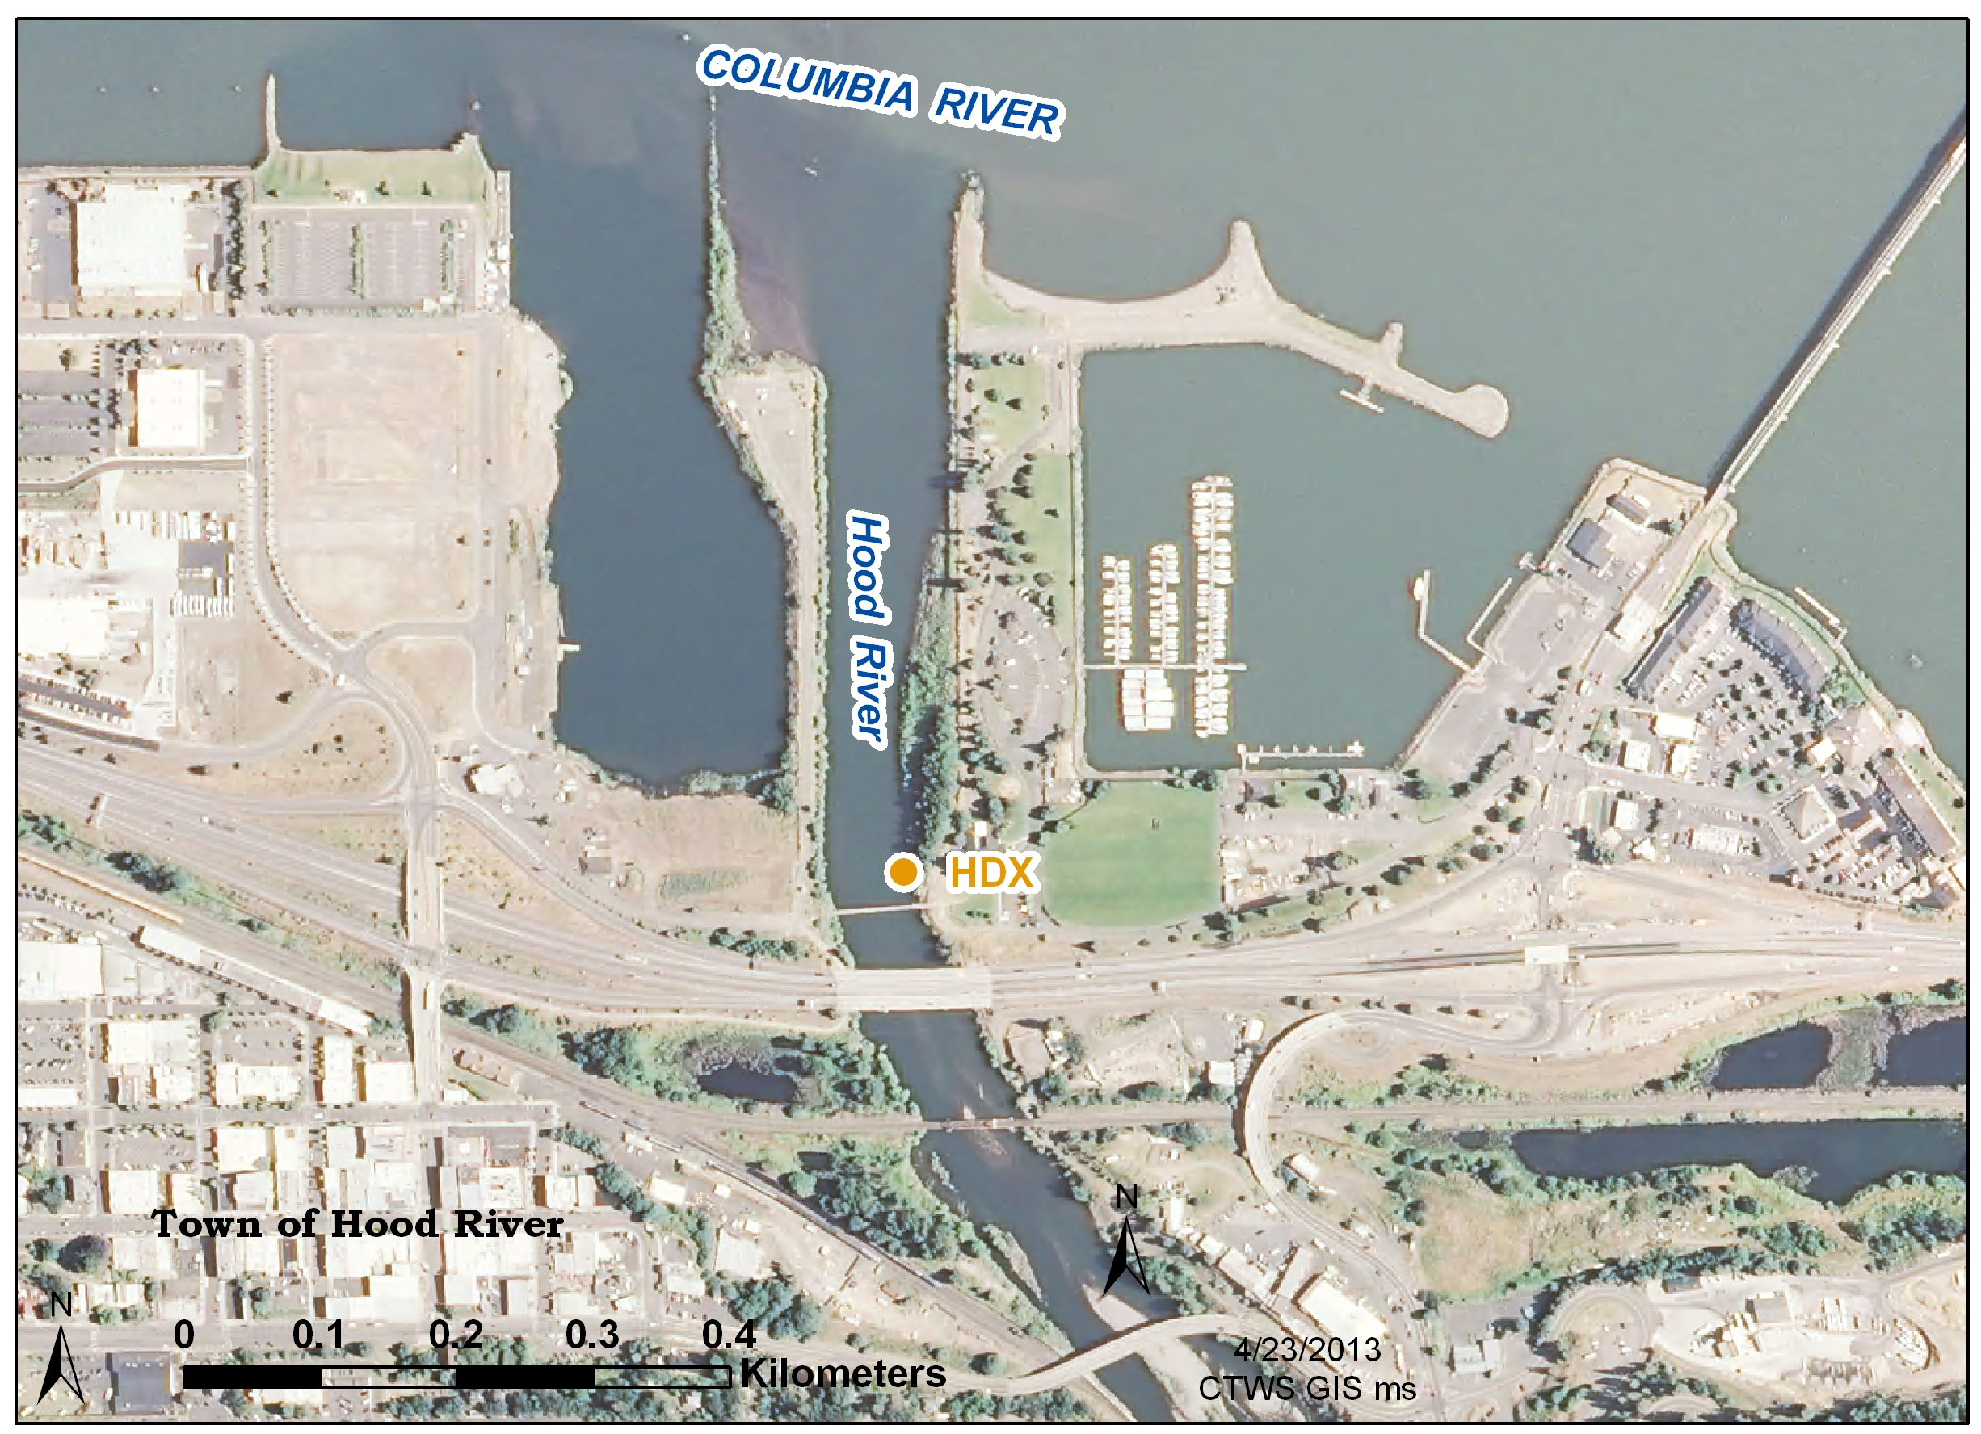
Distribution
2009 - Rm 3 Mainstem
2012 - Rm 2 E. Fork
2013 - Rm 3 E. Fork
approximately 12 Rm
newly seeded habitat

Slide 10
E. Fork and Tucker Park HDX Sites
  E. Fork installed May
-2 Detections 2013
-0 in 2014
    Tucker Park installed Oct
-1 Detection 2013
-0 Detection 2014
Total Detections at HDX Sites = 25 BON Fish
-18 in 2013
-7 in 2014

Slide 11
Hood River- Results
2012-2014
Pacific lamprey natural recolonization <2 years
  Distribution increased 2013 ~1mi & 2014 ~3mi
  First verified adult 2012 (ODFW)
  13 adults captured by ODFW in 2014
  Fish detections at HDX sites (UI)
  - 18 BON Fish(HDX important for info – technology important for this research)
Notes:
The Hood is a difficult river…antenna installation is usually a short window based on flow and turbidity
The adult found in 2012 was hung up on an ODFW screwtrap on the mainstem, as were the R. lamprey.

Slide 12
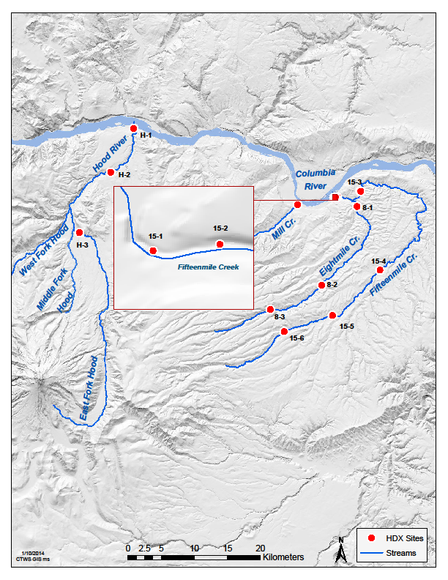
HDX Interrogation Sites
15Mi (7)
8Mi (3)
Mill (1)
2011-2014
637 lamprey used for M-R
– Recap 49%
Detection Efficiency >91% at most
11 fish detected 2 years old
Back outs -TDA and Mill

Slide 13
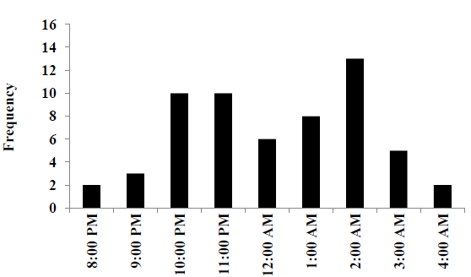
HDX Interrogation Sites
AEB65843E
Notes:
Picture on left is a pass-thru antenna in 8Mi. Schematic of antenna - lampreys affixed w/a PIT tag cross a magnetic field created by the loop of wire and a capacitor inside the tag sends a unique id # to the reader stored here.

Slide 14
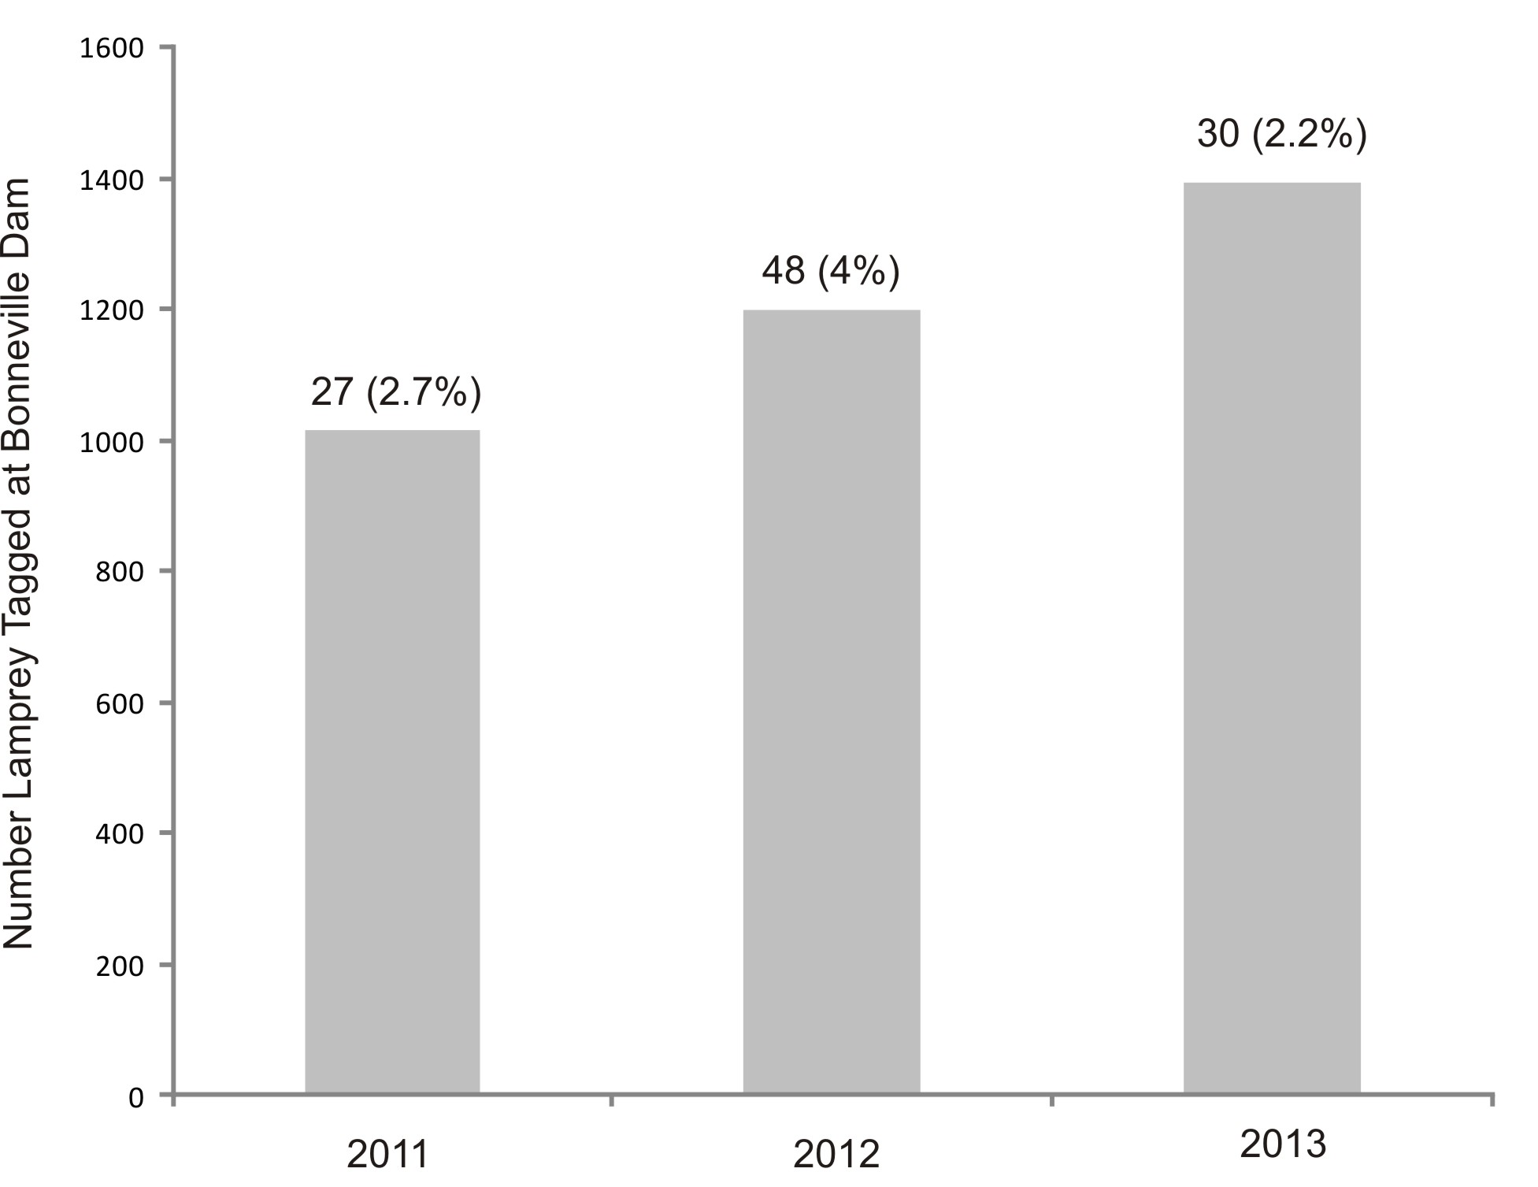
15Mi Detections 2011-2013
Overall BON tagged 5,459
Total detections in 15Mi 157
2014 detections 54 (2.9%)
Notes:
Question has been raised about what these fish in the BON pool are doing – spawing? entering tribs? Gray bar are # of fish tagged at BON Dam, roughly 2% of the run on a yearly basis. The % represents detections at our HDX sites in 15Mi Creek.

Slide 15
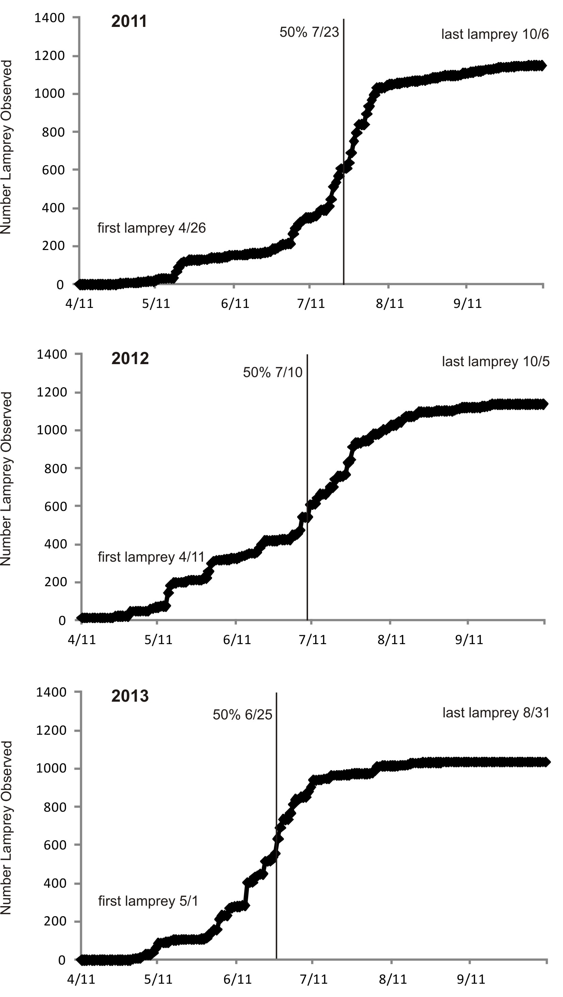

Slide 16
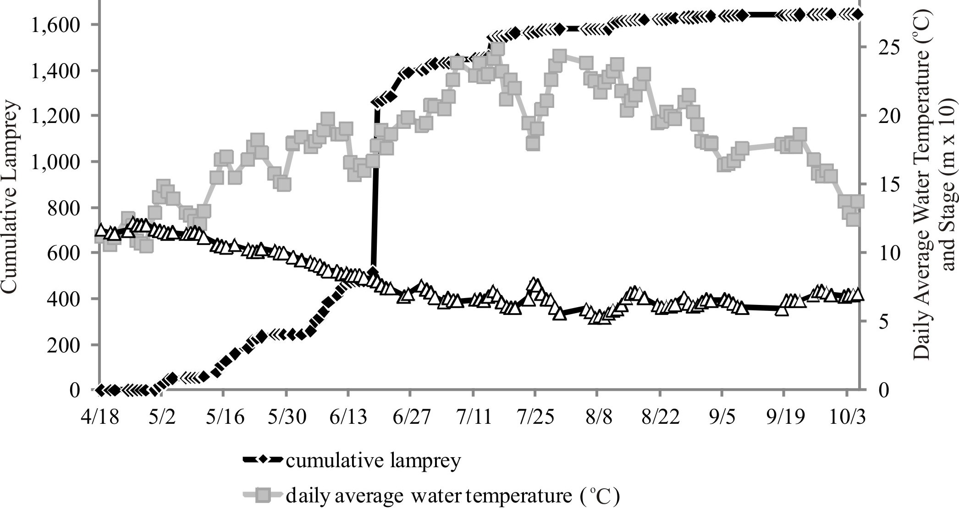
2014 Cumulative lamprey count

Slide 17
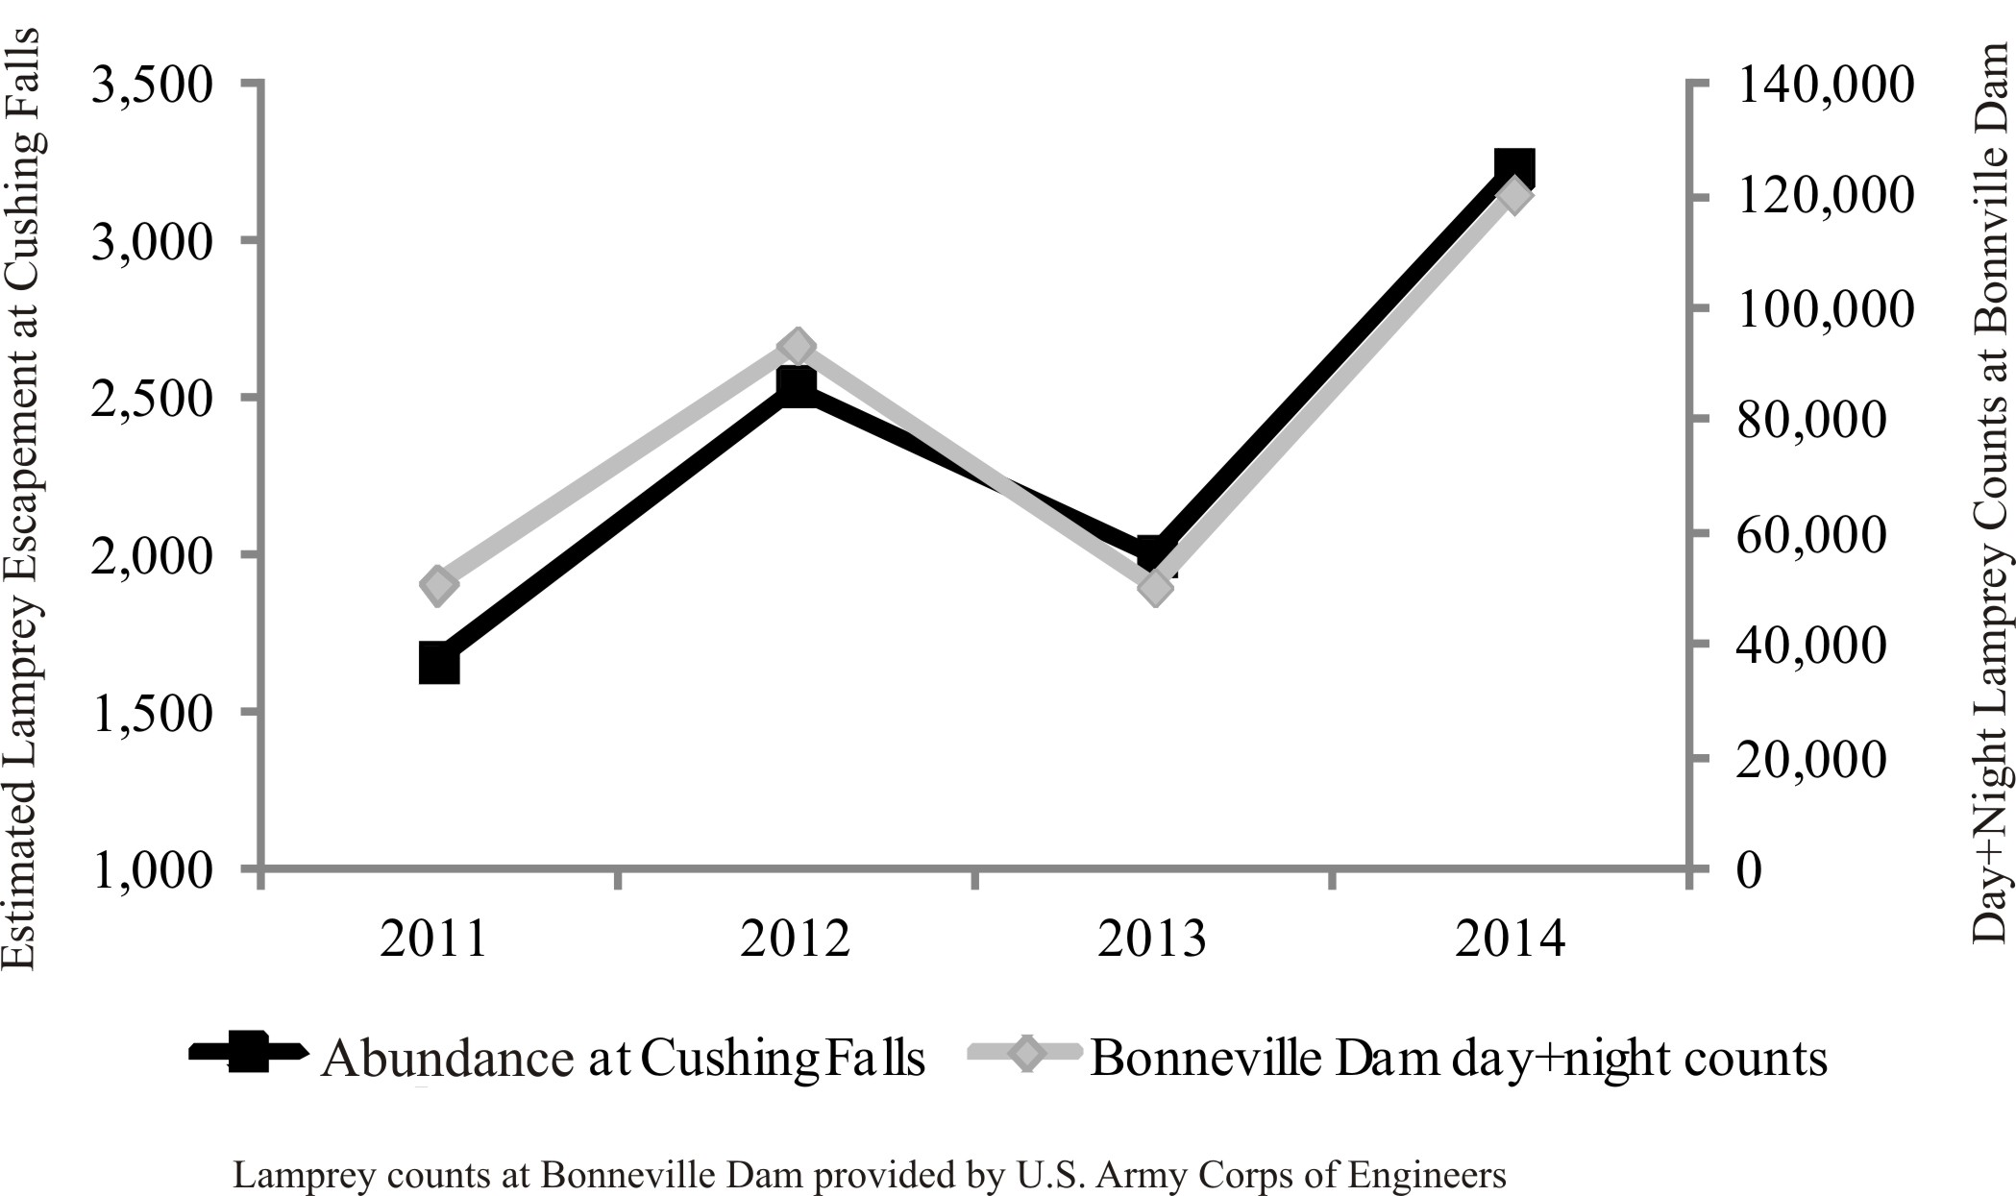
Fifteenmile Abundance and BON counts
2011-2014

Slide 18
Individual Detections 2013-2014

Slide 19
Larval Distribution 2012-2014

Slide 20
Fifteenmile-Results
Adult Population
2011- 1,589 Insp. 1,149
2012- 1,928 Insp. 1,138
2013- 2,363 Insp. 1,034
2014- 2,646 Insp. 1,645
Ammocoete Distributions
Life history information

Slide 21
Research partners - acknowledgements
Funded by BPA Columbia River Accords
Oregon Department of Fish and Wildlife
Farmer’s Irrigation District
U.S. Forest Service, Hood River District
Oregon Water Resources Department
Fifteenmile Watershed Council
Hood River Watershed Council
Private land owners
CRITFC Hagerman Lab

