Slide 1
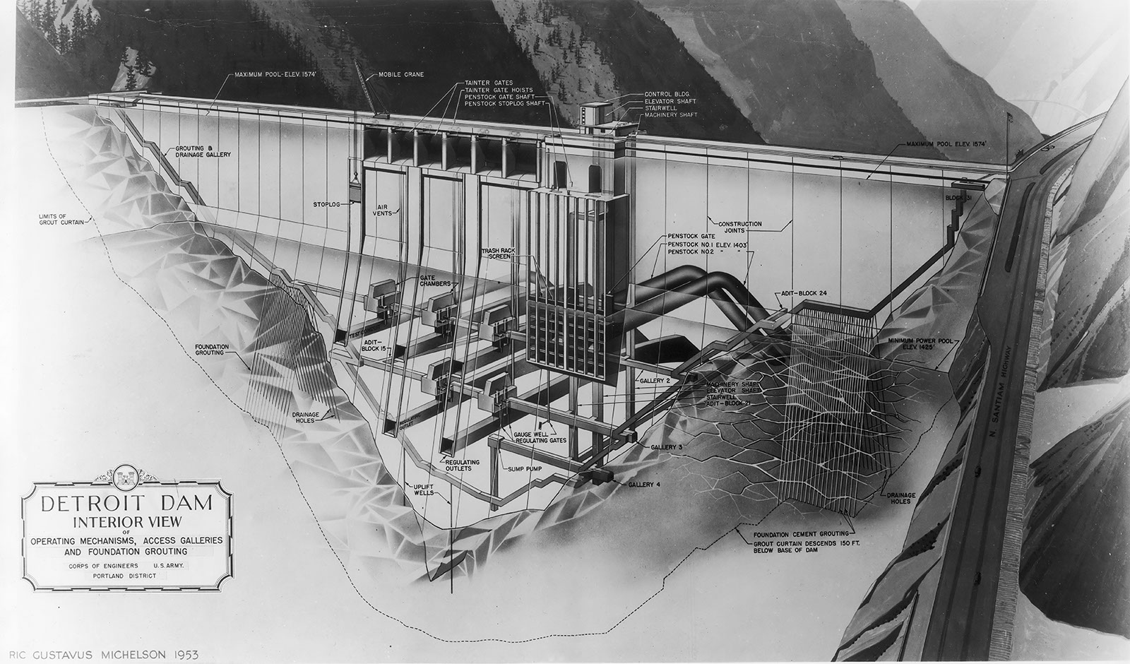
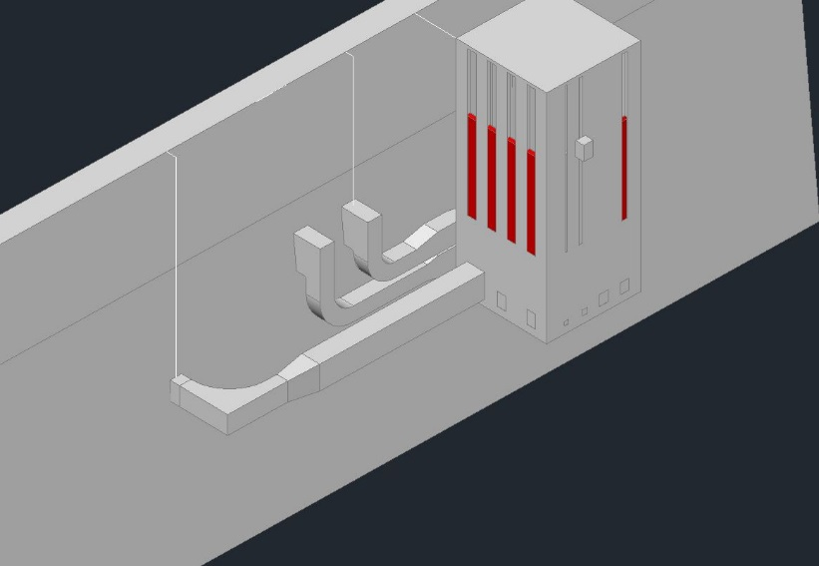
Temperature Modeling of Proposed Floating Screen Structure (FSS) at Detroit Dam
Norman Buccola
September 5, 2017
Source: USACE

Slide 2
Key Questions
What’s the maximum surface flow that can be released through the FSS?
Which temperature target optimizes surface flow and downstream temperature?

Slide 3
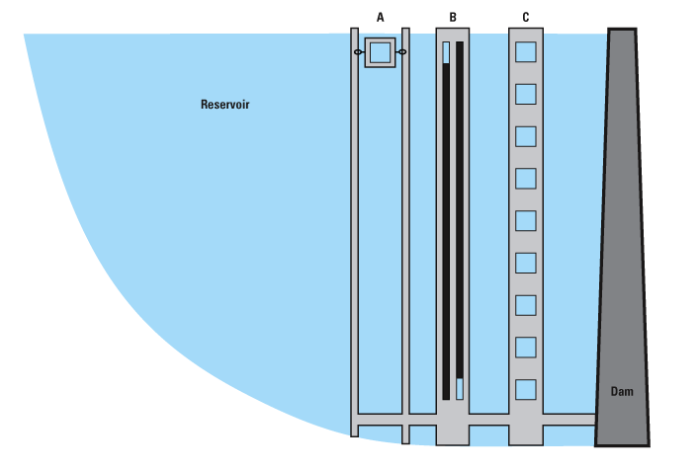
USGS Oregon Added Optimization Features to CE-QUAL-W2
W2 model with outlet structures
+
Downstream temperature target
Outlet restrictions
(min/max flow)
Temp
Day-of-Year
Q₁ + Q₂ + …
Flow (and elevation if applicable) from each outlet to meet the temperature target
Outlet restrictions (e.g., hydropower needs) may limit ability to meet target

Slide 4
Temperature Target Scenarios
2017 operational targets (ODFW)
Pre-dam conditions
Structural / FSS Scenarios
“250Min” - Minimum 250 cfs year-round surface flow
4.8 ft weir depth (1 6-ft weir opening)
“1000Min” - Minimum 1000 cfs year-round surface flow
12.7 ft weir depth Jan-Jun (1 - 10ft weir opening)
18.5 ft weir depth Jun-Dec (1 - 6ft weir opening)
“1500Min” - Minimum 1500 cfs year-round surface flow
18.1 ft weir depth (1 - 10ft weir opening)
“1500Min4500Max” - Min 1500 cfs (year-round) to Max 4500 cfs (Sep 15-Dec 31)
18.1 ft weir depth (1 - 10ft weir opening)
“Existing” (spillway, power penstocks, upper RO)
Maximum spill of 60%
Notes:
Detroit Lake Model
Stewart Rounds, USGS
Apr 5, 2007
Page 4

Slide 5
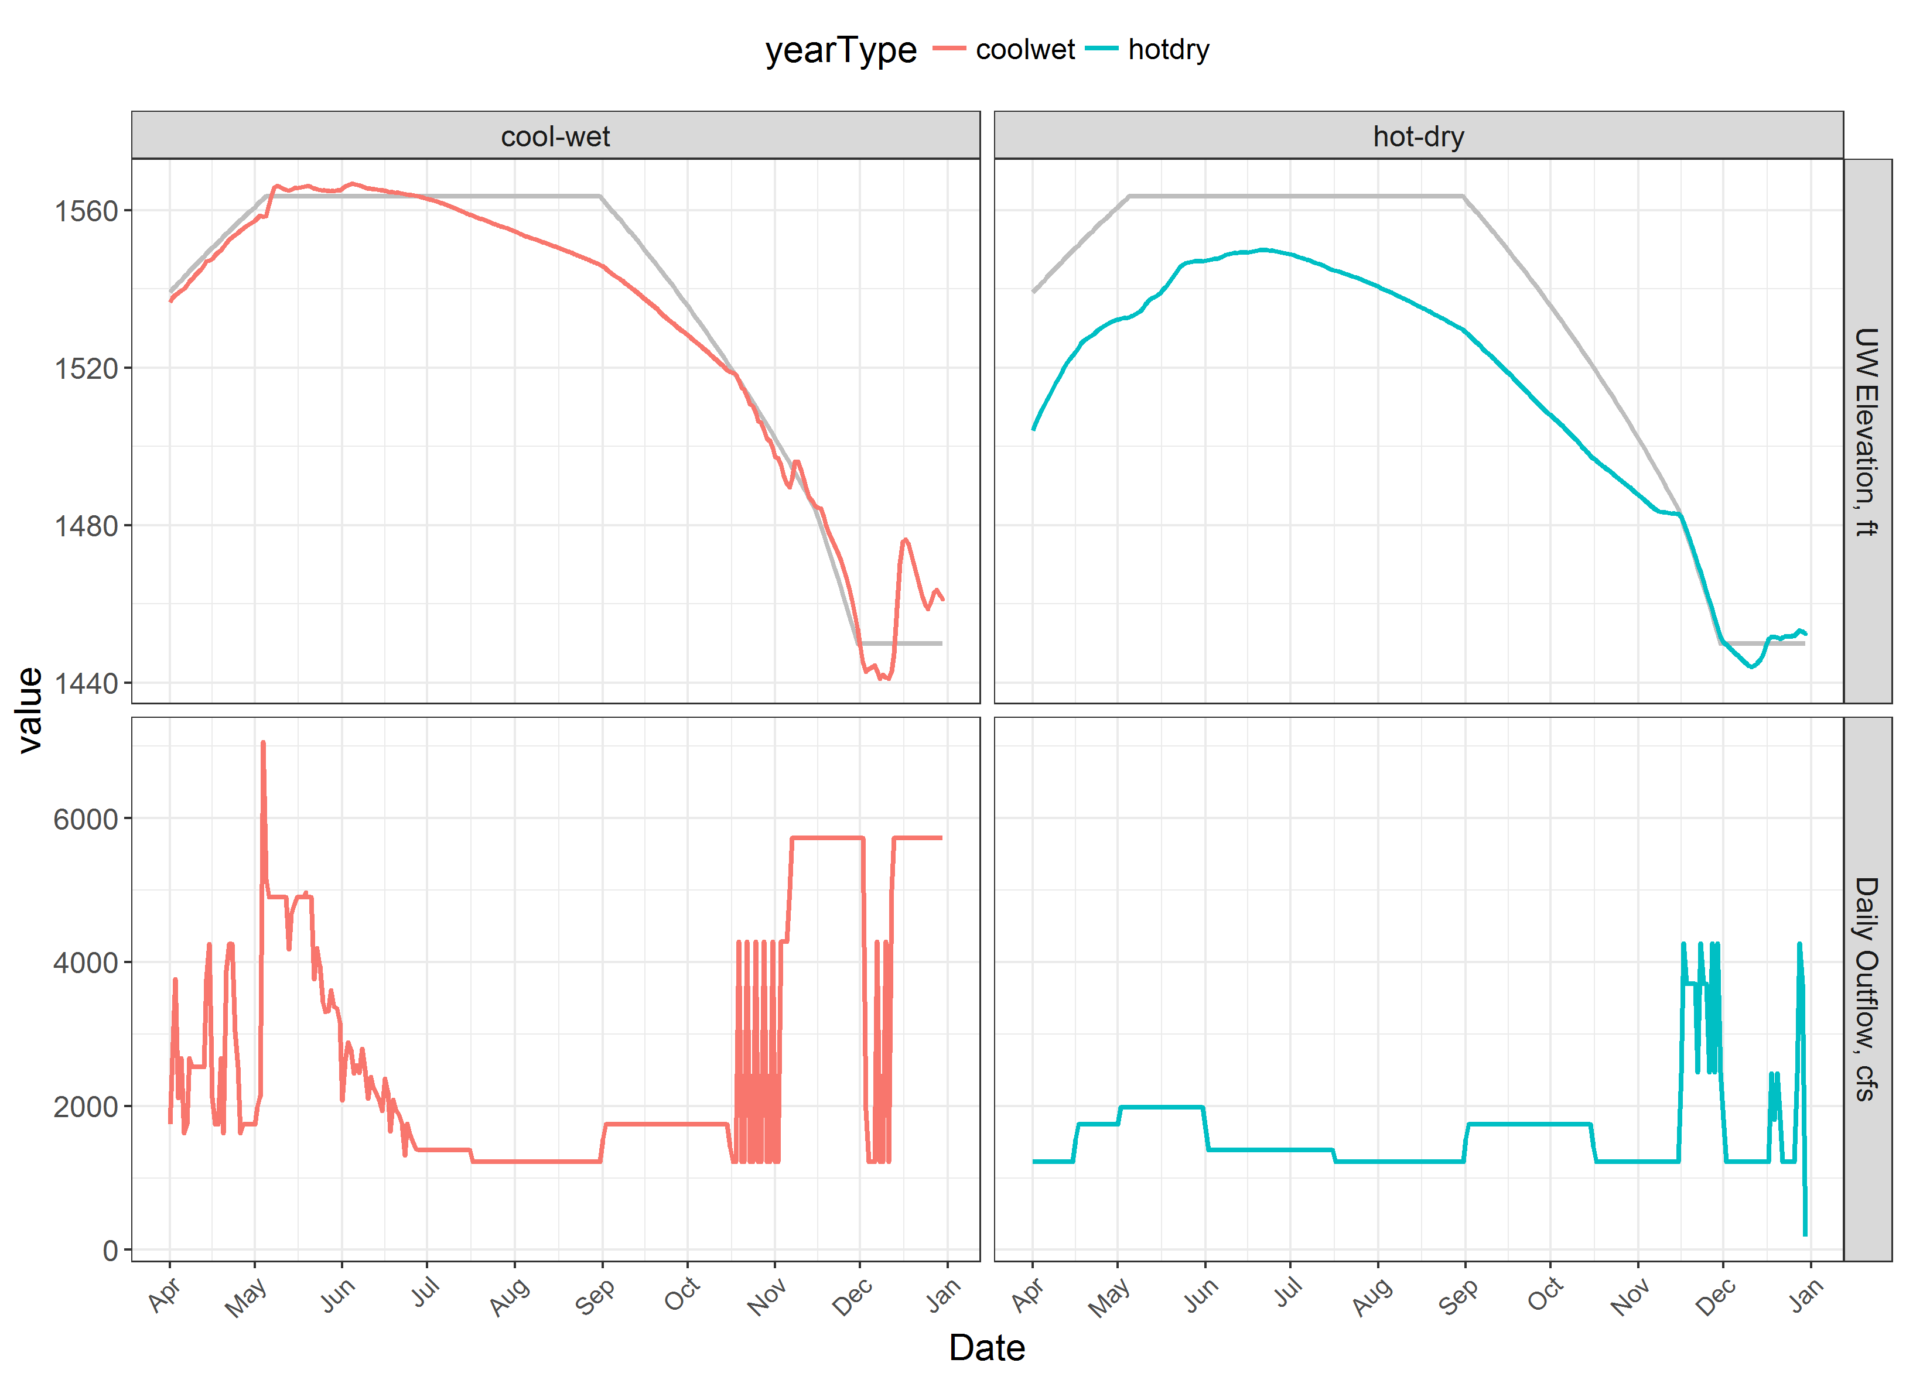
Detroit Year-Type Comparison: Lake Elevation and Outflow
Notes:
Detroit Lake Model
Stewart Rounds, USGS
Apr 5, 2007
Page 5

Slide 6
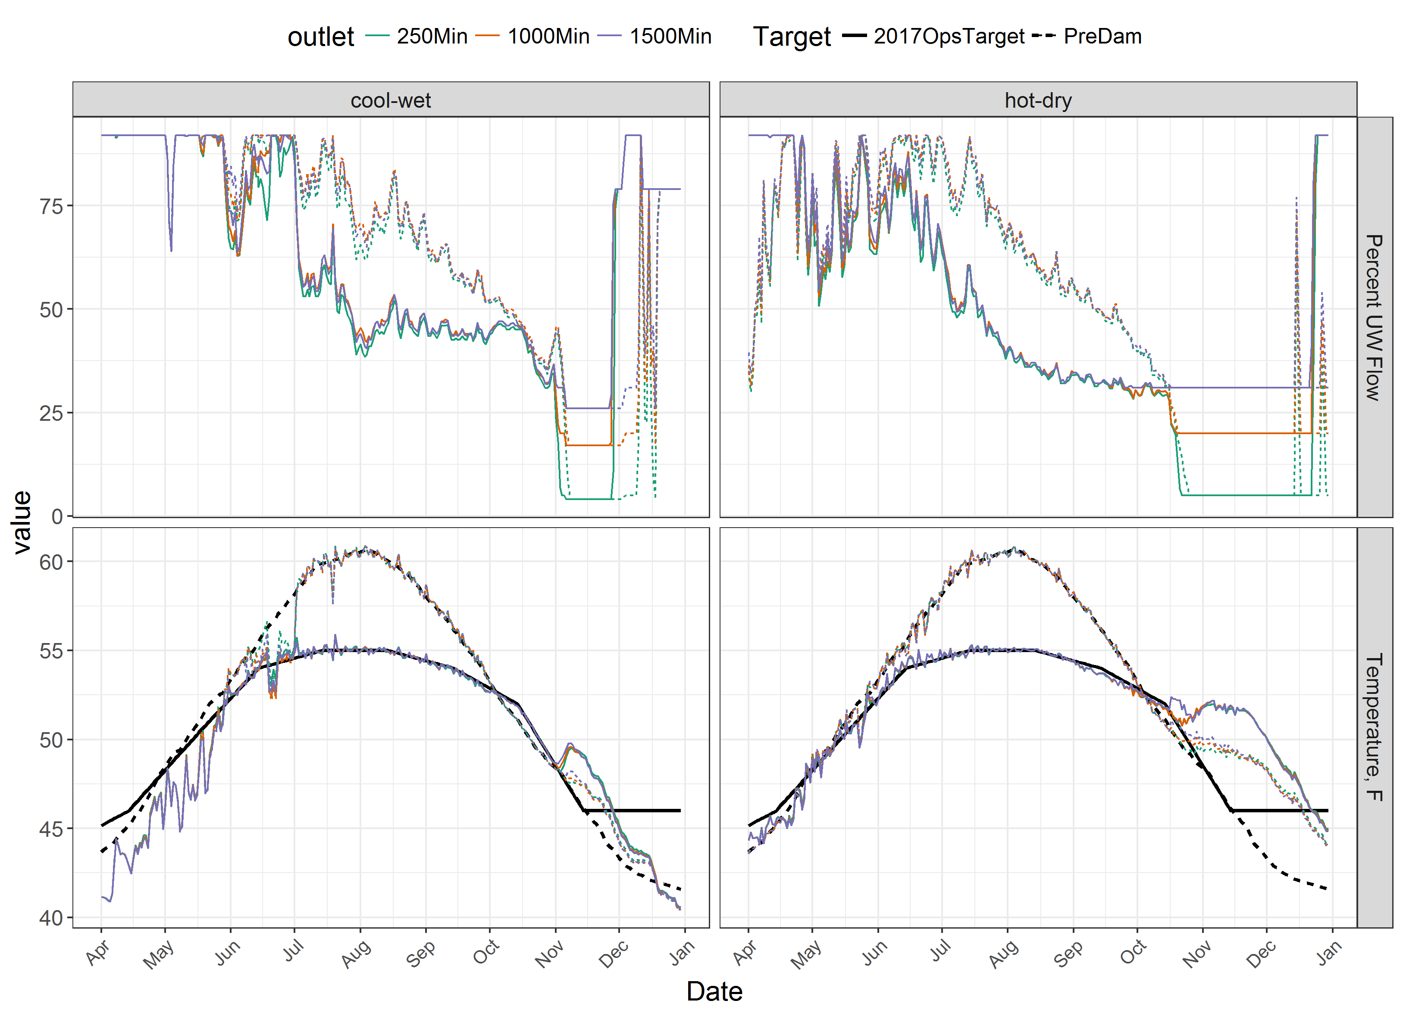
Detroit FSS Temperature Comparison
Percent Upper Weir Flow
Daily Average Temperature [°C]
Notes:
Detroit Lake Model
Stewart Rounds, USGS
Apr 5, 2007
Page 6

Slide 7
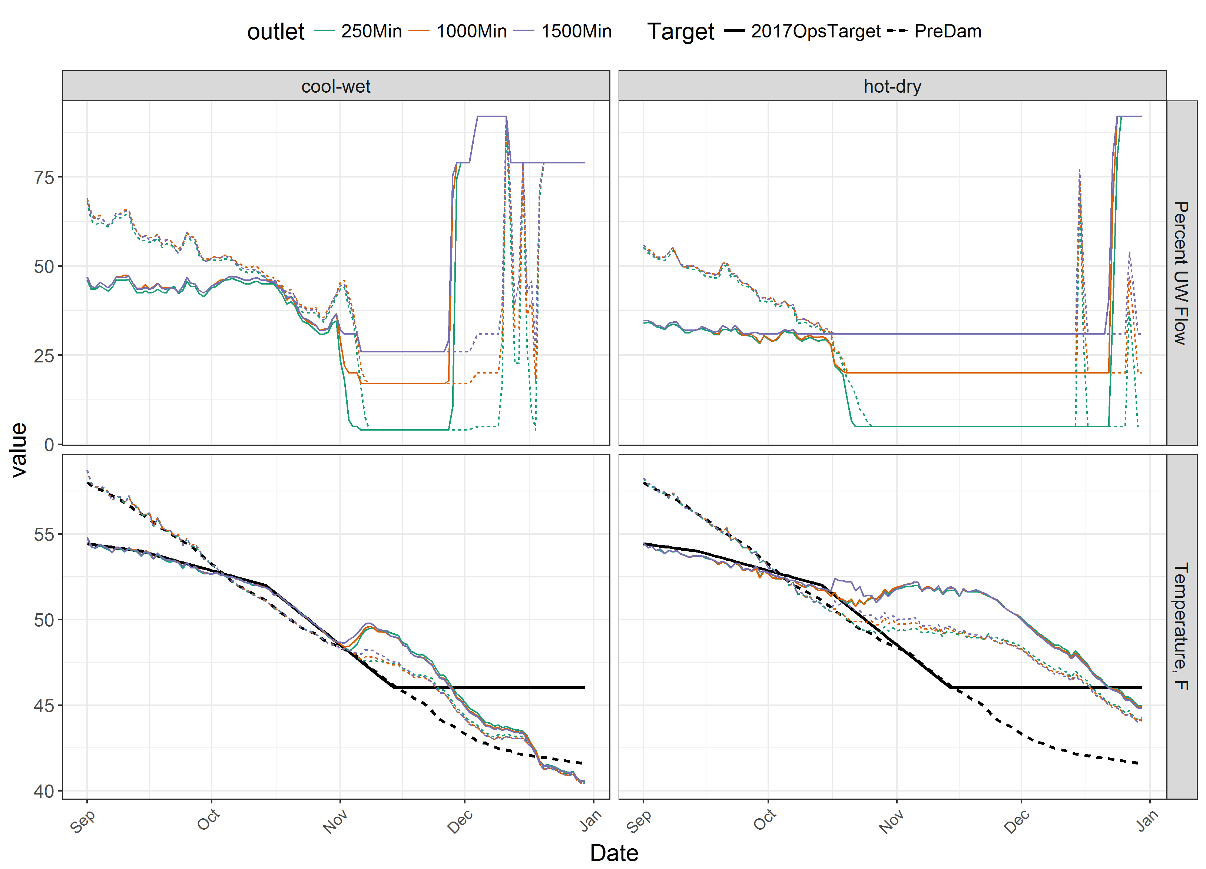
Detroit FSS Temperature Comparison: Fall
Percent Upper Weir Flow
Daily Average Temperature [°C]
Notes:
Detroit Lake Model
Stewart Rounds, USGS
Apr 5, 2007
Page 7

Slide 8
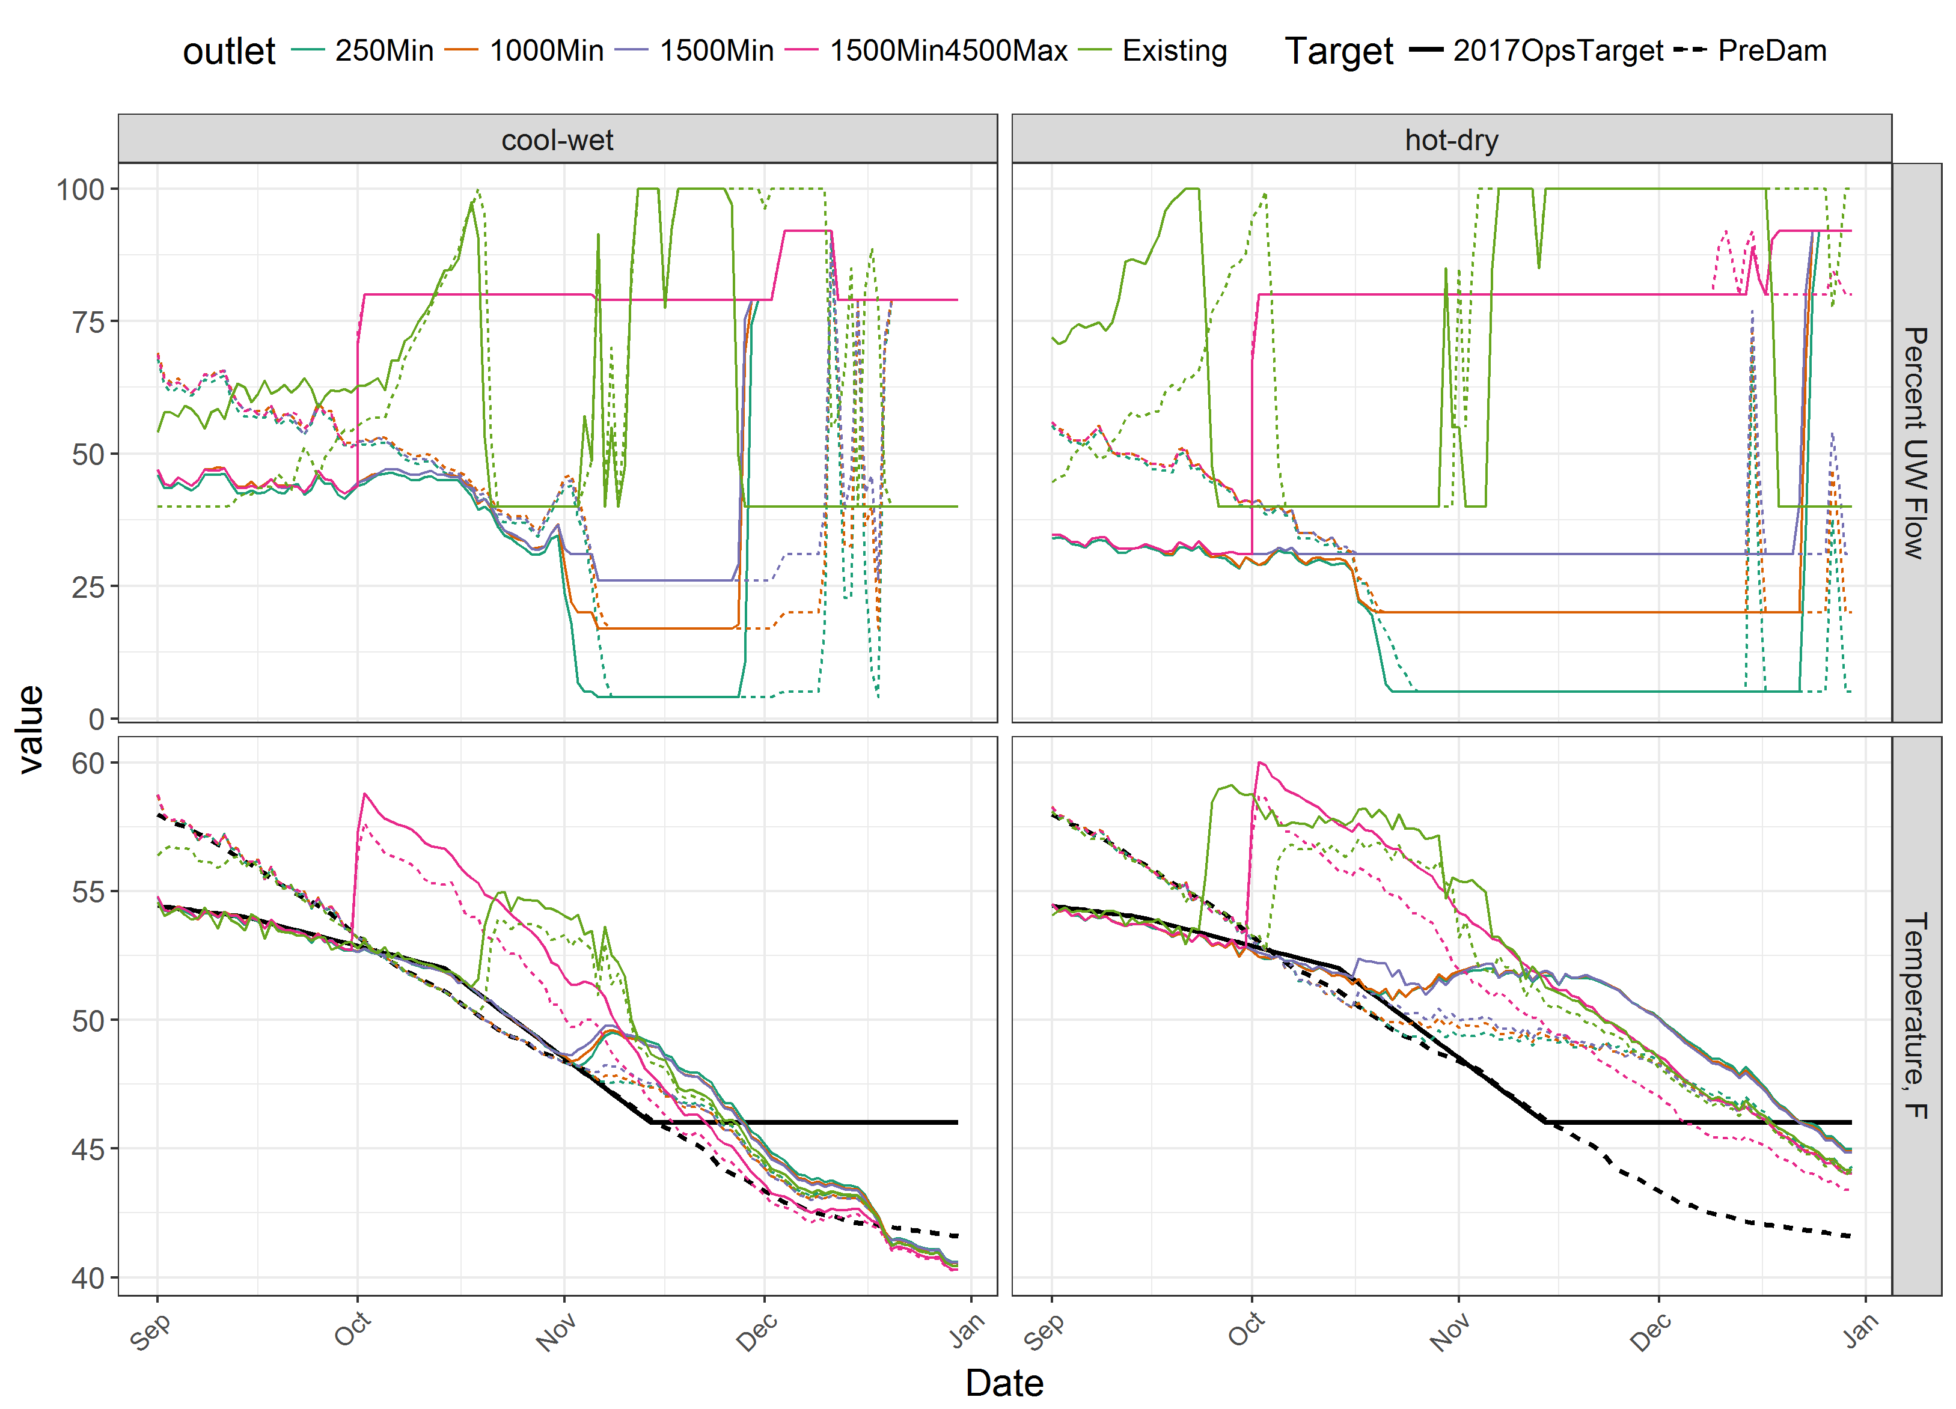
Detroit FSS Temperature Comparison: Fall
Percent Upper Weir Flow
Daily Average Temperature [°C]
Notes:
Detroit Lake Model
Stewart Rounds, USGS
Apr 5, 2007
Page 8

Slide 9
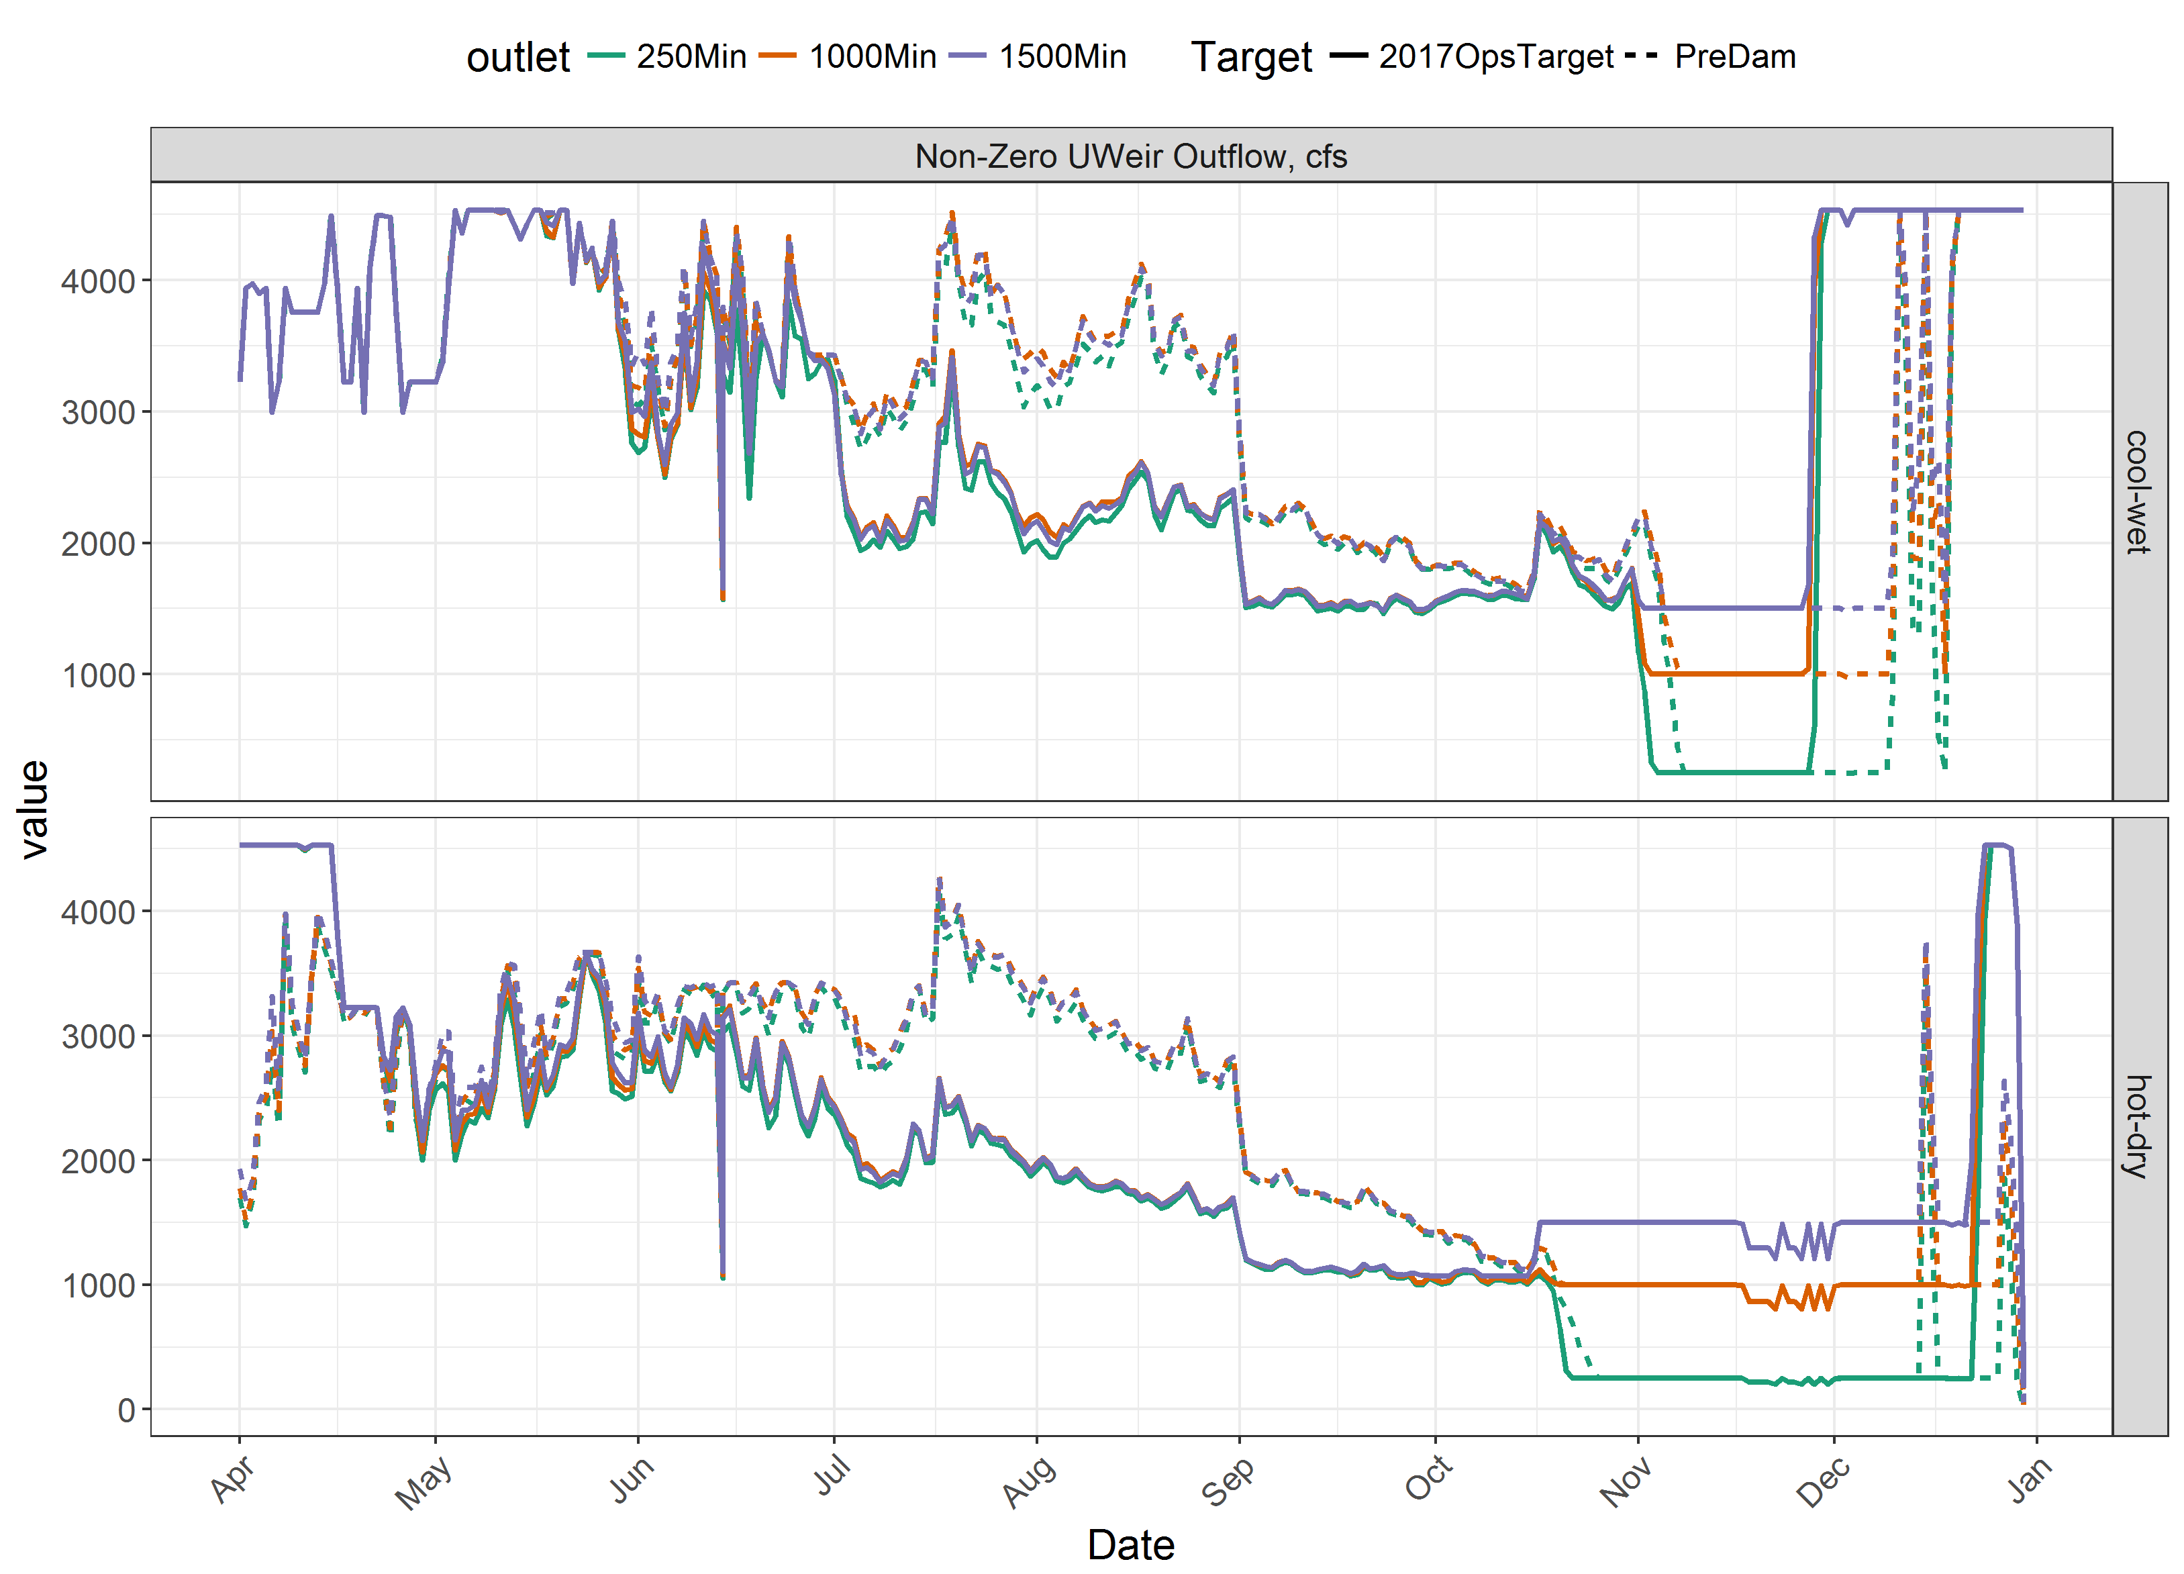
Detroit FSS Upper Weir Outflow Comparison
Non-zero Upper Weir Outflow, cfs
Notes:
Detroit Lake Model
Stewart Rounds, USGS
Apr 5, 2007
Page 9

Slide 10
Incubation period emergence day summary
Accumulated Thermal Unit calculations begin on Sep 20
(day in which 17,500 °F degree-days is achieved)
Results range from Feb-8 to Mar-21
Preliminary results
Notes:
Detroit Lake Model
Stewart Rounds, USGS
Apr 5, 2007
Page 10

Slide 11
Incubation period emergence day summary
Accumulated Thermal Unit calculations begin on Sep 20
(day in which 17,500 °F degree-days is achieved)
Results range from Feb-8 to Mar-21
coolwet
hotdry
2017OpsTarget 1000Min
440
404
PreDam 1000Min
445
419
Preliminary results
Notes:
Detroit Lake Model
Stewart Rounds, USGS
Apr 5, 2007
Page 11

Slide 12
Rearing period summary
Percent time between 57.1 °F (14.0 °C) and 60.8 °F (16.0 °C)
coolwet
hotdry
2017OpsTarget 250Min
0
0
2017OpsTarget 1000Min
0
0
2017OpsTarget 1500Min
0
0
2017OpsTarget 1500Min4500Max
0
0
2017OpsTarget Existing
0
0
PreDam 250Min
14
17
PreDam 1000Min
14
17
PreDam 1500Min
14
17
PreDam 1500Min4500Max
14
17
PreDam Existing
3
9
Preliminary results
Notes:
Detroit Lake Model
Stewart Rounds, USGS
Apr 5, 2007
Page 12

Slide 13
Rearing period summary
Percent time between 57.1 °F (14.0 °C) and 60.8 °F (16.0 °C) during May-Sep
coolwet
hotdry
2017OpsTarget 1000Min
0
0
More time in optimal growth temperature range under Pre-dam targets
PreDam 1000Min
14
17
Preliminary results
Notes:
Detroit Lake Model
Stewart Rounds, USGS
Apr 5, 2007
Page 13

Slide 14
Summary
What’s the maximum flow that can be released from upper weirs?
Minimum upper weir flow (up to 1500 cfs) has minimal downstream effect
(2 days delay in emergence in hotdry year)
Pre-Dam Temperature Target provides some emergence delay compared to 2017 proposed temperature target in hot/dry year
~15-day delay in emergence (hot/dry year)
~5-day delay in emergence (cool/wet year)
PreDam target leads to more optimal rearing temperatures (downstream) for juveniles during May-Sep

Slide 15
CE-QUAL-W2 Model
2-D dynamic reservoir and river model, USACE model, currently maintained by Portland State University
Hundreds of reservoirs and rivers across the world have developed CE-QUAL-W2 models
Can simulate: flow, stage, velocity, water temperature, oxygen, pH, nutrients, organic matter, algae, aquatic plants

Slide 16
Data Needs for CE-QUAL-W2 Temperature Modeling
Climate (Meteorology)
(air T, dew point T, solar radiation, precipitation, wind speed and direction, cloud cover)
Inflows (Q, T)
Outflow (Q)
Bathymetry
Outlet elevations and characteristics

