Slide 1
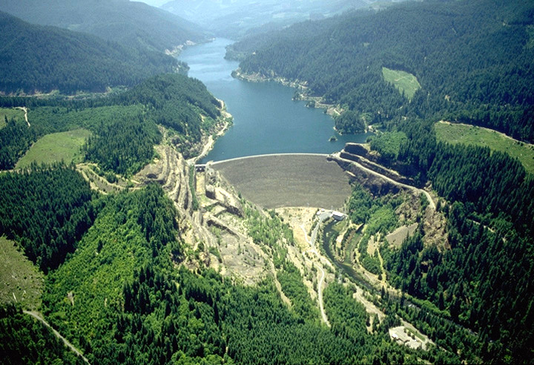

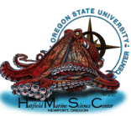

Reintroduction program above Cougar Dam: Assessment of genetic diversity and searching for adfluvial Chinook
Bob Heims, U.S. Army Corps of Engineers
Nick Sard, Dave Jacobson, Michael Hogansen, Kathleen O’Malley, Marc Johnson, Michael Banks
Notes:
Thank you. Today I will talk to you about two topics: The first is our assessment of genetic diversity for the reintroduction program above Cougar Dam, which is useful for managers because the maintenance of genetic variation is important for maximizing adaptive potential of this population in the future – I’d also like to note that Melissa Evans will also talk about this topic tomorrow. PAUSE.
Next I will switch gears and talk about our search for adfluvial Chinook, which may provide more insight on the fate and origin of fish in the genetic pedigrees we have assembled. PAUSE.
But, before I get into those topics I want to give you a brief history of the reintroduction program and highlight two major results we have presented in the past. PAUSE.

Slide 2
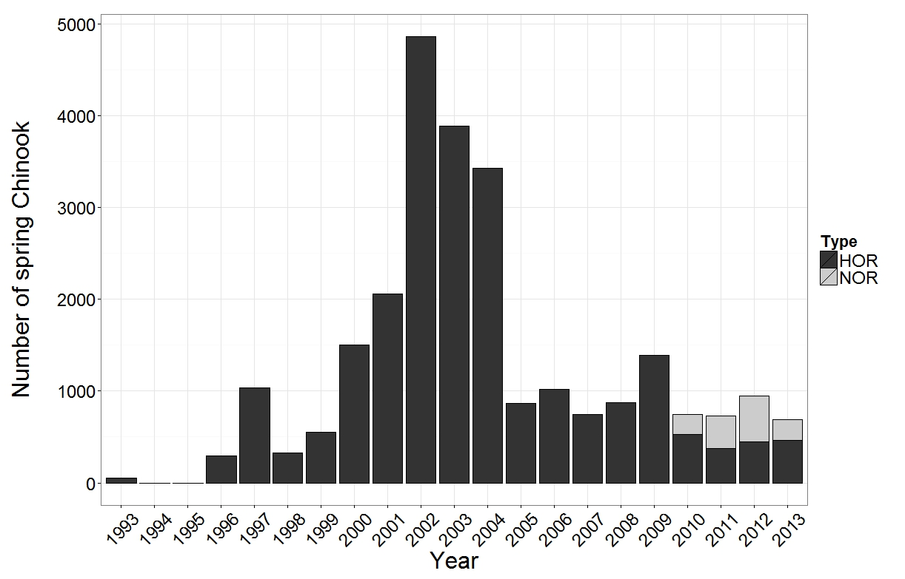
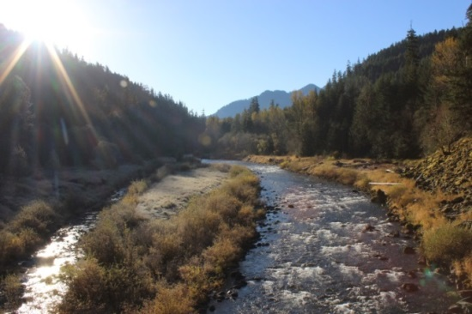
History of Chinook reintroduction above Cougar Dam
Trap and haul facility operational
Tissue sampling
Notes:
This figure shows the number of spring Chinook that have been reintroduced above Cougar Dam since the early 90’s – the majority of which have been HOR.
Since 2007 all reintroduced adults have been tissue sampled for genetic analysis.
In 2010 a trap and haul facility was operational, which enabled the reintroduction of NOR Chinook as well. Both NOR and HOR Chinook have been reintroduced annually since that year. PAUSE.
Finally, reintroduced adults have been released at four different sites since 2007 – as indicated by the triangles in this figure. PAUSE.

Slide 3
Adult cohorts were assigned to age-3 to -6 NOR adult returns
3
4
5
6
3
4
5
2007 | 2008 | 2009 | 2010 | 2011 | 2012 | 2013
Offspring – NOR Chinook captured at trap and haul facility
Notes:
We have genotyped all adults at 11 highly polymorphic microsatellites since 2007. This approached enabled us to assign adult cohorts in 2007 and 2008 to their age-3 to age-6 NOR adult offspring that returned back to the Cougar Trap from 2010 to 2013. PAUSE.

Slide 4
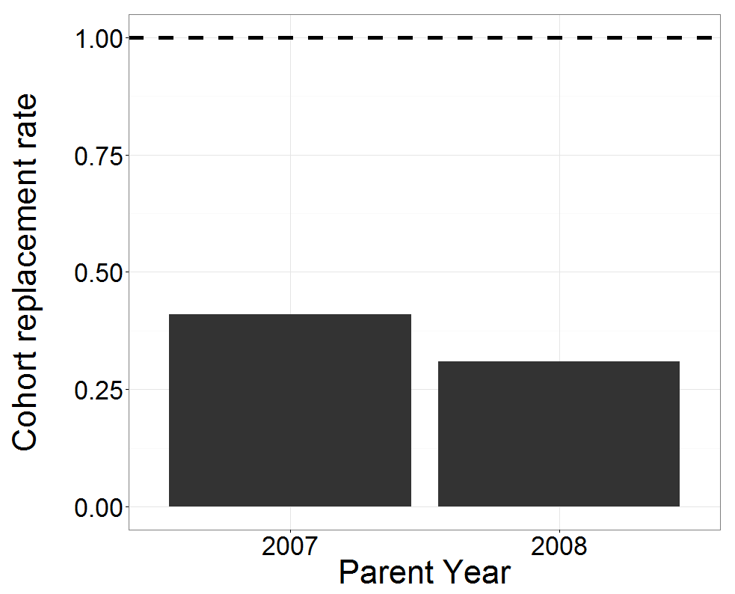
Population is not meeting demographic replacement
*Females only
CRR = Number of offspring / Number of parents
Sard et al. In prep.
Notes:
Based on the adult offspring we identified, we found that the population is not meeting demographic replacement– reflected here by female cohort replacement rate. In both 2007 and 2008 our estimates are well below one. PAUSE.

Slide 5
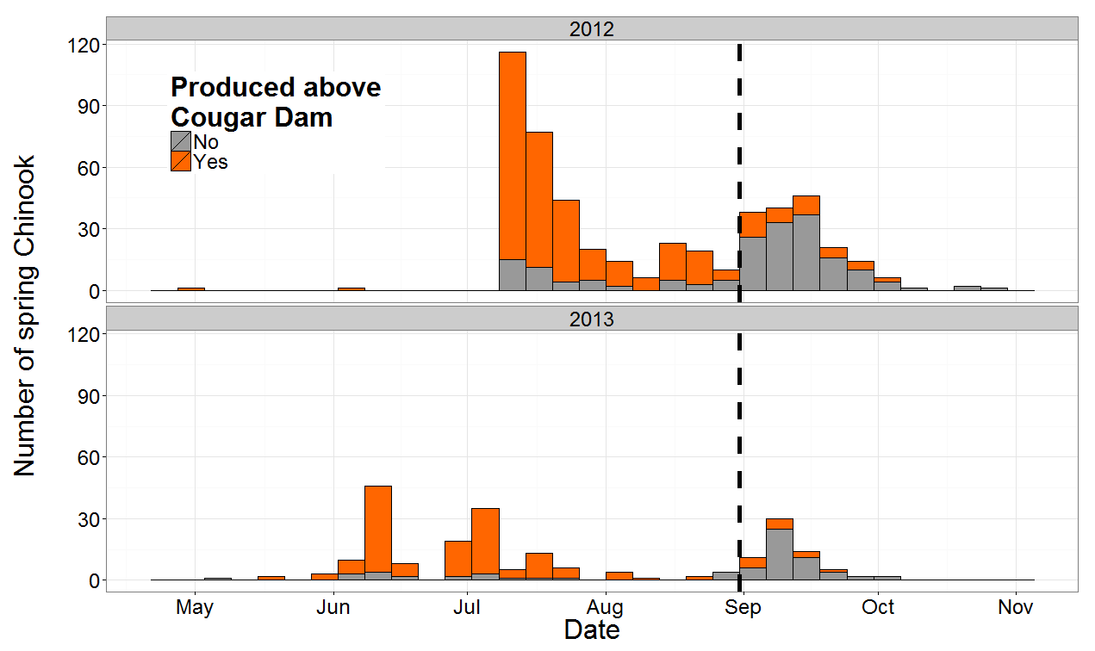
Most NOR Chinook retuning later in the spawning season were migrants
September 1st
Migrants
Sard et al. In prep.
Notes:
In addition, we also found that most NOR Chinook returning later in the spawning season were migrants.
This figure shows counts of NOR chinook according to the date they were sampled at the Cougar Trap in 2012 and 2013. The colors denote whether the Chinook was originally produced above Cougar Dam or not. The Chinook that were not produced above dam are termed migrants.
Note that most Chinook returning after September 1st were migrants. PAUSE.

Slide 6
Genetics: Definitions and examples
Locus – specific location in the genome
Allele – character state at a locus
Genotype – alleles an individual has at a given locus
Locus
5’…gatcggacatacatacatagtatta...3’
Alleles
Allele 1 – copy from Mom
A1
Allele 2 – copy from Dad
A2
Genotype
Fish | Locus 1
#1 | A1 | A2
Notes:
Before I get into our assessment of genetic diversity I want to define a few terms that I will be using and provide an example for each.
A locus is a specific location in the genome. PAUSE. A allele is a character state at a locus. PAUSE. Finally, the alleles an individual has at a given locus are known at its genotype. Pause.
Here is a locus – a specific sequence of A’s, T’s, G’s, and C’s in the genome. Each individual inherits one copy of this locus from its mom and dad. Pause. Copies may vary slightly in the sequence. These variants are called alleles and I indicate them here using different colors. PAUSE.
Collectively, for this individual the alleles it has at this locus are known as its genotype. In this example the alleles are different and therefore its classified as a heterozygote. Pause.

Slide 7
Assessment of genetic variation
Heterozygosity
  Proportion of individuals that have different alleles at a given locus
Number of alleles
Fish | Locus 1
#1 | A1 | A2
#2 | A1 | A1
#3 | A1 | A2
#4 | A2 | A2
  Heterozygosity: 2/4 = 0.5
  Alleles = 2
Expectation:
  Reduction in alleles
    Variance in fitness, low CRR
  No change in heterozygosity
    Low power
Our study:
  8 loci
Notes:
We assessed genetic diversity in potential parents and offspring that returned back to the Cougar Trap using two common measures of genetic variation:
First we calculated heterozygosity, which is defined as the proportion of individuals that have different alleles at a given locus. PAUSE.
So for example, here are four fish. We know their genotypes at Locus 1. Some are heterozygotes and others are not. Here heterozygosity is 0.5. PAUSE.
The second measure of genetic variation we used was the actual numbers of alleles at each locus. PAUSE.
In this example there are two alleles observed at this locus. PAUSE.
In our study we made these calculations using 8 loci that averaged 35 alleles per locus. PAUSE.
Based on theory and many other reintroduction studies we expect to see a reduction in the number of alleles because of the high variance in fitness that we have reported on in the past. PAUSE.
However, we expect that heterozygosity will not change for two reasons. First based on theory, the change is expected to be small, and second the loci we are using provide a coarse estimate of this parameter. Collectively, we have low power to detect changes in heterozygosity during the time frame we have been genetically evaluating this reintroduction. PAUSE.

Slide 8
First approach: Parent to offspring
3
4
5
6
3
4
5
2007 | 2008 | 2009 | 2010 | 2011 | 2012 | 2013
Offspring – NOR Chinook captured at trap and haul facility
Notes:
We first calculated heterozygosity and counted the number of alleles at each locus for all potential parents reintroduced in 2007 and 2008. We also calculated the same measures of genetic variation for their age-3 to age-6 offspring returning back to the Cougar Trap. PAUSE.
Then we compared our estimates of genetic diversity between the potential parents and their offspring. PAUSE.

Slide 9
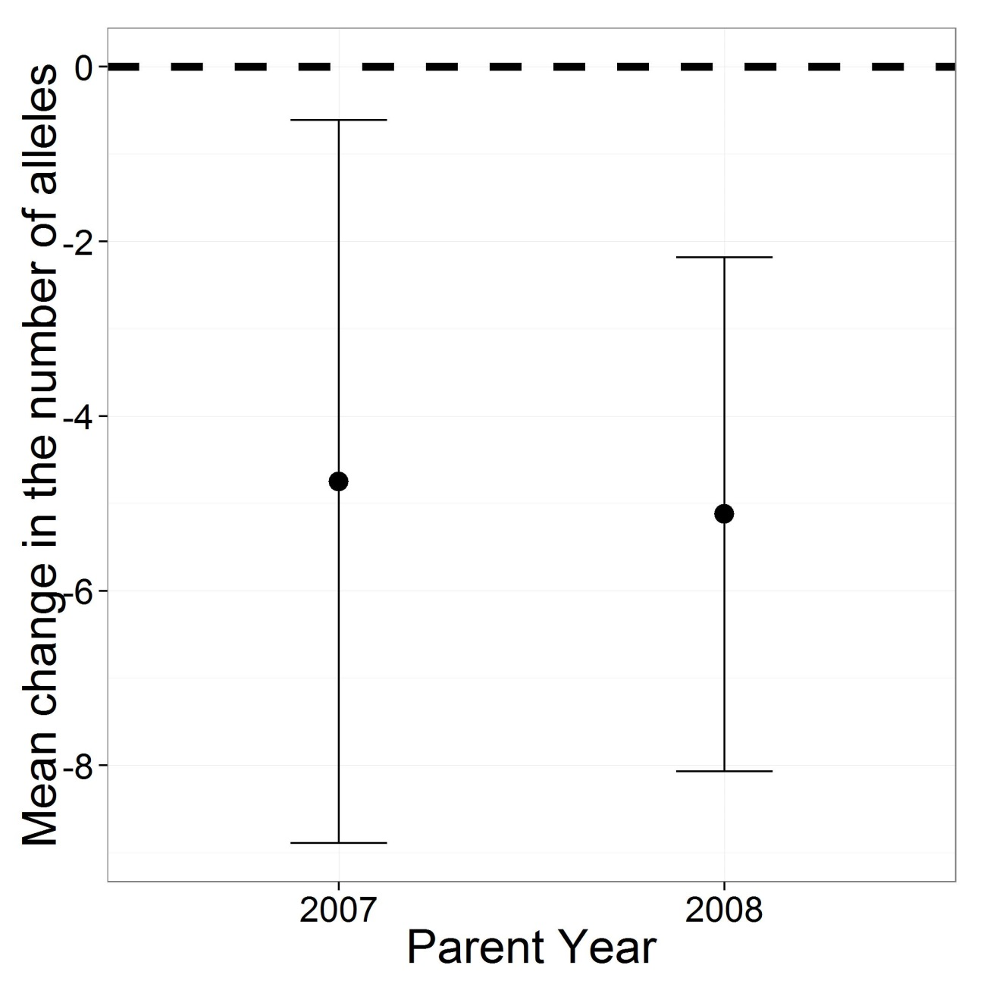
Alleles were lost
Paired t-test: 95 CIs
Notes:
What we found was that on average alleles were lost between the potential parents and returning offspring. In both parent years, 2007 and 2008, the mean change in the number of alleles between potential parents and returning offspring was negative indicating that alleles were lost. Note that the error bars here are 95% confidence intervals and neither encompasses positive values. PAUSE.

Slide 10
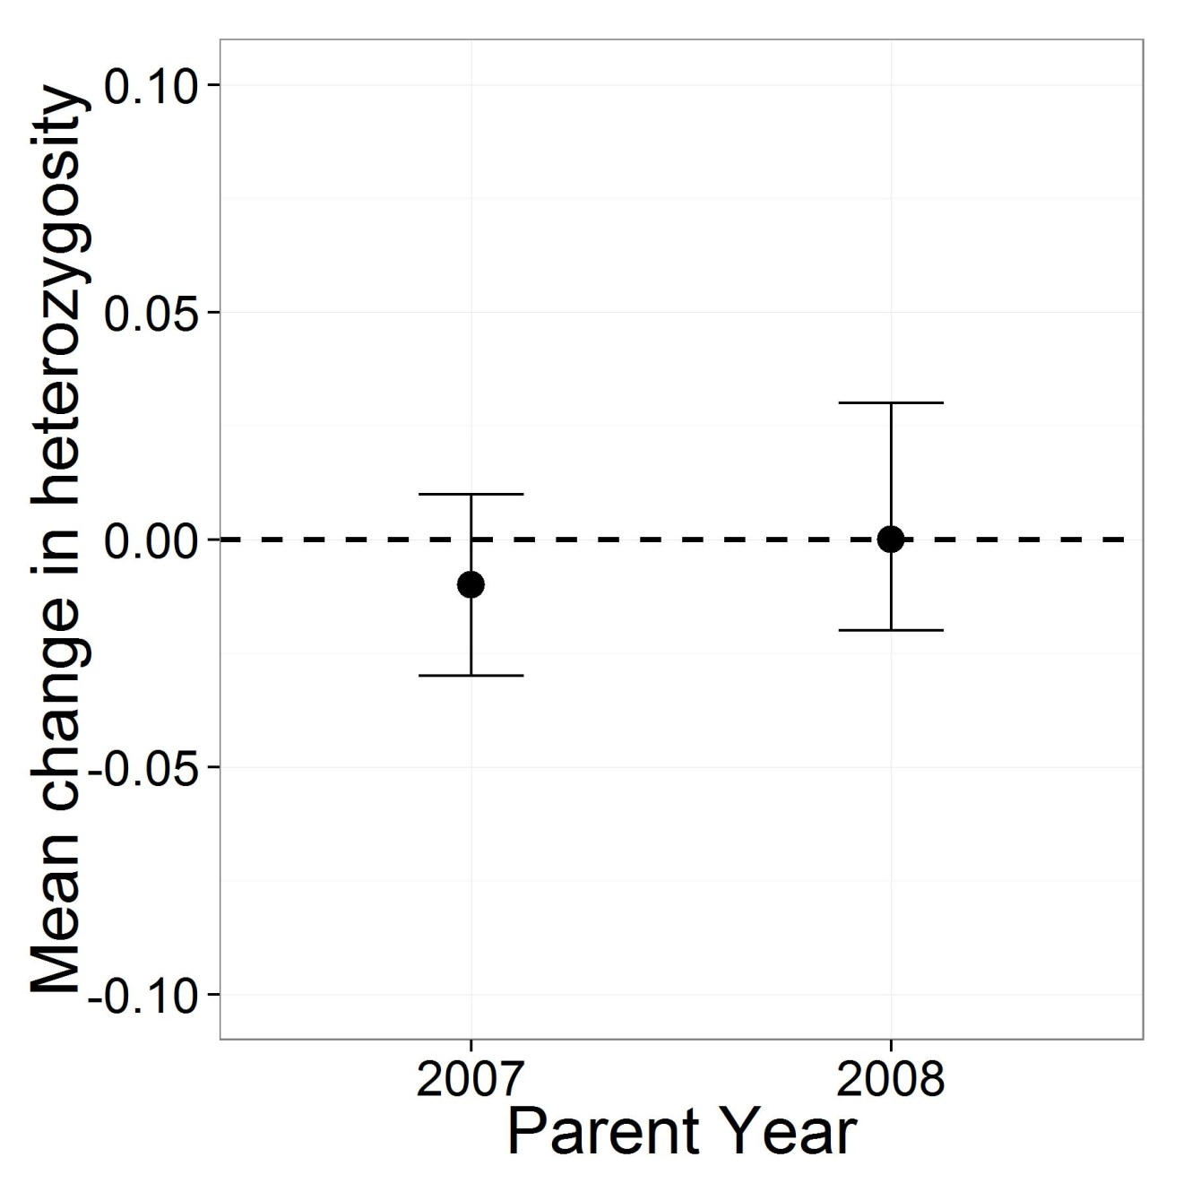
No change in heterozygosity
*Low power to detect change
Paired t-test: 95 CIs
Notes:
However as we expected, we found no change in our estimates of heterozygosity for either parent year. PAUSE.

Slide 11
Second approach: One return cohort
Accounts for overlapping generations
X
*
2007 | 2008 | 2009 | 2010 | 2011 | 2012 | 2013
Offspring – NOR Chinook captured at trap and haul facility
* Assumes no LSDR method
Notes:
Now, we also flipped the coin on its head and evaluated the same parameters from the perspective of one NOR return cohort. This perspective accounted for overlapping generations in Chinook.
So we calculated heterozygosity and counted number of alleles in the 2012 and 2013 return cohorts, as well as for all the potential parents that could have produced them. PAUSE.
Note that in the near future, we intend to perform the analysis after accounting for the late season downstream reason method implemented that year. But for this talk, results specific to the 2013 NOR cohort assume the late season downstream release method was not employed.
To highlight the importance of this second approach here is an example. An allele was present in the 2007 reintroduced cohort, but not present in any of their offspring that returned back to the Cougar Trap in 2012, however this same allele was also present in the 2008 reintroduced cohort and was present in their offspring that returned back in 2012. In this example overlapping generations accounted for some loss in genetic variation. PAUSE.
Therefore this approach enables use ask if genetic variation is being lost after accounting for overlapping generations? PAUSE.

Slide 12
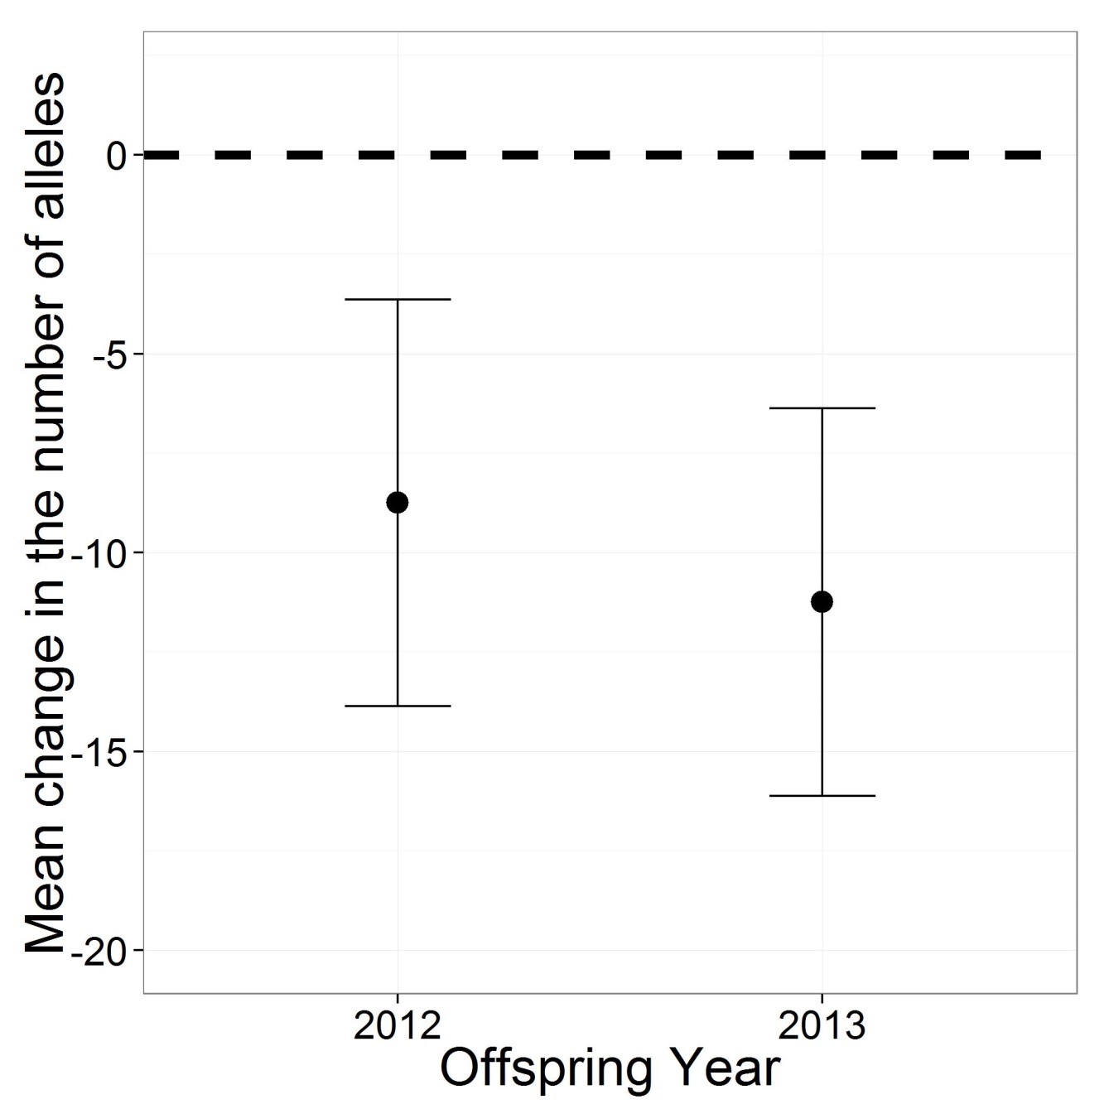
Alleles were lost
Paired t-test: 95 CIs
Notes:
However, we again found that on average alleles were lost between potential parents and returning offspring in both 2012 and 2013. PAUSE.

Slide 13
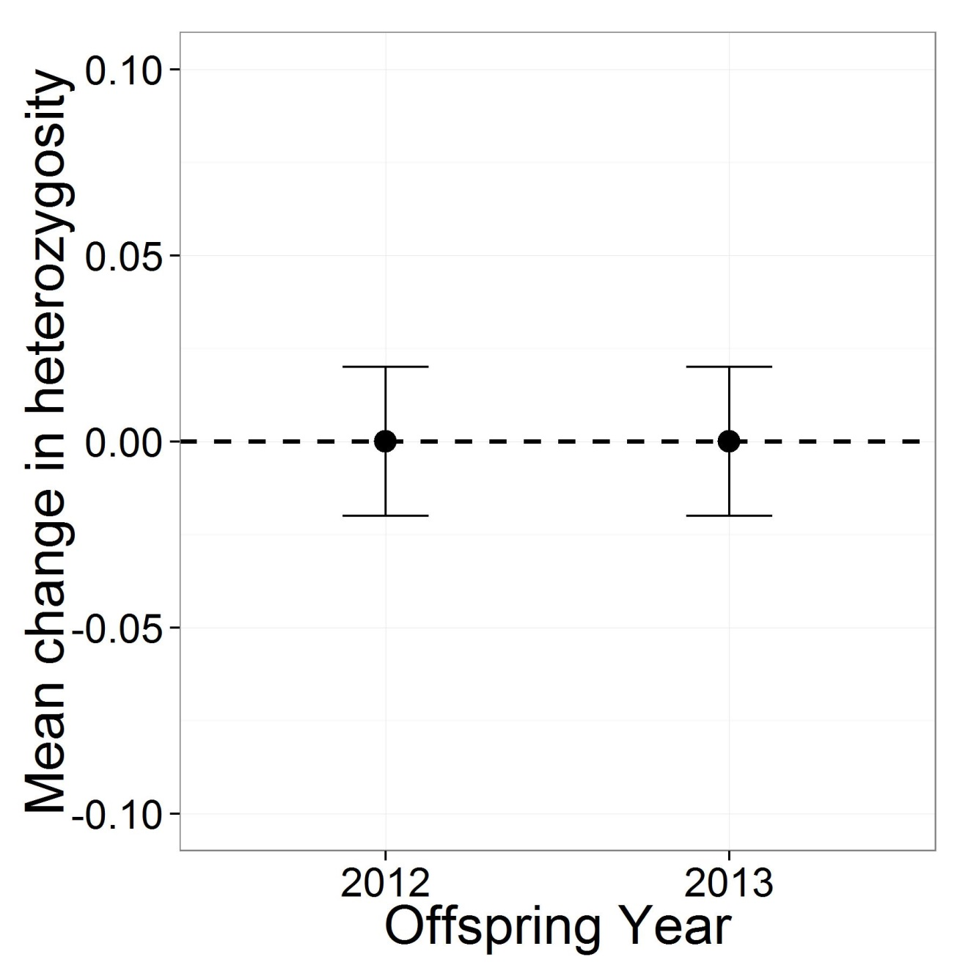
No change in heterozygosity
*Low power to detect change
Paired t-test: 95 CIs
Notes:
And we found no change in heterozygosity either year. PAUSE.

Slide 14
Do NOR migrants restore or contribute new genetic variation?
September 1st
Migrants
Notes:
Now, given that we had evidence that genetic variation was being lost in the reintroduction program, we asked do NOR migrants restore or contribute new genetic variation (as measured through number of alleles)?
Again, these migrants were not originally produced above Cougar Dam.

Slide 15
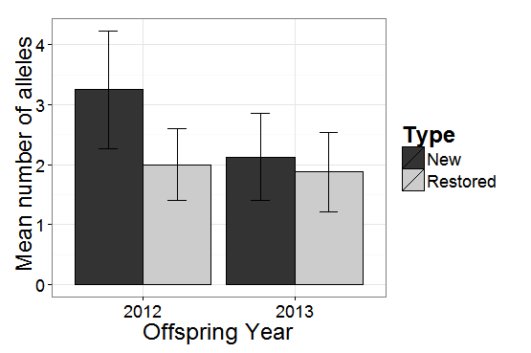
Migrants restored lost and contributed new genetic variation
*
*
*No LSDR
Error bars: SE
Notes:
We found that in both 2012 and 2013, NOR migrants contributed toward the restoration of genetic variation that was lost between potential parents and offspring, as well as contributed new genetic variation that was not previously observed in the reintroduction population. PAUSE.

Slide 16
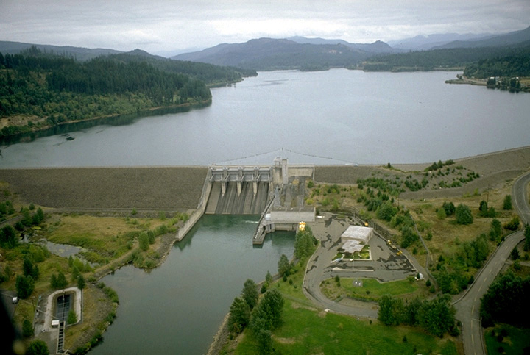
We found similar results in reintroduction program above Foster Dam
Performed identical analyses
Reduction in number of alleles
No change in heterozygosity
CRR ≈ 1
U.S. Army Corps of Engineers
Notes:
I want to note that we performed identical analyses for the reintroduction program above Foster Dam and found similar results.
We found a reduction in the number of alleles and no change in heterozygosity. All of this is important to note because CRRs in that system are about one.

Slide 17
Conclusions
Genetic variation is being lost
  Dam and river passage, ocean survival, etc.
Migrants may offer a potential solution
  May not be productive in the long run
    They may impede adaptation
    Loss to their own source population(s)
Our ongoing studies provide data
  Inform managers
  Monitor strategies to evaluate effectiveness
    LSDR
Notes:
So to summarize, we found that overall genetic variation is being lost. Numerous factors are likely involved including dam and river passage, ocean survival, among others. PAUSE.
2. While migrants may offer a potential solution in part, such a practice may not be productive in the long run because they may impeded adaptation to the above dam environment and they may also be viewed as a loss to their own source populations. PAUSE.
These are all contentious issues for which further data & deliberation is necessary…
PAUSE.
Before I move on I’d like to emphasize here is that our ongoing studies provide the data that enables these decisions to be made from an informed rather than naive position. They also enable monitoring of the actual results for different management practices to determine their effectiveness, such as our evaluation of the late season downstream release method implemented last year. PAUSE.

Slide 18
Searching for adfluvial Chinook
Notes:
Ok, I am switching gears on you and now I will talk about our search for adfluvial Chinook above Cougar Dam.

Slide 19
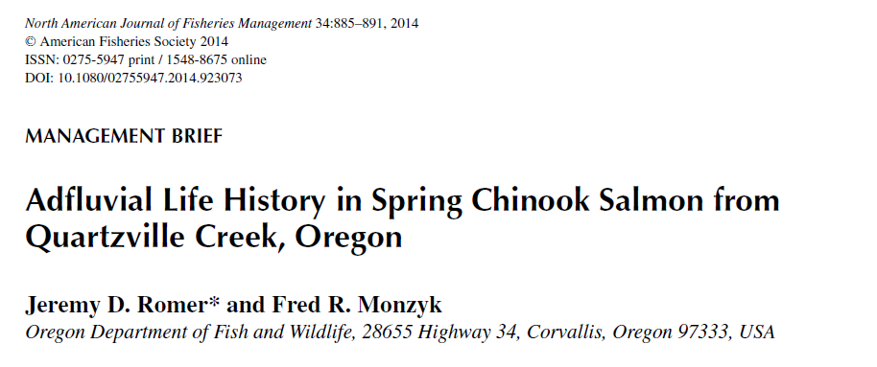
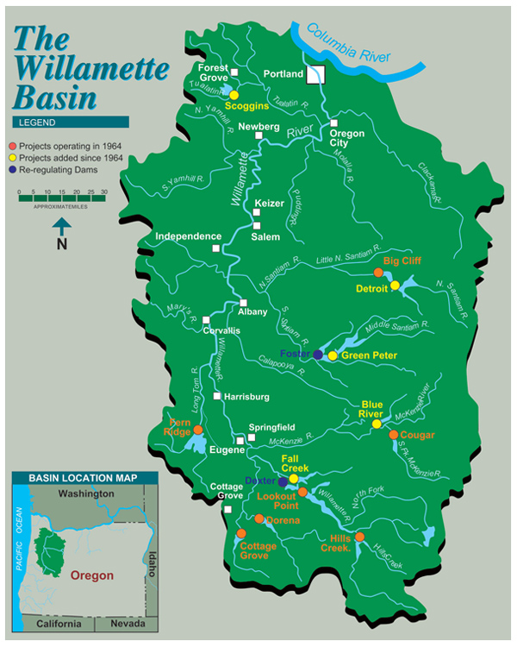
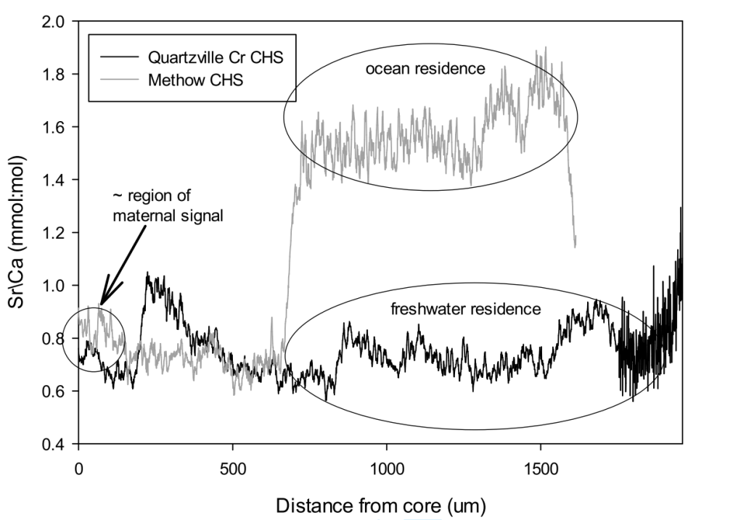
Is there genetic evidence for adfluvial Chinook above Cougar Dam?
?
http://www.nwp.usace.army.mil/Locations/WillametteValley.aspx
Notes:
Our colleagues, Jeremy Romer and Fred Monzyk recently published a paper providing evidence that adfluvial Chinook reside in Quartsville Creek above Green Peter Dam. They showed the Chinook caught above the dam did not have a Sr signature, which indicated they did not migrate to the ocean. Given their findings, we asked the question: Is there genetic evidence for adfluvial Chinook above Cougar Dam?

Slide 20
Adults were assigned to juveniles outmigrating the following year
2008 | 2009 | 2010 | 2011 | 2012
Offspring – juveniles captured in screw trap
Sard et al. Submitted. CJFAS
Notes:
In the past, I have presented some of our results regarding adult cohorts being assigned to outmigrating juveniles. For example, we assigned the Chinook reintroduced in 2008 to juveniles outmigrating in 2009. In total, we have done this for four consecutive reintroduction years.

Slide 21
Juveniles are sampled above the dam
Screw trap
  Genotyped
    2,000 / year
Notes:
All the juveniles I will talk about were sampled in screw trap above the dam. Each year we have genotyped about 2000 juveniles.

Slide 22
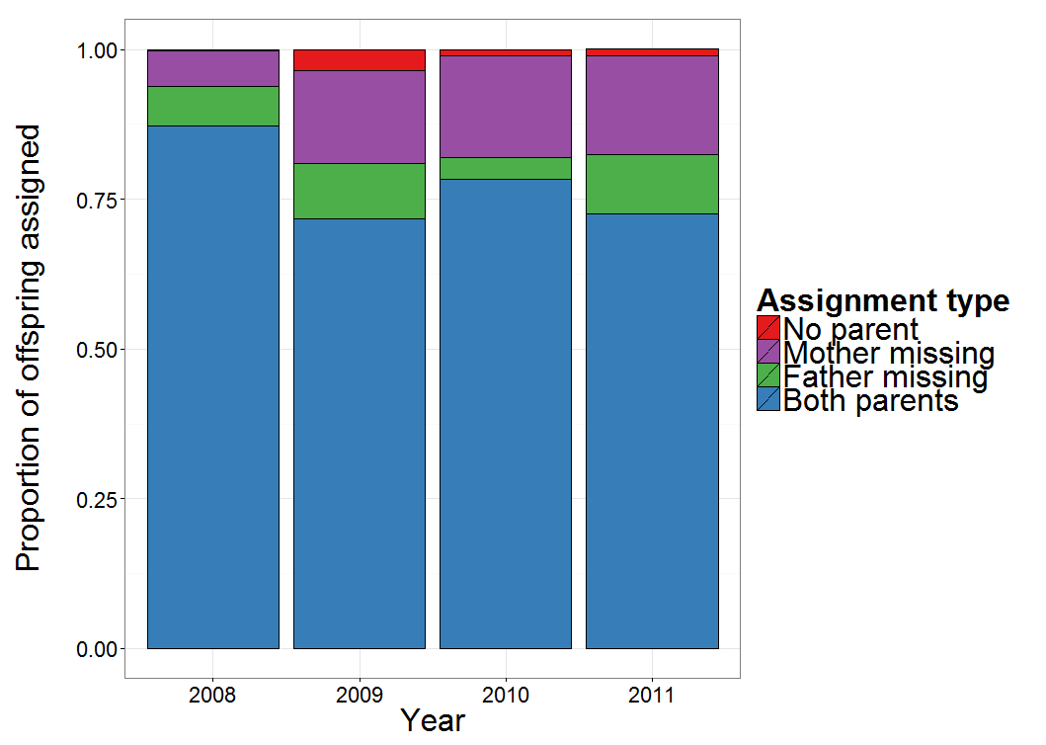
Some offspring are missing at least one parent
Notes:
This figure shows the proportion of offspring that assigned to both parents, were missing a father, missing a mother, or did not assign to any parents for each of the four adult-juvenile genetic pedigrees we have assembled.
About 78% of the offspring assign to both parents, but the remaining 22% of offspring are missing at least one parent. PAUSE.

Slide 23
Three hypotheses to explain missing parents:
Genotyping error and assignment criteria
Incorrect sex identification of adults
Unsampled adfluvial Chinook reside above the dam
Notes:
Three hypotheses to explain the missing parents are:
Genotyping error and assignment criteria we chose to limit false positive assignments in our datasets.
Incorrect sex identification of adults.
Unsampled adfluvial Chinook that reside above the dam.
I will not get into the methods of how we tested hypotheses one and two because I am limited by time. So I will cut to the chase.

Slide 24
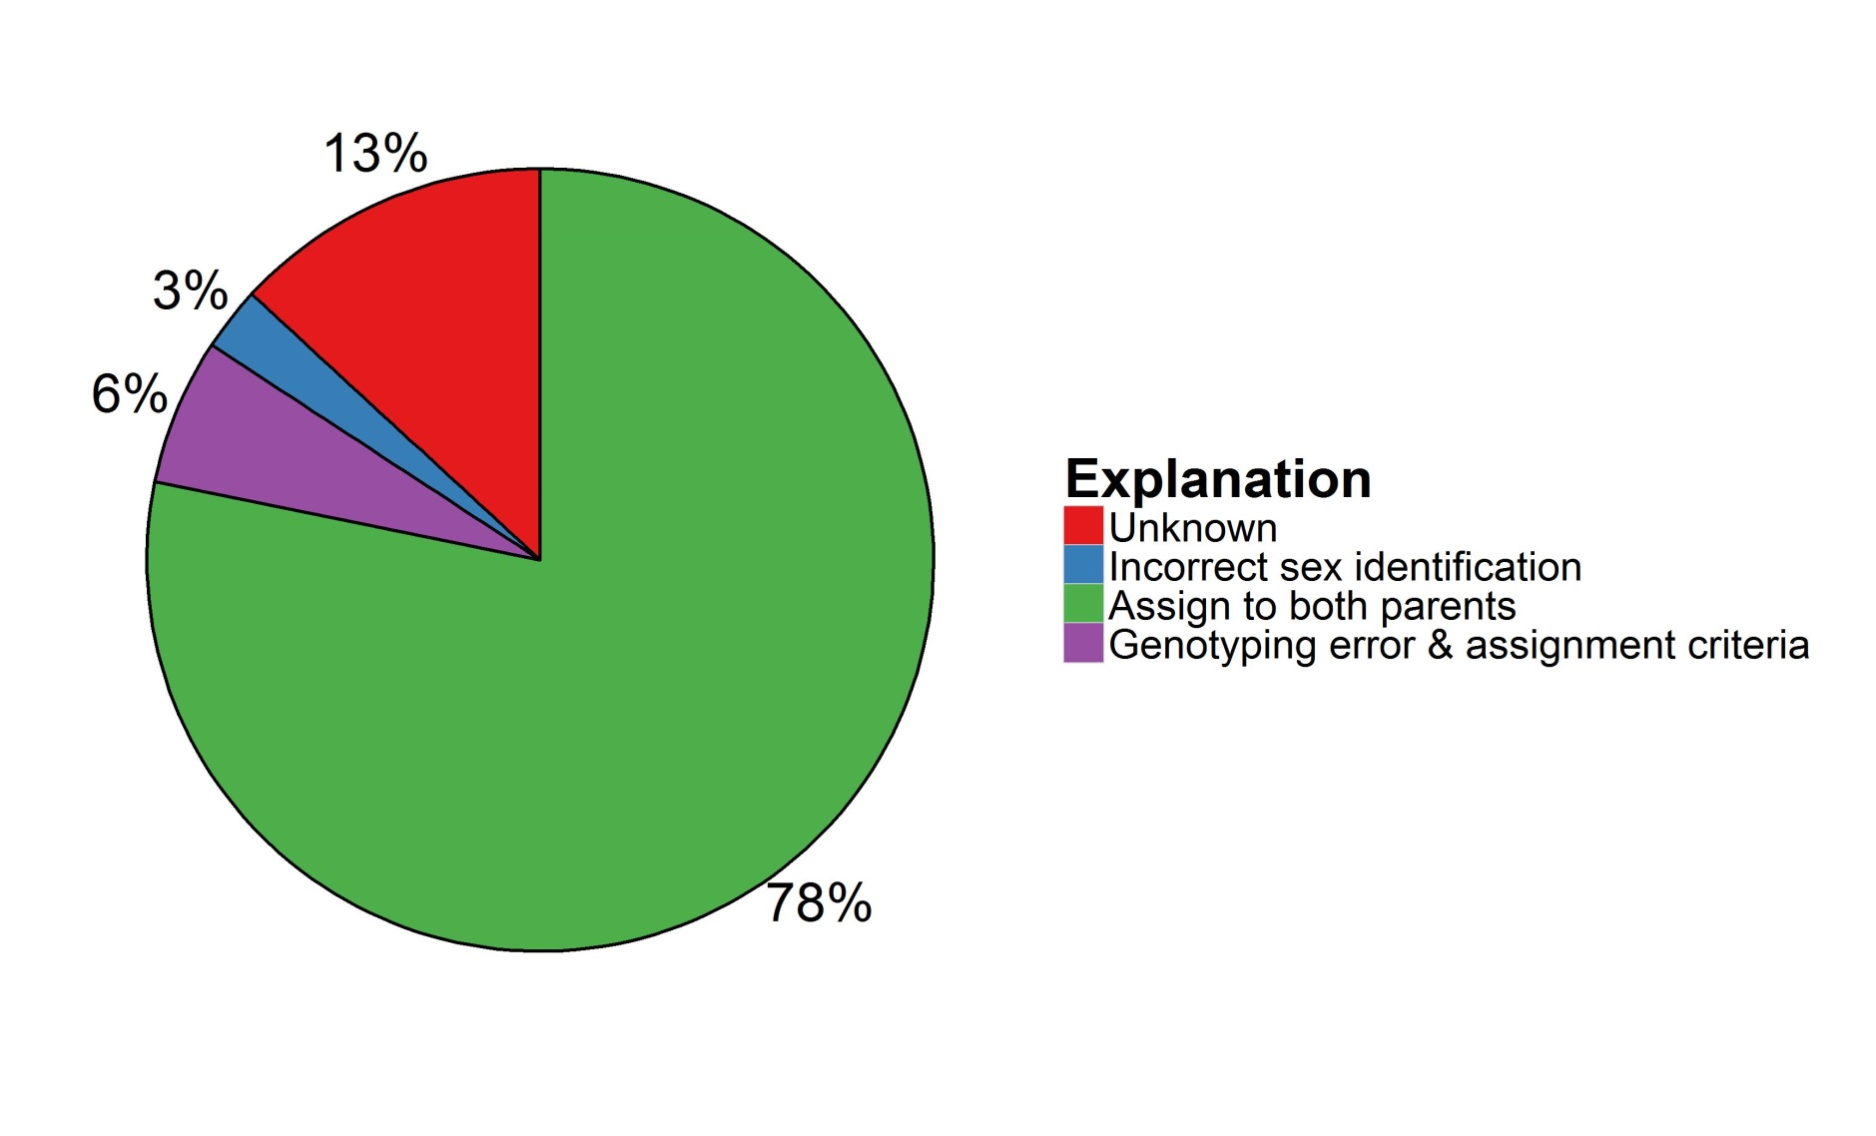
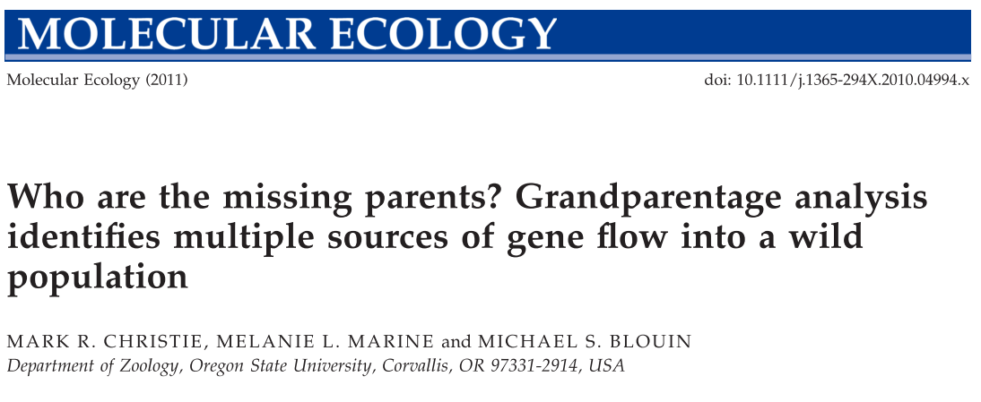
Some offspring remain unexplained after testing hypotheses 1 & 2
Mean values for each hypothesis
Notes:
This pie chart summarizes the proportion of offspring explained by pedigree approach, and hypotheses one and two. Like I said before, about 78% of offspring assign to both parents, but that leaves 22% unexplained.
Hypothesis one, which is based on an experimentally estimated 2% genotyping error and assignment criteria, explain about 6% of the missing parents.
Hypothesis two, incorrect sex identification, explains about 3% of the missing parents.
This still leaves some offspring missing at least one parent unexplained. Pause.
We employed methods developed by Mark Christie, a recent post-doc in the Blouin lab at Oregon State University, which use genotypes of known grandparent mating pairs and grandoffspring to infer the existence of a missing parent.

Slide 25
Known grandparent pairs can be used to identify missing parents
Grandparent pair
Our study:
  11 loci
  35 alleles/locus
Parent
?
Grandoffspring
(Juveniles)
Grandparent pair – grandoffspring trio
Notes:
For example:
Here we have a pedigree. Square are males, circles are females, and the colors within the shapes indicate each individuals genotype at a given locus. Horizontal lines indicate mate pairs and vertical lines connect parents to offspring they produced. Pause.
This grandoffspring has one known parent, a female, but its missing a father. Because we know the genotypes for the grandparent pair, we can infer that they could have produced a male that mated with this female to produce this juvenile. Collectively we call these grandparent pair – grandoffspring trios. Pause.
This is a simplified example. In our study we performed this analysis with 11 loci that averaged 35 alleles per locus, which greatly increased our power to identify missing parents. Pause.

Slide 26
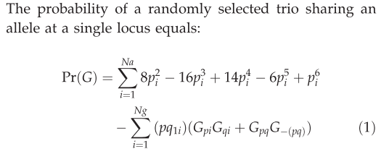

We calculated the number of observed trios expected by chance
… →
Notes:
We also calculated the expected number of grandparent pair – grandoffspring trios that would occurr by chance using equations developed by Mark Christie. Pause.

Slide 27
Preliminary evidence suggests adfluvial Chinook may reside above Cougar Dam
Searched for age-1 to -4 missing adults
  15 comparisons
    13 of 15: Observed trios > expected by chance
Two more adult-juvenile pedigrees to assemble
  Increase age-1 to -4 comparisons
  Add new age-5 and -6 comparisons
Notes:
Thus far, we have searched for age-1 to age-4 missing adults, which total 15 comparisons in all. In 13 of the 15 comparisons, we found that the number of observed grandparent pair – grandoffspring trios was greater than expected by chance. Therefore, preliminary evidence suggests adfluvial Chinook may reside above Cougar Dam. Pause.
But, we have more work to do. We have two more adult to juvenile pedigrees to assemble, which will increase age-1 to age-4 comparisons and add new age-5 and age-6 comparisons. Pause.

Slide 28
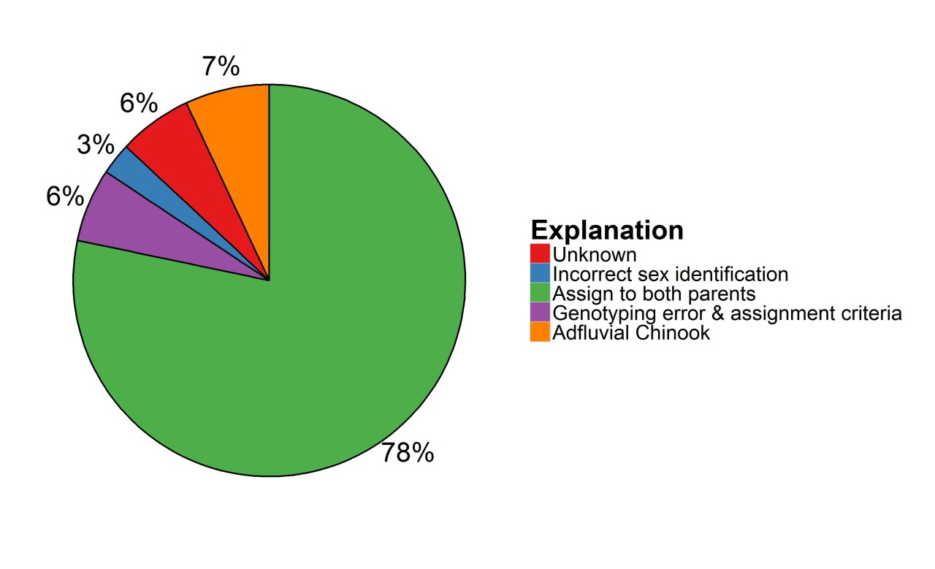
Adfluvial parents may account ~7% of offspring missing a parent
Generalized
  One year - 2011
Anadromous parents
  Anadromous x Adfluvial?
  Adfluvial x Adfluvial?
No > Age-4 comparisons
Notes:
Based on our preliminary results, we estimate that adfluvial parents may account for 7% of offspring missing a parent. Note that this result is generalized and is only for the 2011-2012 adult to juvenile pedigree.
In addition, we only have knowledge of anadromous-anadromous or anadromous X adfluvial or adfluvial X adfluvial mating events that contribute to offspring missing at least one parent.
Finally, we have yet to account for any missing age-5 or age-6 parents, which could have contributed to offspring missing at least one parent as well. Pause.

Slide 29
Key points
Part 1: Assessment of genetic variation
Genetic variation is being lost
  Migrants boost and restore diversity
Part 2: Searching for adfluvial Chinook
Two more adult-juvenile pedigrees to assemble
  Test all putative grandparent-grandoffspring trios
    Genotype at 5 more loci
Notes:
Key point to take away from my talk are:
First, genetic variation is being lost in the reintroduced population and that migrants boost and restore genetic diversity. Pause.
Second, we have more work to do in our search for adfluvial Chinook. We have two more adult to juvenile pedigrees to assemble. Following their assembly, any putative grandparent pair – grandoffspring trios will be genotyped at 5 more loci. All trios that match at a then total of 16 loci will be incorporated into our estimates of the percent of offspring missing at least one parent that can be explained by adfluvial Chinook. Pause.

Slide 30
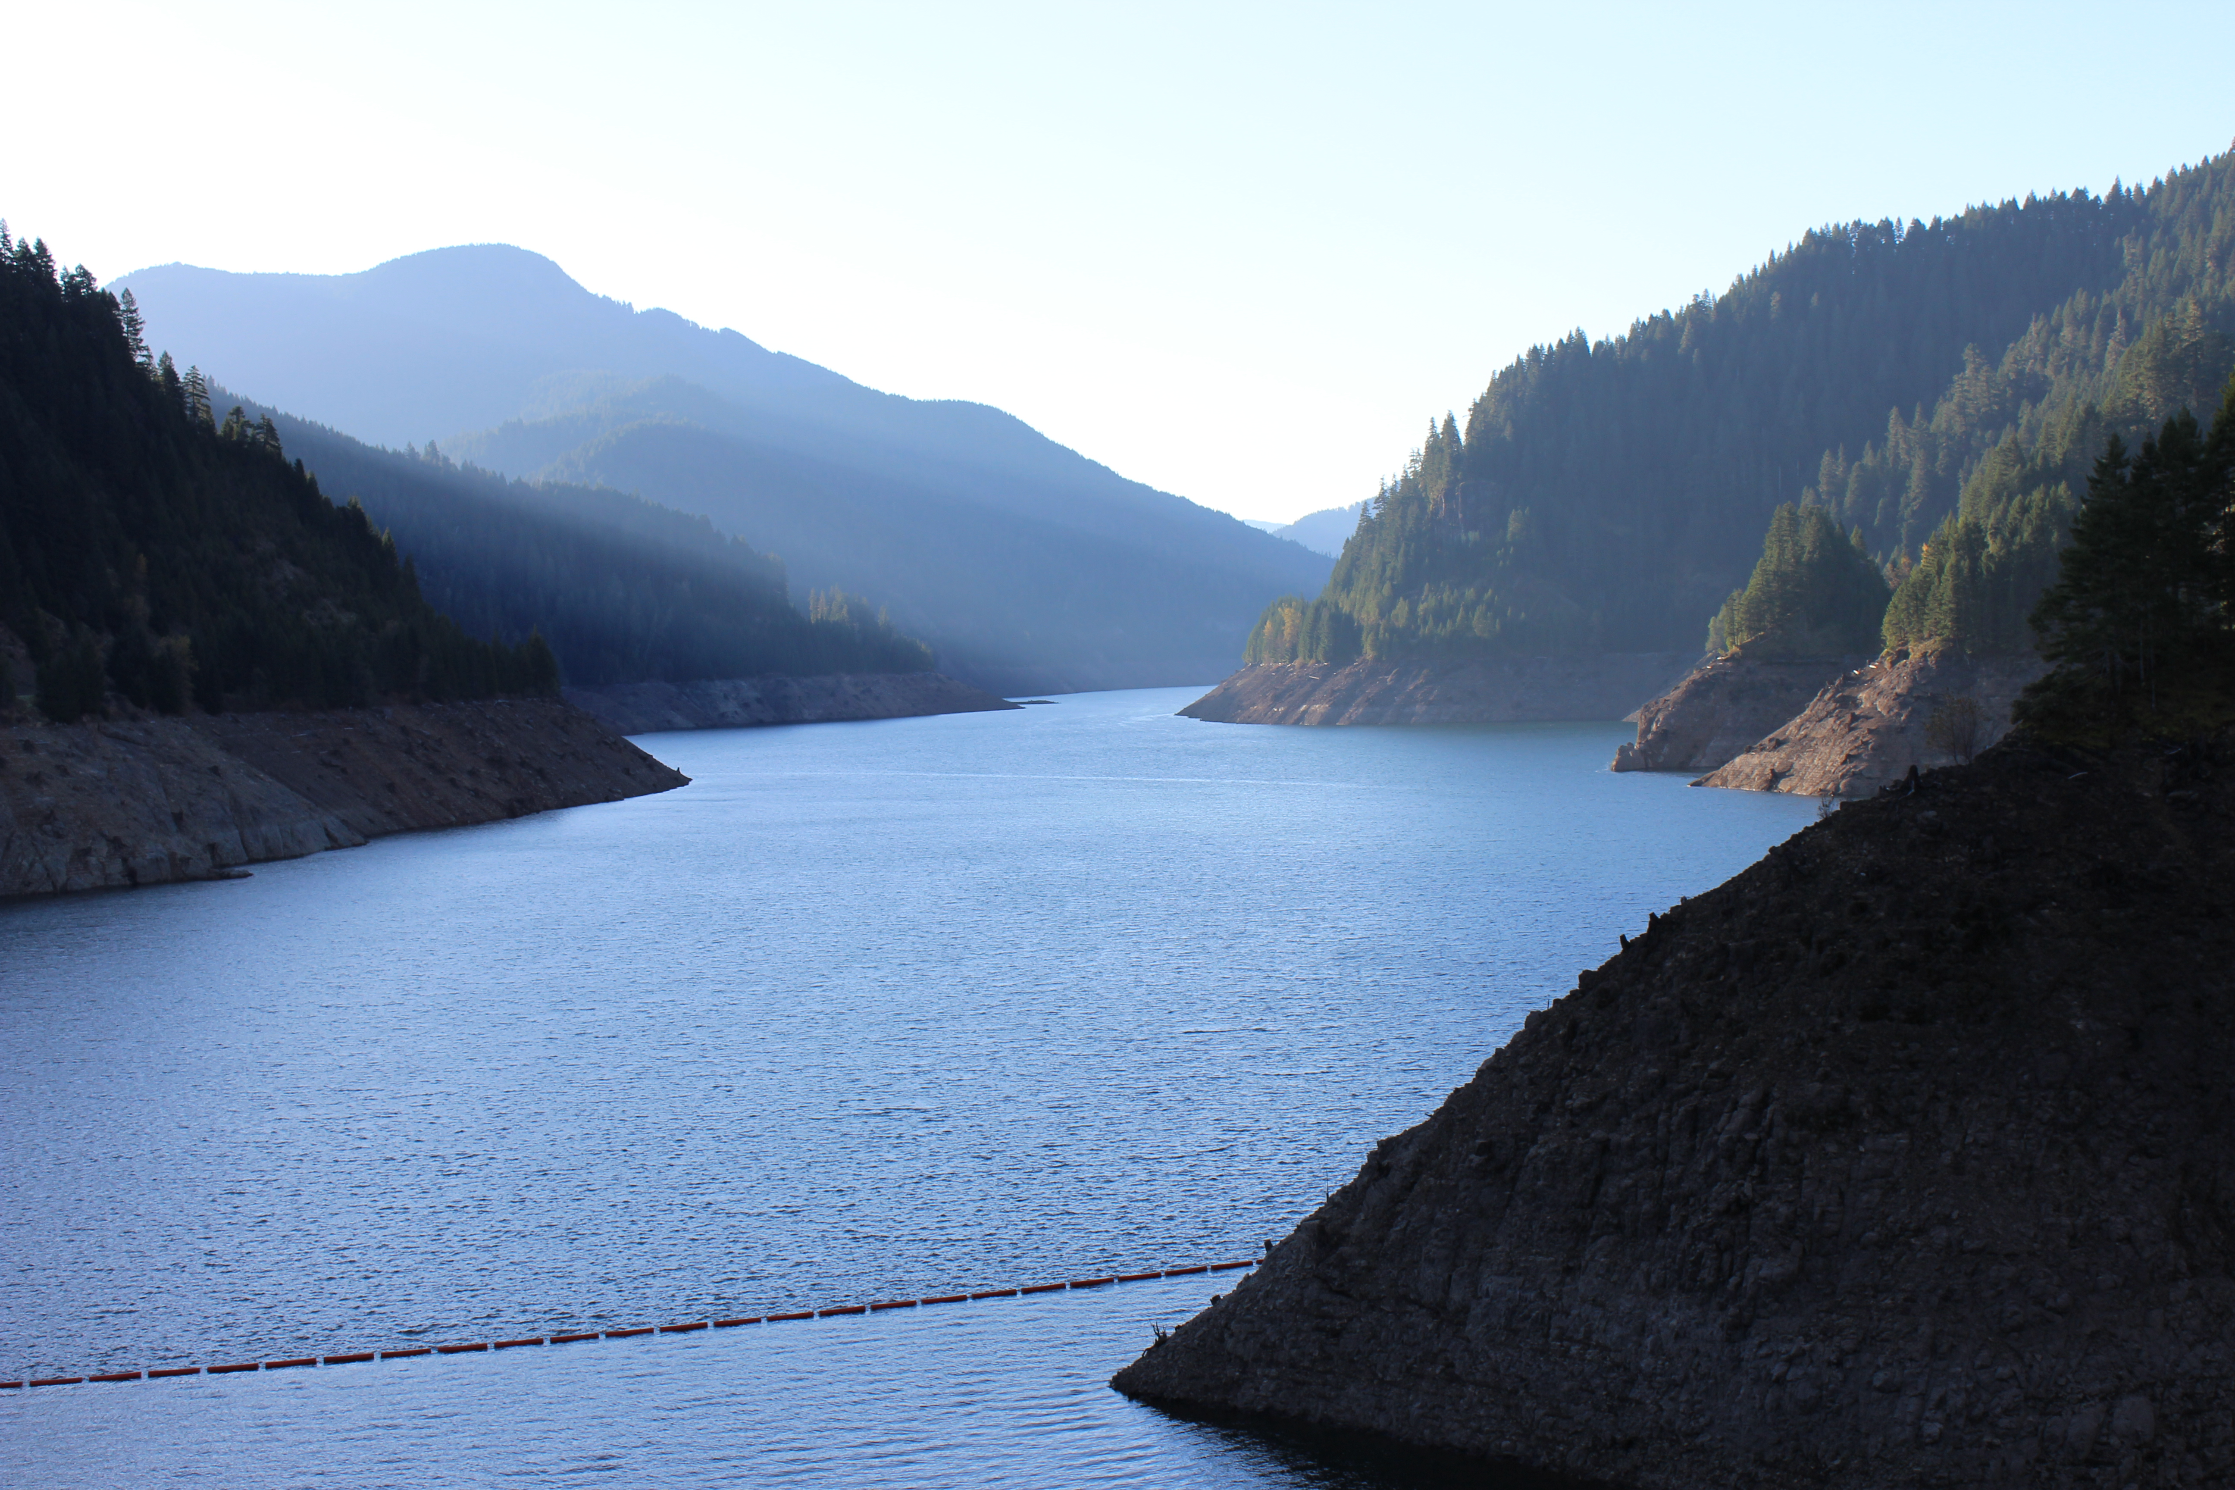


Acknowledgements
ODFW
Mark Wade
Nik Zymonas
Lisa Borgerson
Kanani Bowden
Ben Clemens
Oregon State University
Carl Schreck
Jen Britt
Sana Banks
Miles Naughton
USACE
Greg Taylor
Doug Garletts
Chad Helms
David Griffith
Notes:
With that I would like to thank our collaborators at Oregon Department of Fish and Wildlife, Oregon State University, and Army Corps of Engineers for collecting samples and administrative support.

Slide 31
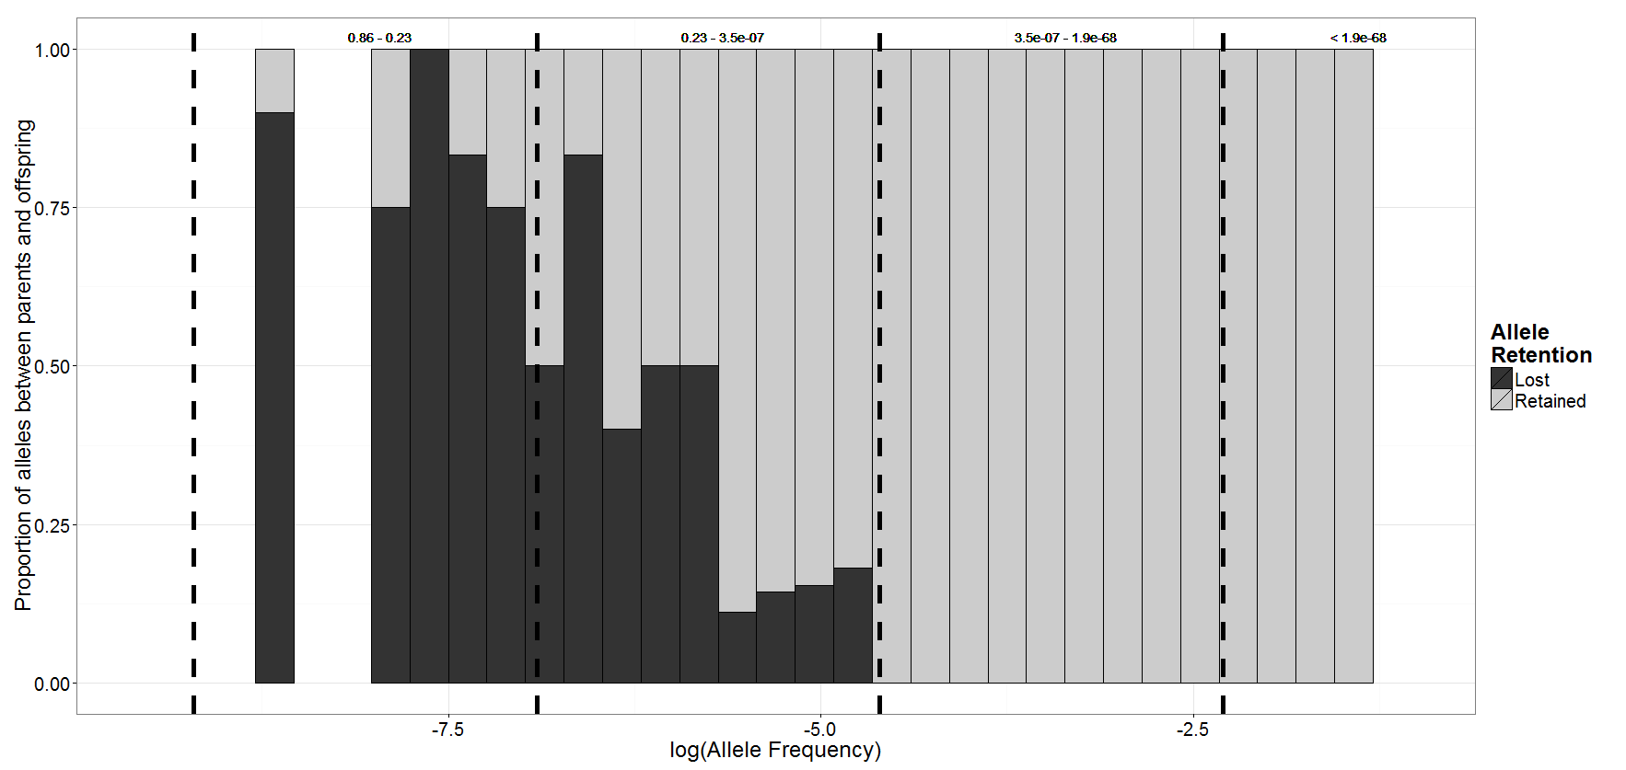
Some alleles lost are likely due to genetic drift
High
Low

Slide 32
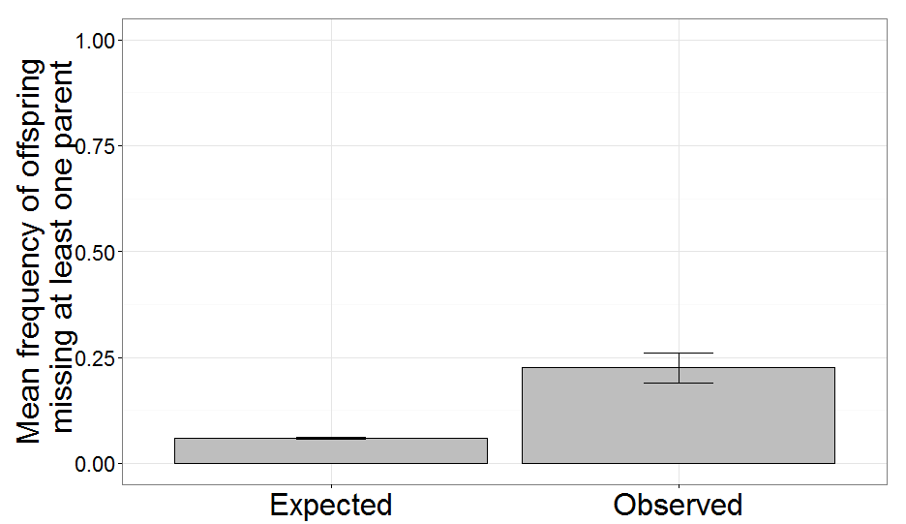
Exp. 1 : Genotyping error does not explain all missing parents
Simulated data
  800 parents, 2000 offspring, 2% genotyping error rate

Slide 33
Exp. 2: Background on assignments
Lowest probability of being false?
?
0.001
0.01

Slide 34
Exp. 2: Background on assignments
Lowest probability of being false?
?
0.001
0.01

Slide 35
Exp. 2: Background on assignments
Offspring | Mother | Father
Kid_001 | Mom_001 | Dad_001
Kid_002 | Unknown | Dad_001
Kid_003 | Mom_002 | Unknown
… | … | …
Male
Female?
Female
Male?
Locus 1 | Locus 1 | Locus 2 | Locus 2
101 | 102 | 201 | 202

Slide 36
Exp. 2: Background on assignments
Offspring | Mother | Father
Kid_001 | Mom_001 | Dad_001
Kid_002 | Unknown | Dad_001
Kid_003 | Mom_002 | Unknown
… | … | …
Male
Female?
Female
Male?
Locus 1 | Locus 1 | Locus 2 | Locus 2
101 | 102 | 201 | 202
101 | 103 | 202 | 204
Male?

Slide 37
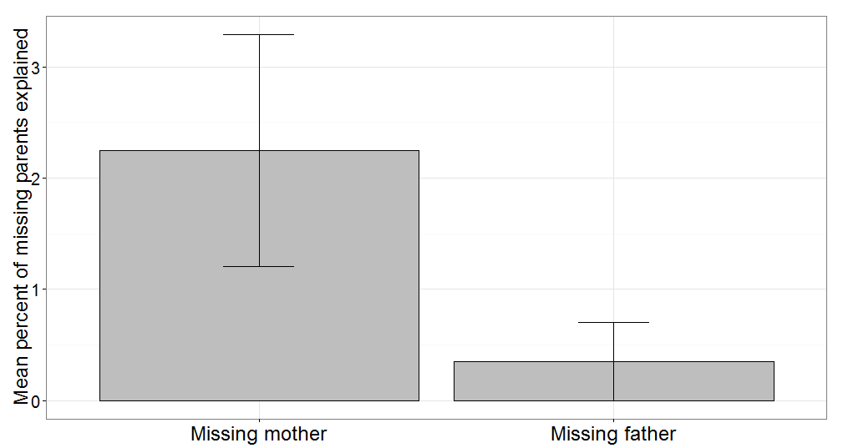
Incorrect sex identification does not explain all missing parents

Slide 38
Grandparentage analysis approach
Type | GP Year | Missing Parent Year
 |  | 2008 | 2009 | 2010 | 2011 | 2012 | 2013
Missing Father | 2007 | 1 | 2 | 3 | 4 | 5 | 6 |  | Age
 | 2008 |  | 1 | 2 | 3 | 4 | 5 |  | 1
 | 2009 |  |  | 1 | 2 | 3 | 4 |  | 2
 | 2010 |  |  |  | 1 | 2 | 3 |  | 3
 | 2011 |  |  |  |  | 1 | 2 |  | 4
 | 2012 |  |  |  |  |  | 1 |  | 5
Missing Mother | 2007 |  |  | 3 | 4 | 5 | 6 |  | 6
 | 2008 |  |  |  | 3 | 4 | 5
 | 2009 |  |  |  |  | 3 | 5
 | 2010 |  |  |  |  |  | 3
 | 2011

Slide 39
Preliminary evidence suggests adfluvial Chinook reside above Cougar Dam
Type | GP Year | Missing Parent Year
 |  | 2008 | 2009 | 2010 | 2011 | 2012 | 2013
Missing Father | 2007 | 1 | 2 | 3 | 4 | 5 | 6 |  | Age
 | 2008 |  | 1 | 2 | 3 | 4 | 5 |  | 1
 | 2009 |  |  | 1 | 2 | 3 | 4 |  | 2
 | 2010 |  |  |  | 1 | 2 | 3 |  | 3
 | 2011 |  |  |  |  | 1 | 2 |  | 4
 | 2012 |  |  |  |  |  | 1 |  | 5
Missing Mother | 2007 |  |  | 3 | 4 | 5 | 6 |  | 6
 | 2008 |  |  |  | 3 | 4 | 5
 | 2009 |  |  |  |  | 3 | 5 | Obs. > Exp.
 | 2010 |  |  |  |  |  | 3 |  | Yes
 | 2011 |  |  |  |  |  |  |  | No

