Slide 1

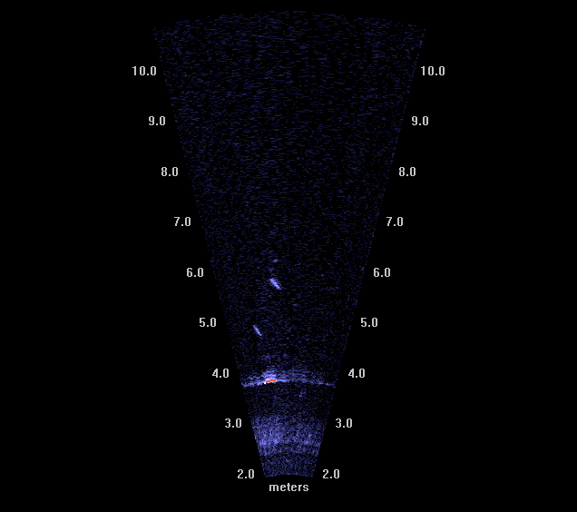
AN EVALUATION OF FISH BEHAVIOR AT THE PORTABLE FLOATING FISH COLLECTOR AT COUGAR RESERVOIR USING ACOUSTIC CAMERAS, 2014
Noah Adams, Collin Smith, and Gabriel Hansen
Western Fisheries Research Center
Columbia River Research Laboratory
Cook, Washington, USA
For
Army Corps of Engineers
Willamette Fisheries Science Review
February 11, 2015
Portland, Oregon
Trash Boom
Entrance to PFFC
U.S. Department of the Interior U.S. Geological Survey

Slide 2
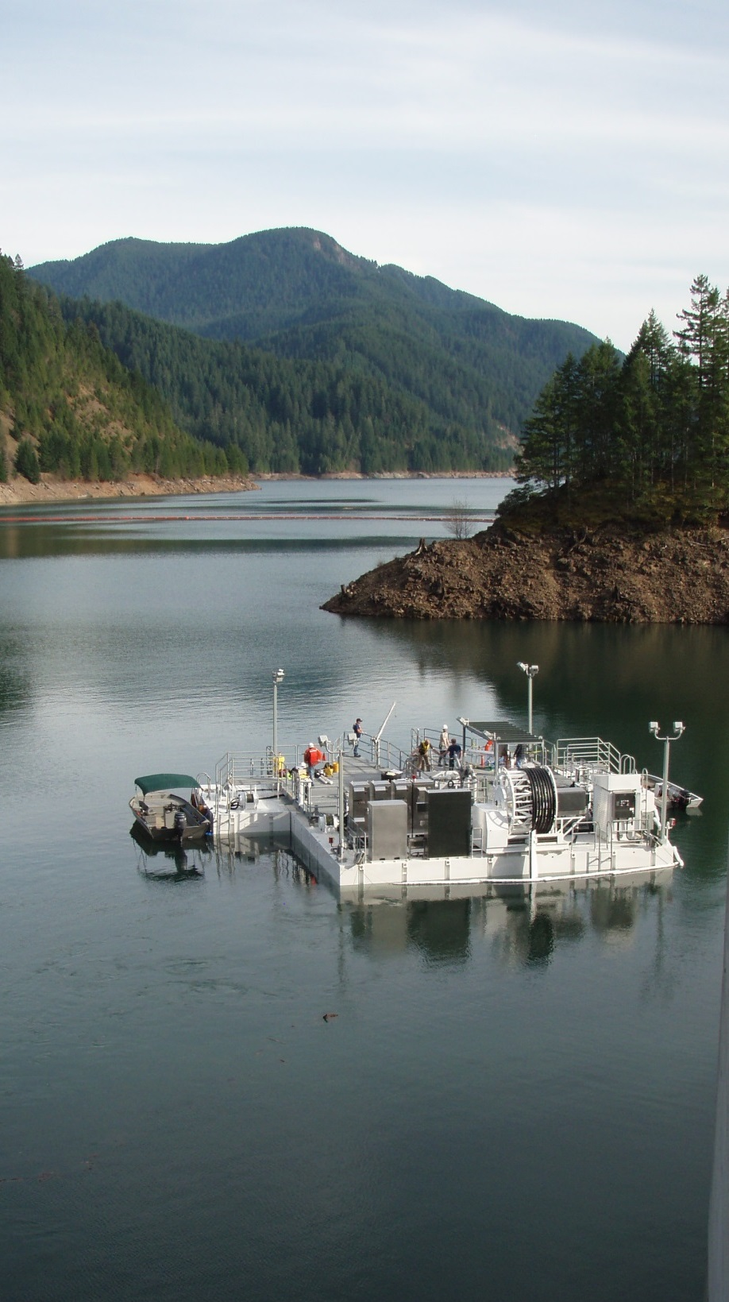

Goals for 2014
Use acoustic cameras to quantify fish behavior upstream and inside the PFFC.
Fry
Parr
Smolts
Estimate number of fish entering and exiting the PFFC and identify areas of rejection.
Examine predator activity near the PFFC.
Targets
30 - 60 mm
60 - 90 mm
90 - 250 mm
> 300 mm

Slide 3
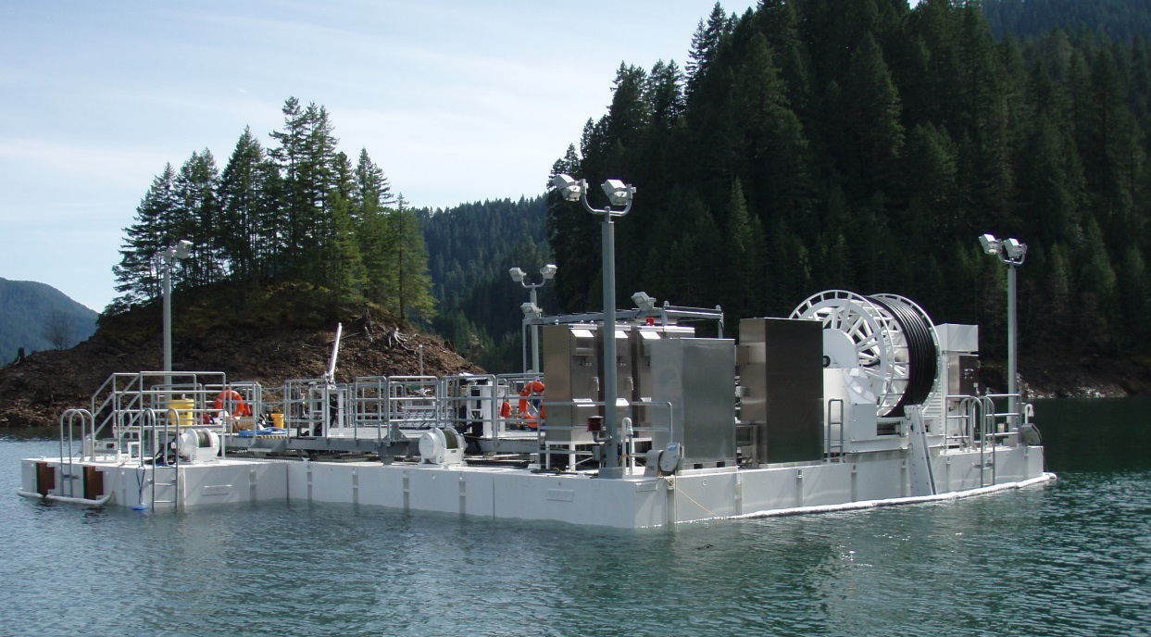
Outline
Methods
- Equipment
- Data
- Processing
- Tracking
- Analysis
Results
- Abundance
- Density
- Movements

Slide 4
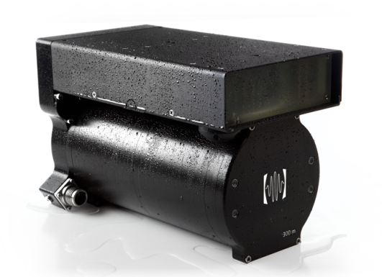
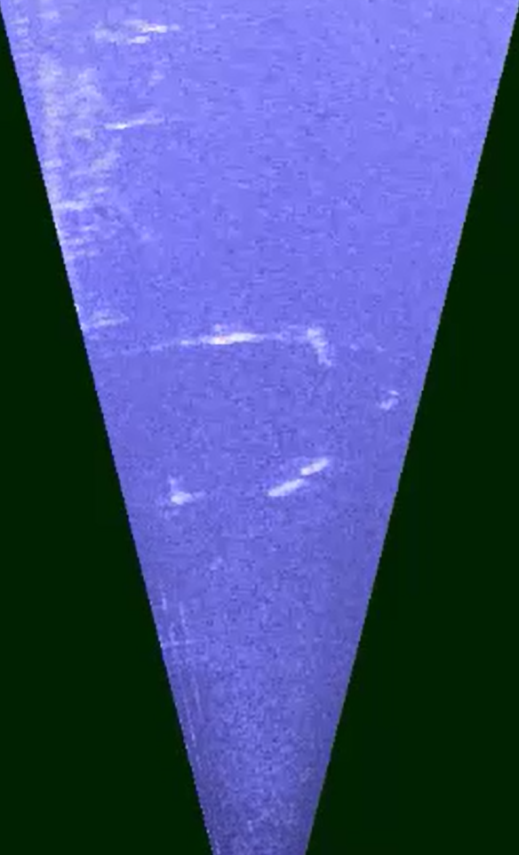
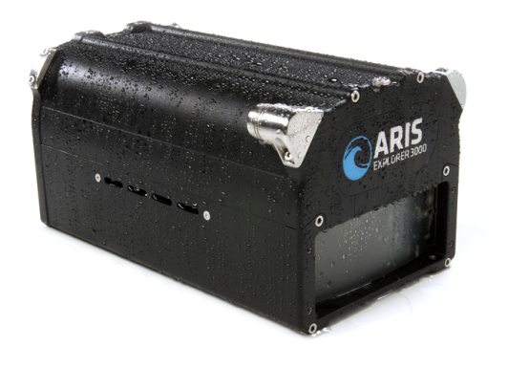
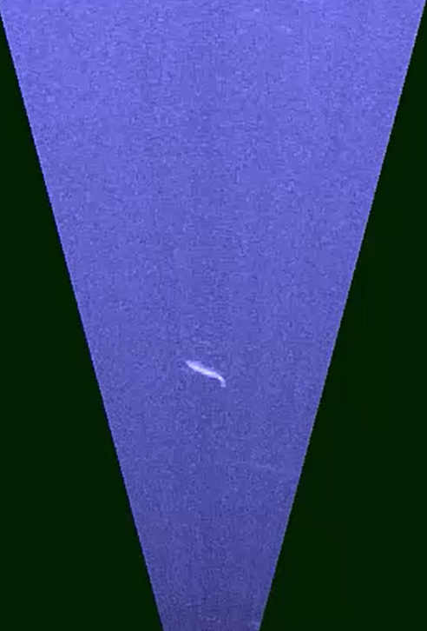
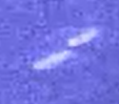

Equipment
DIDSON
1.8 MHz
14° x 29°
~10 m range
Fish >40 mm
ARIS
3.0 MHz
14° x 30°
~5 m range
Fish >30 mm

Slide 5
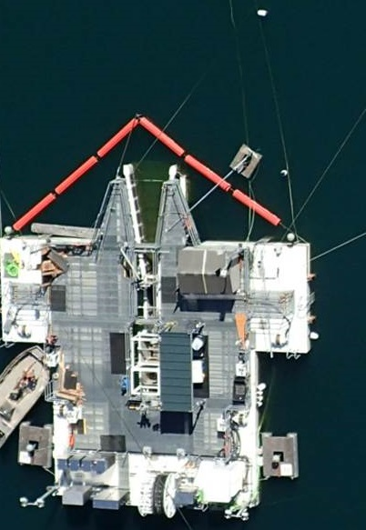
Camera Deployment
30 May to 3 December
Collected 7,500 hours of video.
~30 terabytes of data
ARIS
DIDSON
Scale
3 m

Slide 6
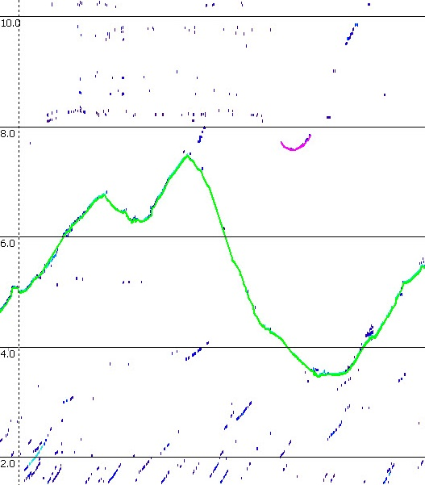
Data Processing and Analysis
Data processing and quantitative analysis methods were developed during 2013.
Echogram
EchoView software used for semi – automated data processing and tracking.
- More data can be processed
- Data processing is constant
- Processing yields quantitative target information
* Target size
* Target density
* Direction
* Speed
* etc….
Video → Digital target → Track

Slide 7
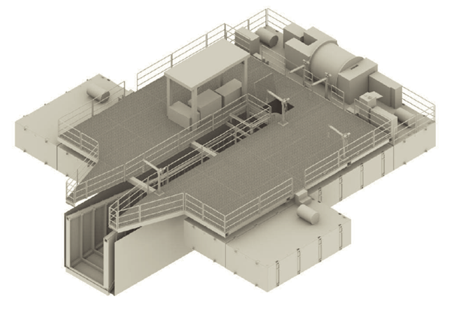
Results (for today’s presentation)
- DIDSON
100% of 110 days spread across the season
- ARIS
50% of 110 days spread across the season
(two 15 min. blocks randomly selected for each hour)
- Combined
~ 9,500 fish tracks
~ 300,000 individual track data points

Slide 8
Abundance at PFFC 2014 vs. WTC tower 2013
(DIDSON only)
348
72
29
12
30 - 250 mm
> 300 mm

Slide 9
Abundance at PFFC by Fish Size
(DIDSON + ARIS)

Slide 10
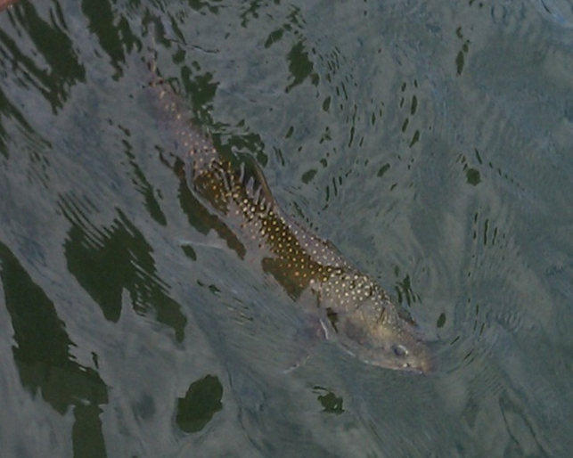
Abundance at PFFC by Hour of Day
(DIDSON only)
Fry
Parr
Smolts

Slide 11
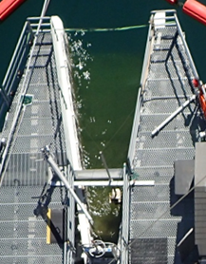
Abundance Inside PFFC
Fish size 30-250 mm
PFFC TRAP CATCH
N = 320
53%
35%
27%
24%

Slide 12
Abundance Inside PFFC
Fish size 30-250 mm
PFFC TRAP CATCH
N = 320
53%
35%
27%
24%

Slide 13
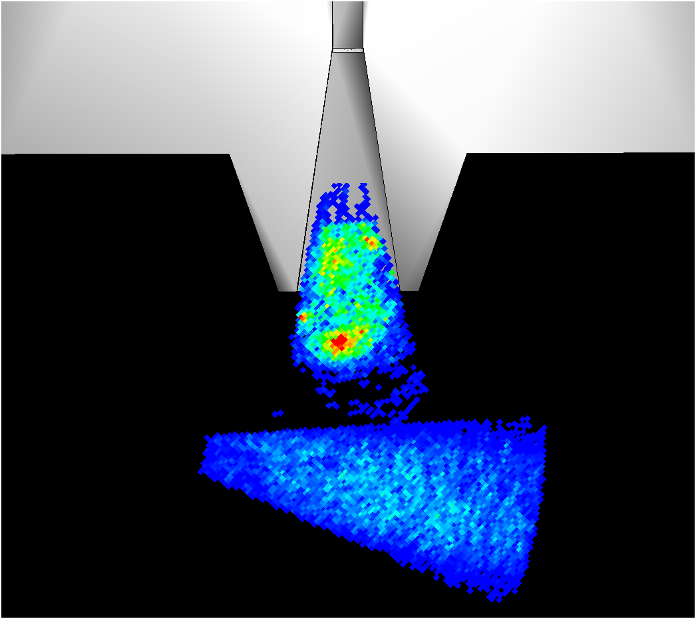
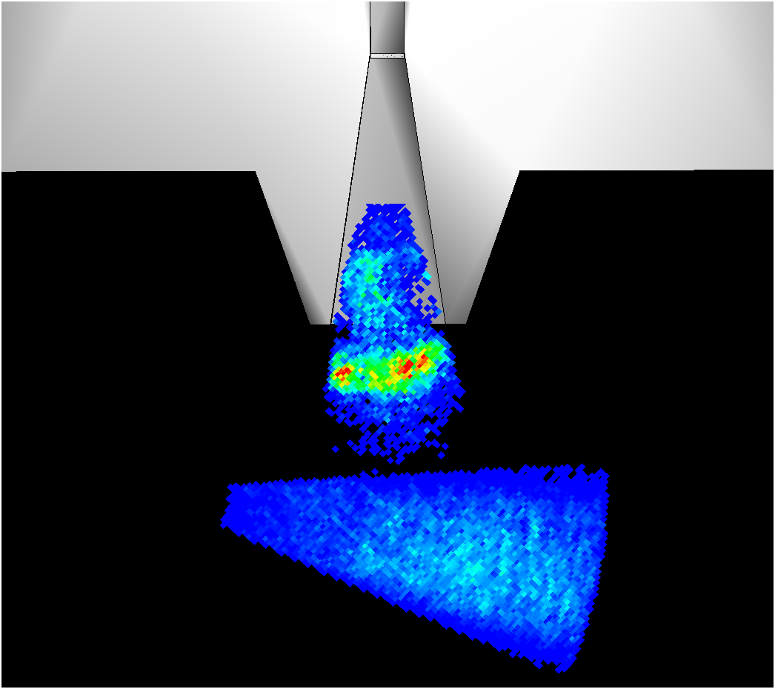
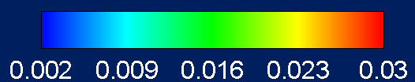
Proportional Density Upstream of PFFC
Fish size 30-250 mm
Low treatment (~50cfs)
High treatment (~100 cfs)
Aris - 805
Aris - 980
Didson – 2,020
Didson – 3,583

Slide 14

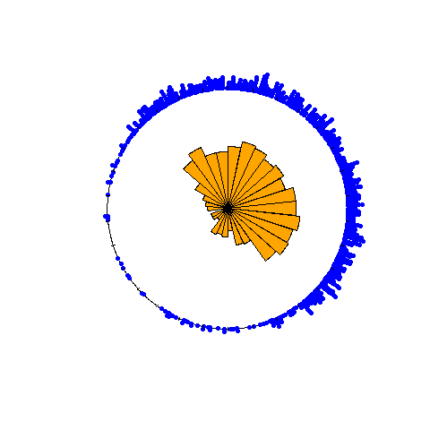
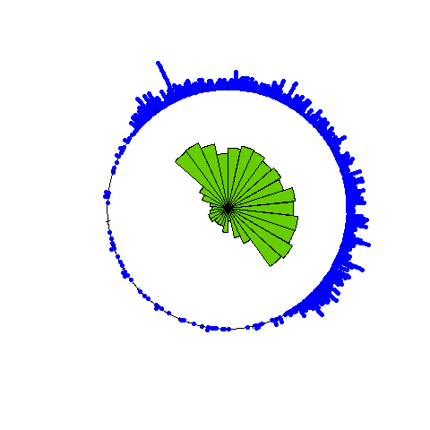
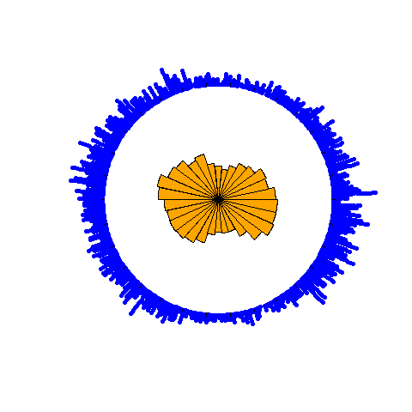
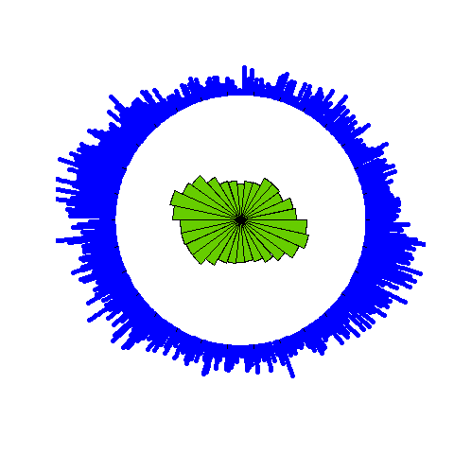

Direction of Movement at PFFC
Fish size 30-250 mm
Low
High
n = 758
n = 941
p > 0.10
p > 0.10
n = 2,000
n = 3,532
* Watson’s Two-Sample Test for Common Distributions

Slide 15
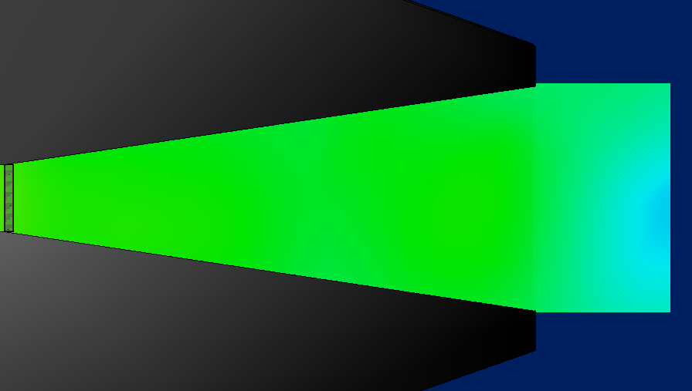
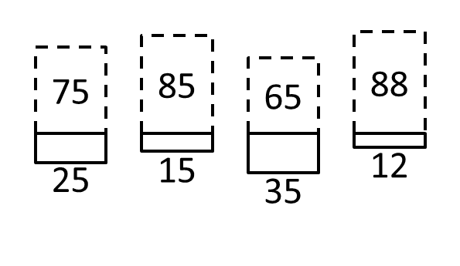
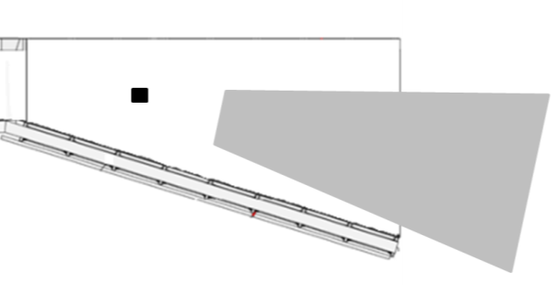
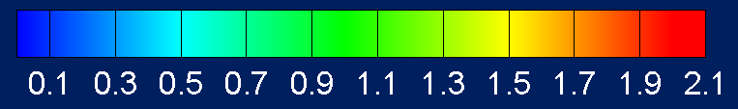
Direction of Movement Inside PFFC
Low treatment - Fish size 30-250 mm
Distance from camera (m)
3.5
4.25
5.0
5.75
6.5
N
204
189
237
186
ARIS
36%
Velocity (ft/s)

Slide 16
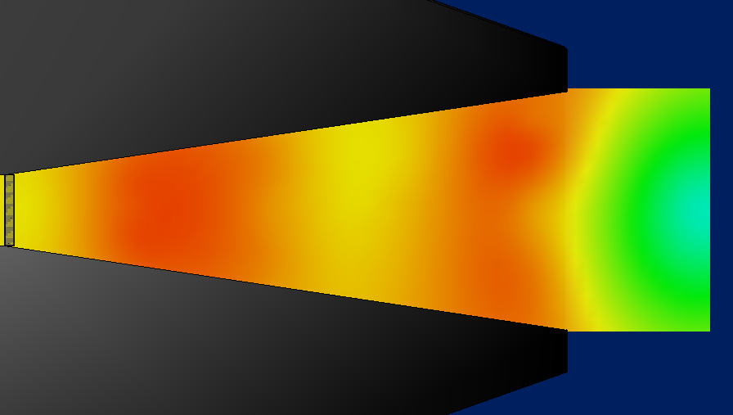
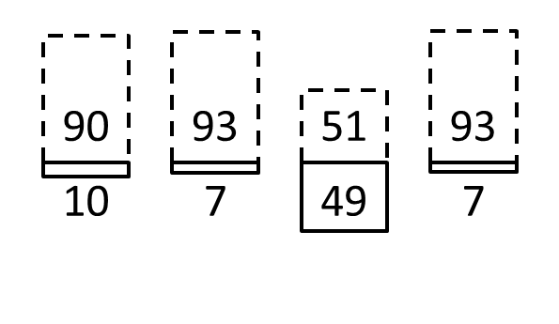
Direction of Movement Inside PFFC
High treatment - Fish size 30-250 mm
Distance from camera (m)
3.5
4.25
5.0
5.75
6.5
N
118
124
235
320
ARIS
40%
Velocity (ft/s)

Slide 17
Summary
Median daily observations were much less upstream of PFFC compared to upstream of WTC tower.
PFFC needs to be moved closer to the tower?
Predators appear to play a role in deterring juvenile fish from entering the PFFC.
Consider minimizing predator habitat…. log boom?
Entrance conditions cause fish to avoid going in the PFFC and the vast majority that did go in turned around and left.
Modifications to achieve design flows upstream and inside the PFFC should increase capture efficiency.
Multiple evaluation tools provided valuable information to inform changes that could improve PFFC performance.

Slide 18

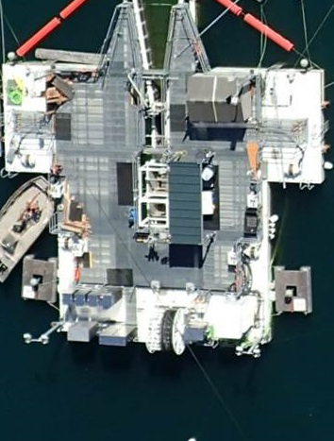
Acknowledgements
USGS
John Beeman, Hal Hansel, Amy Hansen, Scott Evans, Philip Haner, Tyson Hatton, Eric Kofoot, Kyle Martens, Jamie Sprando, Matt Sholtis, Collin Smith, Nick Swyers, Craig Haskell, Glen Holmberg, Russell Perry,
John Plumb
USACE
David Griffith, Wes Hively, Andrew Janos, Todd Pierce, Mary Karen Scullion
QUESTIONS ?

