Slide 1
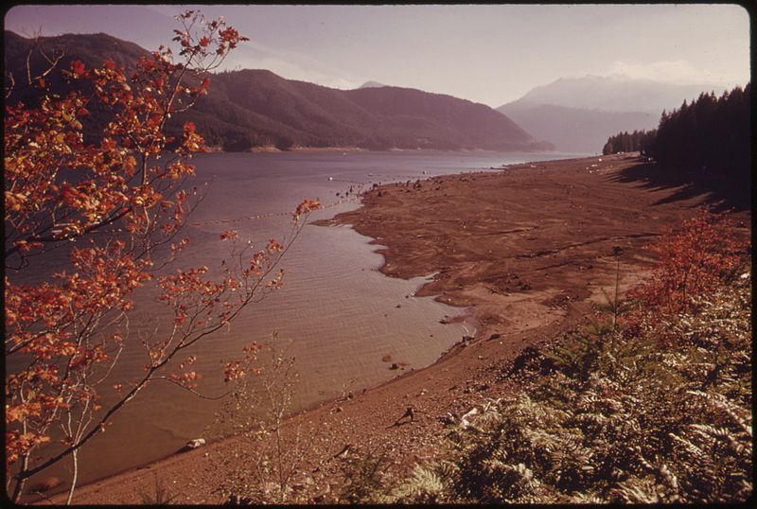

Simulating Temperature Management under Climate Change at Detroit Lake, OR
Norman Buccola, John Risley, and Stewart Rounds
USGS Oregon Water Science Center, Portland, OR
2014 Willamette Fisheries Science Review
Portland, Oregon, February 12, 2015
U.S. Department of the Interior
U.S. Geological Survey
Photo from U.S.EPA
Notes:
Photo from sep, 1973 (drought year)

Slide 2

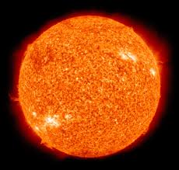
Motivation for Temperature Modeling
Endangered/Threatened Salmon
What can USACE do to improve water temperature downstream of Willamette dams?
Water temperature under future climate:
How will current operations work in the future?
How to improve conditions?
Can dams help mask climate change effects?
wikimedia.org
Notes:
Detroit Lake Model
Stewart Rounds, USGS
Apr 5, 2007
Page 2
(2008 NMFS Biological Opinion)

Slide 3
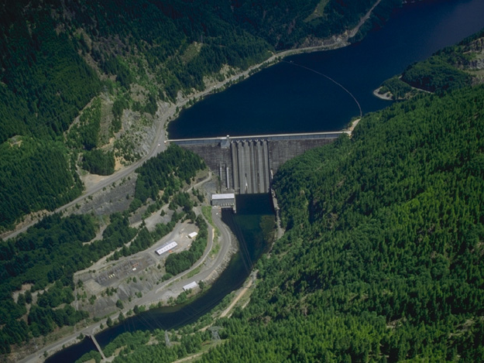
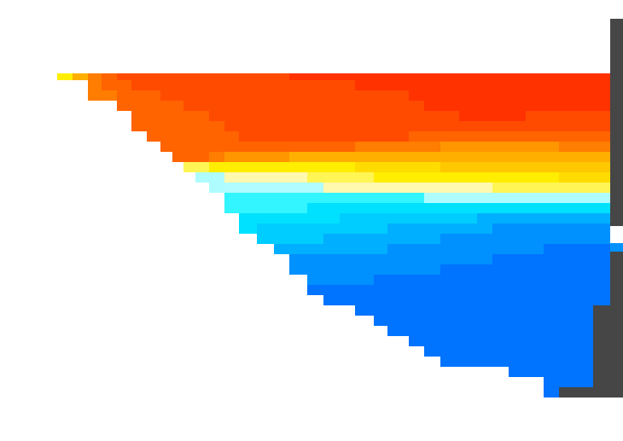
Changed Dam Operations to Modify Downstream Water Temperature
Detroit Dam
463 feet tall
Multiple outlets:
Spillway
Power penstocks
Upper regulating outlets
Lower regulating outlets
Temperature affects fish habitat and the timing of migration, spawning, egg incubation and emergence, etc.
Warm or cool temperatures accessed with different outlets
Photo from U.S. Army Corps of Engineers

Slide 4
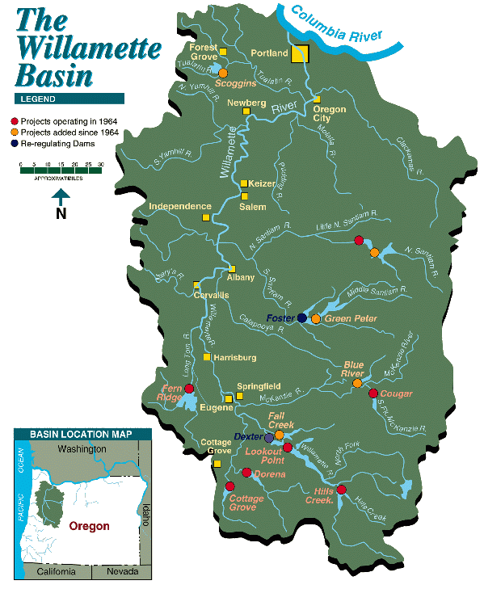
Detroit Dam
Built in 1953
463 ft tall
Uses/Functions:
Flood management
Hydropower (100MW capacity)
Water quality Improvement
Irrigation
Recreation
Fish and wildlife habitat
Big Cliff
Detroit
http://www.nwd-wc.usace.army.mil/nwp/teacup/willamette/

Slide 5
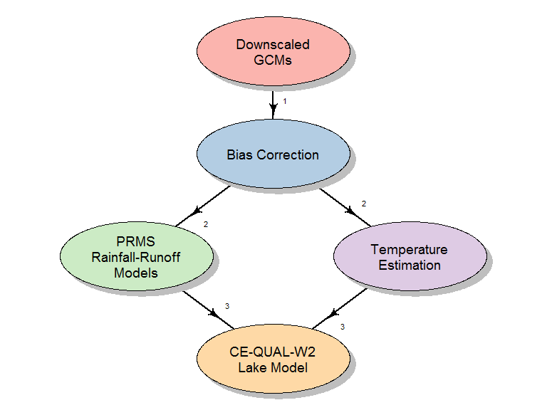
Model Flowpath
Notes:
Hostetler, S.W., Alder, J.R. and Allan, A.M., 2011

Slide 6
Water Quality Model: CE-QUAL-W2
Corps of Engineers model
Lakes, reservoirs, rivers, estuaries
2-D: longitudinal, vertical
Dynamic
Flow, temperature, water quality
DO phytoplankton zooplankton
ammonia phosphorus dissolved OM
nitrate detritus sediment OM
alkalinity pH suspended sediment
TDS chloride
Notes:
The model we used was CE-QUAL-W2, a Corps of Engineers model that is good for simulating dissolved oxygen, algae, and phosphorus in rivers and long narrow lakes.
The model represents the lake along two dimensions: along its length (longitudinal) and from top to bottom (vertical). In this way, material can be transported downstream, and any important water-quality variations with depth can be simulated.

Slide 7
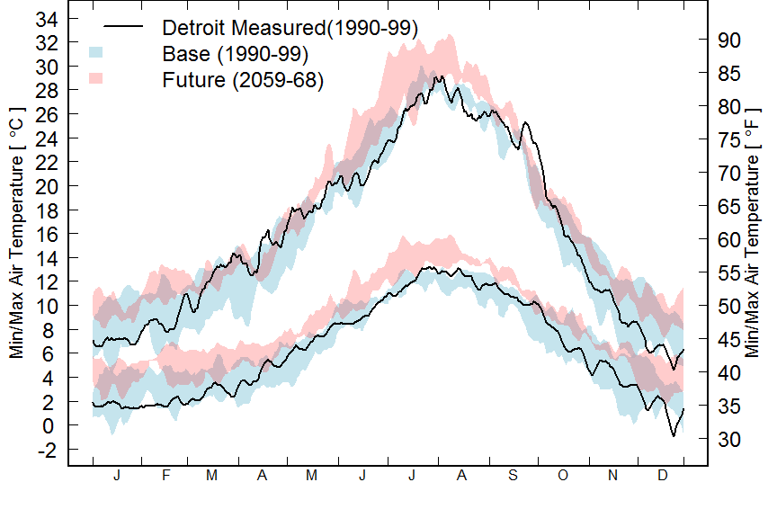
Air Temperature
Provisional data, subject to revision
Notes:
Detroit Lake Model
Stewart Rounds, USGS
Apr 5, 2007
Page 7
About a 2 deg C warming from base to future period

Slide 8
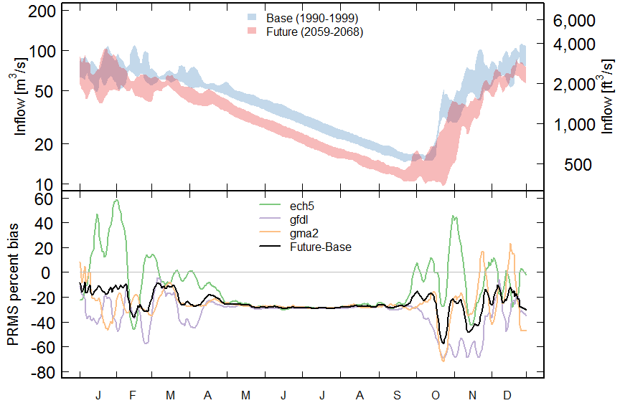
Detroit Inflows
PRMS percent change Inflow [m^{3/}/s]
Provisional data, subject to revision
Notes:
Detroit Lake Model
Stewart Rounds, USGS
Apr 5, 2007
Page 8
About a 23% reduction in inflow from base to future

Slide 9
Operational Scenarios
curmins – Current operating rules*
curmins_rc30 – Begin refill on Jan 1
lowmins – Lower release rates
*lower release rates in drought years
Structural Scenarios
curmins_fl – curmins with a hypothetical floating release outlet
Notes:
Detroit Lake Model
Stewart Rounds, USGS
Apr 5, 2007
Page 9

Slide 10
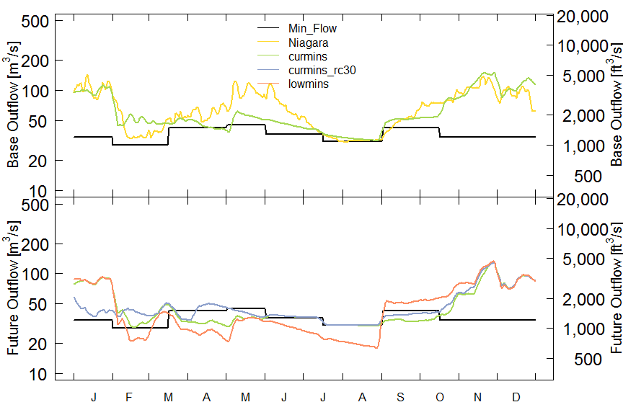
Detroit Outflows
Provisional data, subject to revision
Notes:
Detroit Lake Model
Stewart Rounds, USGS
Apr 5, 2007
Page 10

Slide 11
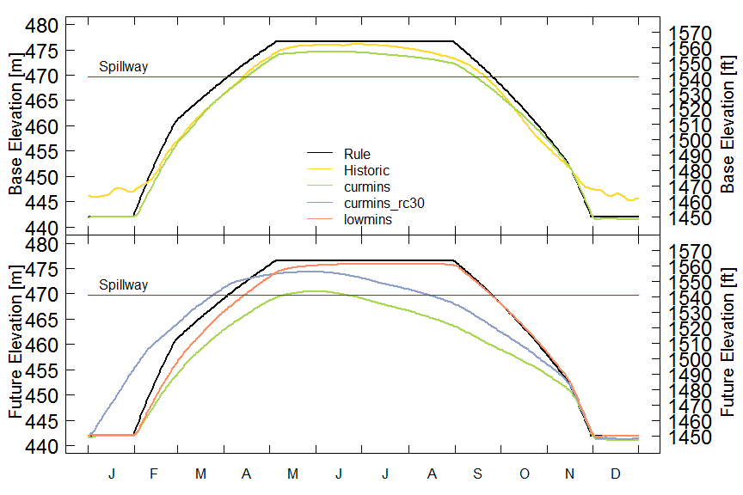
Detroit Lake Elevation Change
Provisional data, subject to revision
Notes:
Detroit Lake Model
Stewart Rounds, USGS
Apr 5, 2007
Page 11

Slide 12
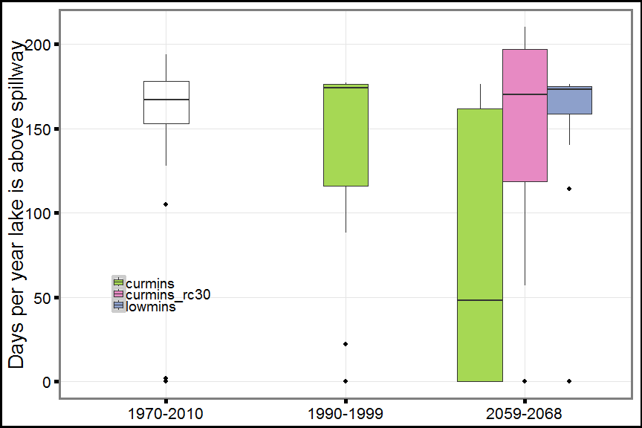
Number of Days Above Spillway
Altered operations needed to fill reservoir more often and keep full longer
Provisional data, subject to revision
Notes:
Detroit Lake Model
Stewart Rounds, USGS
Apr 5, 2007
Page 12

Slide 13
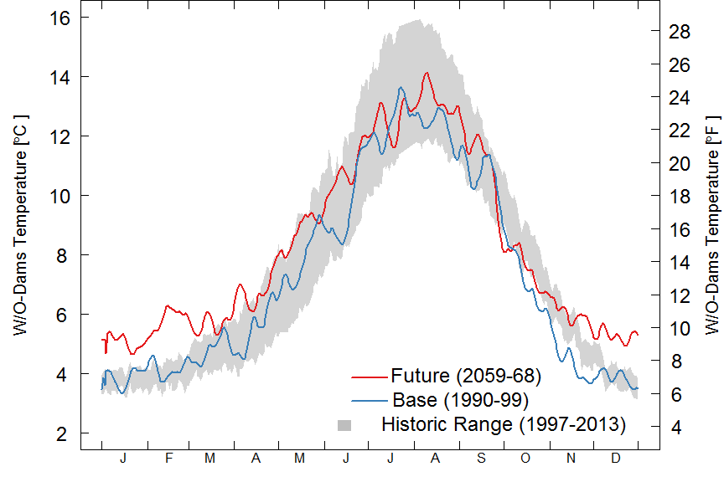
Detroit Inflow Temp
Provisional data, subject to revision
Notes:
Detroit Lake Model
Stewart Rounds, USGS
Apr 5, 2007
Page 13

Slide 14
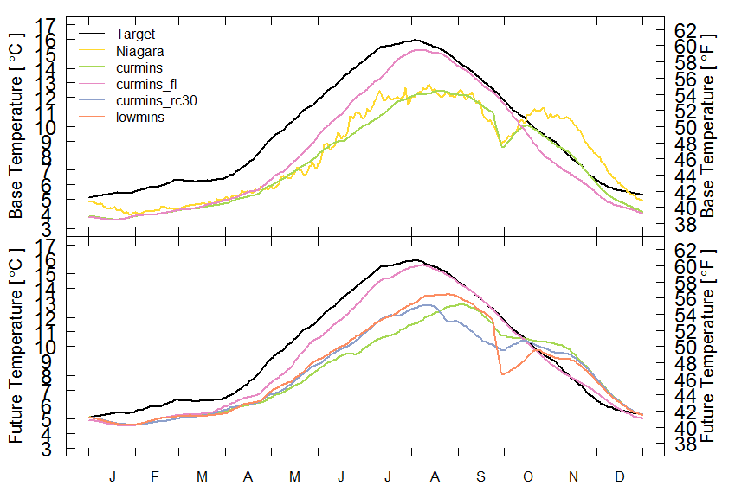
Detroit Release Temperature
Provisional data, subject to revision
Notes:
Detroit Lake Model
Stewart Rounds, USGS
Apr 5, 2007
Page 14

Slide 15
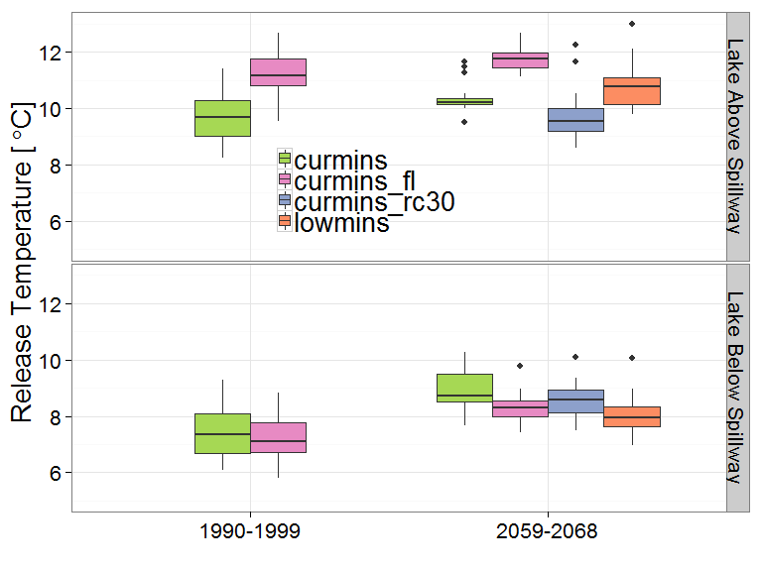
Detroit Release Temperature
Provisional data, subject to revision
Notes:
Detroit Lake Model
Stewart Rounds, USGS
Apr 5, 2007
Page 15

Slide 16
Future Impacts
Upstream
23% reduction in annual inflow
1°C increase in mean annual inflow temp
Downstream ~1.5°C warming in fall*
*using current operational rules
Potential Future Temperature Mitigations
Begin refill earlier
Reduce minimum late-summer releases
Hypothetical floating release structure
Provisional data, subject to revision

Slide 17
Impacts of Climate Change
(Lower+warmer inflows in spring/summer)
Operational trade-offs more visible
Flood management (spring)
Flow augmentation (summer)
Hydropower (summer/fall)
Lake Elevation
Recreation
Temperature control
Notes:
Detroit Lake Model
Stewart Rounds, USGS
Apr 5, 2007
Page 17

Slide 18
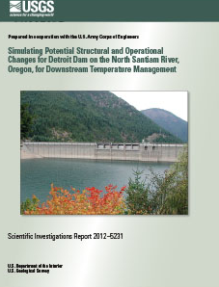
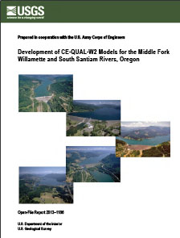

Thanks! Publications to date
Simulating Potential Structural and Operational Changes for Detroit Dam on the North Santiam River, Oregon, for Downstream Temperature Management
Buccola, N.L., and Rounds, S.A., 2011, Sullivan, A.B., Risley, J.C., 2012
http://pubs.usgs.gov/sir/2012/5231/
Development of CE-QUAL-W2 models for the Middle Fork Willamette and South Santiam Rivers, Oregon
Buccola, N.L., Stonewall, A.J., Sullivan, A.B., Kim, Yoonhee, and Rounds, S.A., 2013
http://pubs.usgs.gov/of/2013/1186
Simulations of a Hypothetical Temperature Control Structure at Detroit Dam on the North Santiam River, Oregon
Buccola, N.L., Stonewall, A.J., and Rounds, S.A., in press
Simulating Future Water Temperature in the North Santiam River, Oregon
Buccola, N.L., Risley, J.C., and Rounds, S.A., draft
Contact:
Norman Buccola - nbuccola@usgs.gov 503-235-3245
John Risley – jrisley@usgs.gov 503-251-3279
Stewart Rounds - sarounds@usgs.gov 503-235-3280
Acknowledgements:
USACE Portland District: Kathryn Tackley and Dan Turner
Notes:
If there’s anyone out there interested in developing this kind of project, don’t hesitate to call. We’re available to chat.

