Slide 1


Considering Genetics in Salmon Restoration: Insights from Functional Genes
Melissa Evans, Sam Shry, Nick Sard, Dave Jacobson,
& Kathleen O’Malley
Fisheries Genetics Lab, Oregon State University
Notes:
Hello everyone and thank you for sticking around for the final talk of the symposium. Again, my name is Melissa Evans and I am a researcher at Hatfield Marine Sciences Center where I work with the Fisheries Genetic group. Our work is priomarily focused on monitoring the demographic viability of salmon reintroductions above dams using genetic estimates of fitness for reintroduced salmon.
However, we are also taking advantage of the extensive number of samples that have been collected over the years from reintroduced individuals to examine patterns of genetic diversity within restored populations.
As Nick discussed yesterday, genetics tools can be used in a comparable way to ecological monitoring and can be harnessed to provide insight into the ability of populations to adapt to novel or changing environments. This is obviously relevant which is relevant in reintroduction/restoration contexts and the long-term potential for these projects to restore self-sustaining populations.
Today I am going to talk about some of the work we have initiated looking at functional gene diversity in reintroduced Chinook salmon from the South Fork McKenzie and South Santiam Rivers.

Slide 2
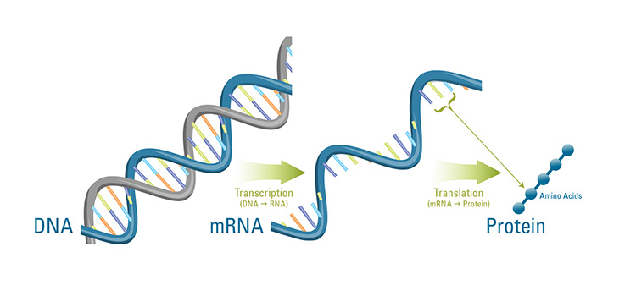
Functional genes influence phenotype
Notes:
So, you may be wondering what “functional” genes are and why they are important.
Functional genes are regions of DNA that are actually transcribed into RNA and eventually translated into proteins. You probably learned about this in high school biology. Not all DNA is “functional” – for instance, most of the markers we use in our pedigree work are likely non-functional, part of the reason they have accumulated so many variants (i.e. not influenced by selection).
Functional genes are of interest to researchers because they influence phenotype, or the traits that we see in organisms, e.g. such as skin, hair or eye colour.

Slide 3
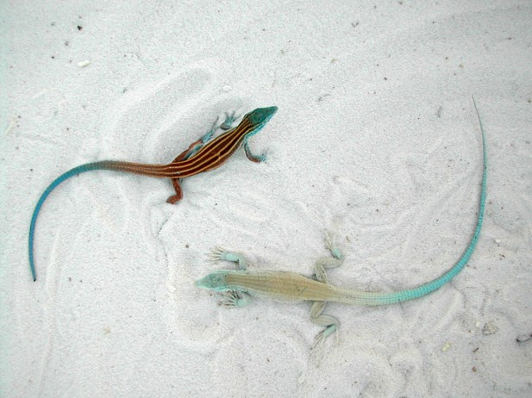
Functional genes influence phenotype
and fitness!
Notes:
Because functional genes influence phenotype, they play important roles in individual fitness, which is defined as an individual’s ability to survive and reproduce
A nice example of this is found in lizard species from the White Sands of New Mexico. These species exhibit a “white” skin phenotype that has diverged from the ancestral brown colouration, shown here on the upper left of the picture, found in populations that reside surrounding the white sands. The white sands lizards have lost the ability to accumulate melanin in their skin cells, which leads to this white/blanched coloration.
Research has shown that this pronounced phenotypic change can be attributed to a mutation at one gene, called MC1R, which is involved in the accumulation of melanin in melanocytes. This mutation would have evolved randomly in the genome of the lizards and then, over time, increased in frequency due to natural selection, likely driven by the survival advantage these white lizards experience in the white sands environment.
This is a classic example of genetic adaptation to a novel environment.

Slide 4
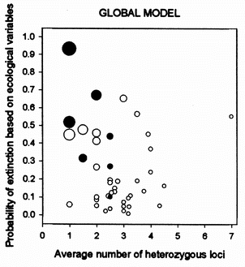
Adaptation and genetic diversity
Adaptation is a mechanism of persistence in the face of novel or changing environments
Genetic diversity underlies adaptation and population persistence
Adaptation important for the long term success of population restoration efforts
P (EXTINCTION)
DIVERSITY
Saccheri et el. 1998, Nature
Notes:
Processes like we have observed in the White Sands lizards demonstrate how adaptation is a mechanism of persistence in the face of novel or changing environments
Genetic diversity underlying functional traits, such as skin colour, facilitates adaptation when environments change. The abilities of organisms to adapt is a particularly relevant issue for the persistence of wild populations as the climate changes and globally, organisms are faced with changing conditions. On the right of the slide here you can see observed changes in average surface temperature across the globe, showing that essentially all regions of the planet are facing the effects of climate change.
Moreover, one can imagine how adaptation and the genetic diversity associated with functional traits can be critical to the long-term success of population restoration efforts.

Slide 5
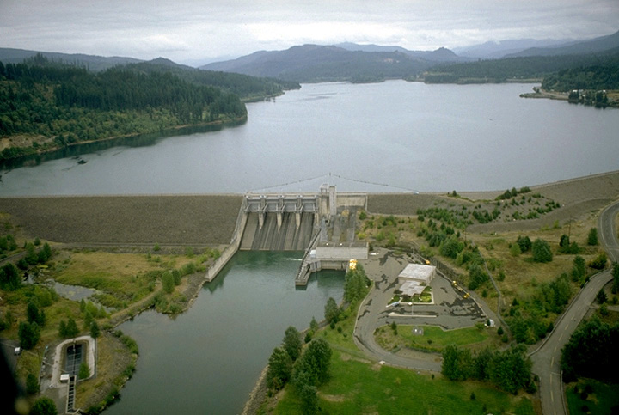
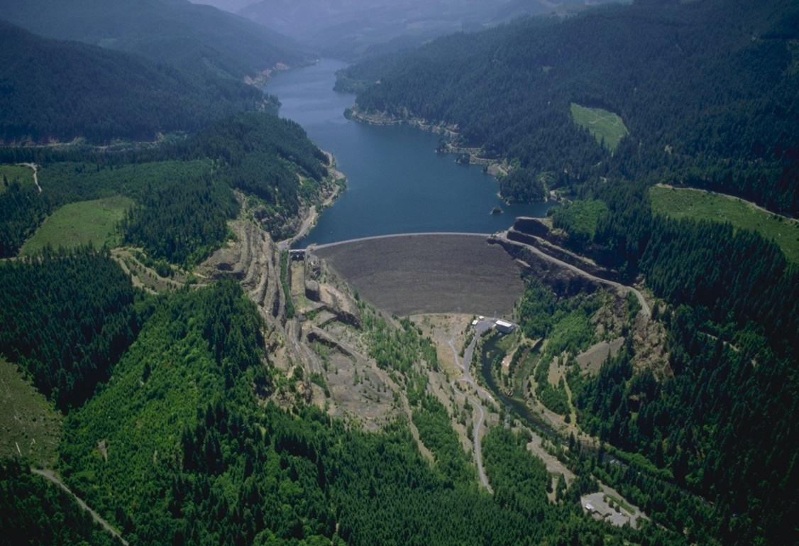
Genetic monitoring of Chinook salmon reintroductions
Contemporary demographic processes
  Pedigree-based estimates of reproductive success
  Population productivity
Prospective assessment of adaptive potential
  Diversity of genes linked to migration timing
  Immune gene diversity
Notes:
I our lab we have been working in collaboration with the Army Corps of engineers to use genetic monitoring of demographic processes in Chinook salmon populations that are currently undergoing restoration to historical habitats located above dams.
As outlined in my previous talk today, we use genetic methods to reconstruct pedigrees, or relationships among individuals in a population. The pedigree are then used to identify the offspring of salmon that have been reintroduced above Foster and Cougar dams, in previous years. These parent-offspring assignments provide insight into the fitness/reproductive success of reintroduced salmon and also enable us to estimate the overall contribution of the reintroduction program to wild adult recruitment back to the system.
As I mentioned at the beginning of the talk, we are taking advantage of this large database of genetic samples collected from reintroduced salmon over the years to examine genetic diversity within reintroduced populations.
We have recently initiated work looking at genetic diversity associated with functional traits which should provide insight into the ability of these populations to adapt to stochastic environments.
One of the projects I will talk about today is examining genes associated with migration timing
We are also investigating genetic diversity associated with immunity

Slide 6
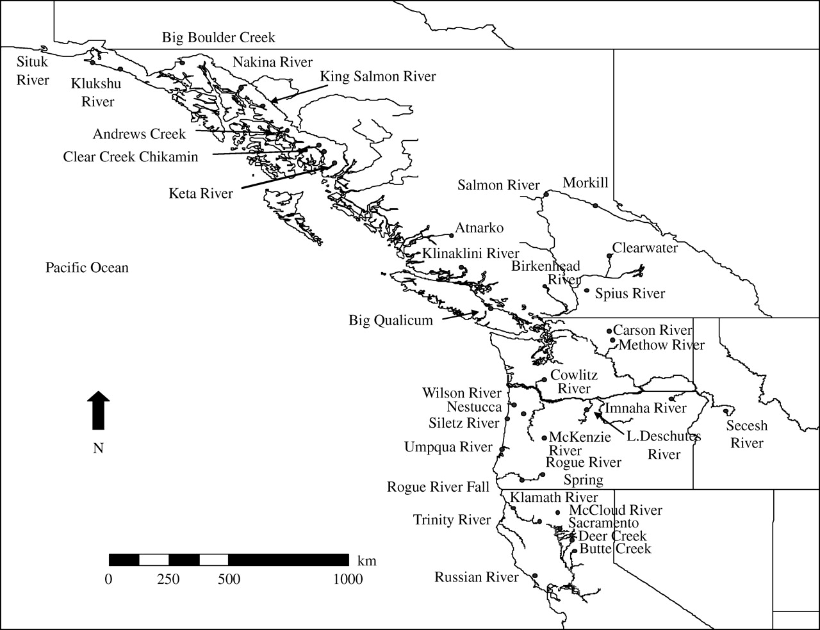
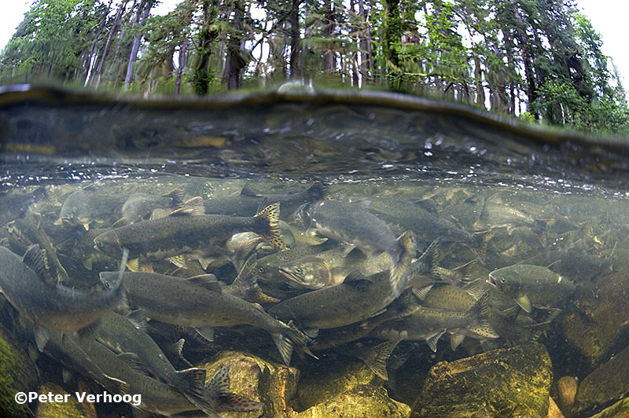

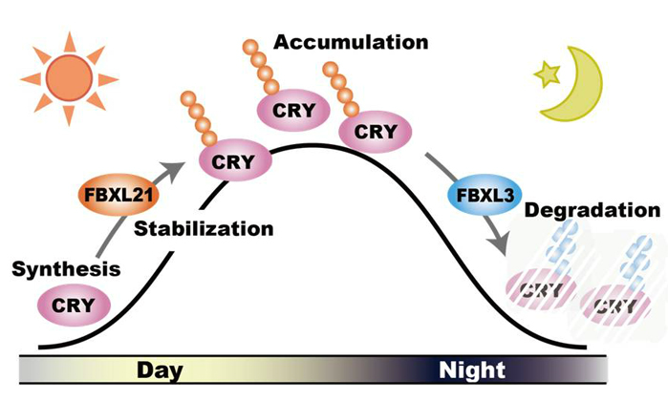
Reproductive timing in Chinook salmon
Circadian Rhythm Mechanism
Earlier
Later
O’Malley and Banks 2008, Proc. B
Notes:
Migration timing to the spawning grounds is highly variable both within and across populations and species of salmonids. For instance, across the eastern Pacific range of Chinook salmon migration timing to the spawning grounds tends to begin earlier in northern compared to southern populations.
However there is also variation within populations, as is seen in spring Chinook salmon from the Willametter basin, wherein salmon begin arriving to the spawning grounds as early as May and continue to arrive through to October.
This variation, is to some extent, likely driven by differences in the genetics of individuals and populations. For instance, research has shown that migration timing is heritable, meaning that offspring migration timing resembles that of its parents.

Slide 7
Circadian clock mechanism and salmon migration
Regulates timing of internal biological processes
  e.g. sleep-wake cycle
Responds to light-dark cycle (photoperiod)
Allows organisms to predict and prepare for environmental change
  Daily
  Seasonally
Notes:
Several studies conducted in our lab have demonstrated links between migration timing and candidate gene that code for the circadian clock.
The circadian clock regulates the timing of internal; biological processes such as an organisms physiology, i.e. when to sleep or wake.
This clock responds to light-dark cycles (photoperiod).
Photoperiod provides a cue of environmental changes, both daily, in terms of day and night, but also seasonally, because photoperiod changes with season.
Thus, the circadian clock has been hypothesized to be a mechanisms that salmonids and other organsims may use to accurately hone migration timing to optimal environmental conditions for their and their offspring’s survival.

Slide 8
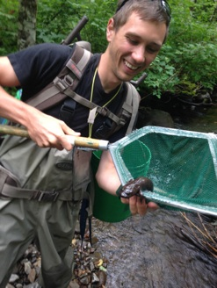

Arrival time to spawning grounds and circadian genes in reintroduced Chinook salmon
Sam Shry, U. Arkansas, 2014 NSF-funded summer student at HMSC
Notes:
During the summer of 2014, we hosted an undergraduate student from the University of Arkansas, Sam Shry, to work on a project examining genes of the circadian clock in reintroduced spring Chinook salmon from the South Santiam and SF McKenzie rivers.
Sam and his project was funded by the National Science Foundation’s Research Experience for undergraduates program.

Slide 9
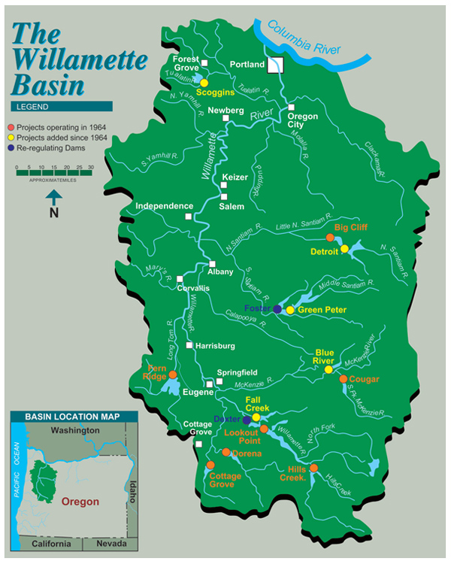
Circadian genes in reintroduced salmon
Genotyped reintroduced spring Chinook salmon at two genes: OtsClock1b and OmyFbxw11
Salmon from South Santiam and South Fork McKenzie rivers
90 NOR salmon genotyped in each of 2012 and 2013 (total N = 360)
Random sampling of salmon that arrived to trap-and-haul facilities May-October of each year
Notes:
Sam genotyped reintroduced salmon at two genes with known links to the circadian clock mechanism, called OtsClock 1b and OmyFbxw11. Both genes are associated with production of proteins that are involved in the regulation of the circadian clock.
We genotyped 90 salmon that were reintroduced above Foster Dam and Cougar Dam in each of 2012-2013. We randomly selected salmon returning to each trap facility between May-October, and so have an estimate of arrival time to the spawning grounds per individual as well.

Slide 10
Circadian genes in reintroduced salmon
Gene | Allele (bp) | Santiam 2012 | Santiam 2013 | McKenzie 2012 | McKenzie 2013
OtsClock1b | 293 | - | - | 0.017 | 0.017
 | 329 | - | 0.006 | - | -
 | 335 | 0.399 | 0.528 | 0.611 | 0.506
 | 338 | - | 0.011 | - | -
 | 359 | 0.601 | 0.456 | 0.372 | 0.478
OmyFbxw11 | 168 | - | - | 0.006 | -
 | 174 | 0.067 | 0.069 | 0.067 | 0.028
 | 176 | 0.872 | 0.897 | 0.861 | 0.972
 | 178 | 0.061 | 0.034 | 0.067 | -
Evans et al. (submitted), Cons. Genet.
Notes:
Overall, Sam observed a total of five alleles (genetic variants) at the Otsclock 1b gene and four alleles at the Omyfbxw11 gene.
This table shows the frequency of each of the alleles broken down by population and year of study.
You can seen for instance, that Clock1b alleles 335 and 359 were the most frequent, representing about 40% and 60% of alleles observed for instance in South Santiam salmon in 2012.
Allele 176 was most common in all four populations in all years at OmyFbxw11

Slide 11
Circadian genes in reintroduced salmon
Gene | Allele (bp) | Santiam 2012 | Santiam 2013 | McKenzie 2012 | McKenzie 2013
OtsClock1b | 293 | - | - | 0.017 | 0.017
 | 329 | - | 0.006 | - | -
 | 335 | 0.399 | 0.528 | 0.611 | 0.506
 | 338 | - | 0.011 | - | -
 | 359 | 0.601 | 0.456 | 0.372 | 0.478
OmyFbxw11 | 168 | - | - | 0.006 | -
 | 174 | 0.067 | 0.069 | 0.067 | 0.028
 | 176 | 0.872 | 0.897 | 0.861 | 0.972
 | 178 | 0.061 | 0.034 | 0.067 | -
Study of 42 Chinook salmon populations in North America found similar levels of diversity at OtsClock1b; typically 2 common and 1-2 rare alleles (O’Malley and Banks 2008, Proc. B)
Evans et al. (submitted), Cons. Genet.
Notes:
At OtsClock1b, these levels of diversity are similar to what has been observed in a previous study of 42 Chinook salmon populations in North America, wherein 2 common alleles are typically found along with 1-2 rare alleles.
This comparative approach suggests that genetic diversity at circadian-associated genes has likely been maintained through the use of captive-rearing programs and reintroduction operations over time.
We can’t say for certain whether these patterns reflect levels of historical diversity present pre-dam, because we don’t currently have historical samples. We would be interested to know however, if any of you are aware of scale samples that may have been collected in the past.

Slide 12
Circadian genes in reintroduced salmon
Gene | Allele (bp) | Santiam 2012 | Santiam 2013 | McKenzie 2012 | McKenzie 2013
OtsClock1b | 293 | - | - | 0.017 | 0.017
 | 329 | - | 0.006 | - | -
 | 335 | 0.399 | 0.528 | 0.611 | 0.506
 | 338 | - | 0.011 | - | -
 | 359 | 0.601 | 0.456 | 0.372 | 0.478
OmyFbxw11 | 168 | - | - | 0.006 | -
 | 174 | 0.067 | 0.069 | 0.067 | 0.028
 | 176 | 0.872 | 0.897 | 0.861 | 0.972
 | 178 | 0.061 | 0.034 | 0.067 | -
Evans et al. (submitted), Cons. Genet.
Notes:
In addition to documenting allelic diversity, an important finding of this study was our observation of spatial and temporal structure to allele frequencies.
For instance, at both genes, we observed some alleles that were unique to either the South Fork McKEnzie or South Santiam population; e.g. allele 293 was unique to SF Mck, whereas alleles 329 and 338 were unique to South Santiam. Interestingly alleles 329 and 338 were only observed in South Santiam salmon in 2013, and not in 2012.
I think temporal variation in allele frequencies/diversity suggests that it is important to consider multiple years in reintroduction plans if we hope to capture all of the diversity likely to be present in the source/”donor” population.

Slide 13
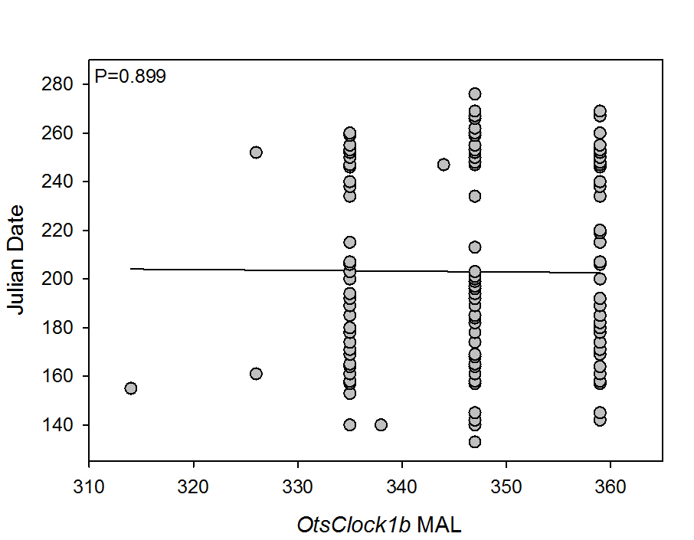
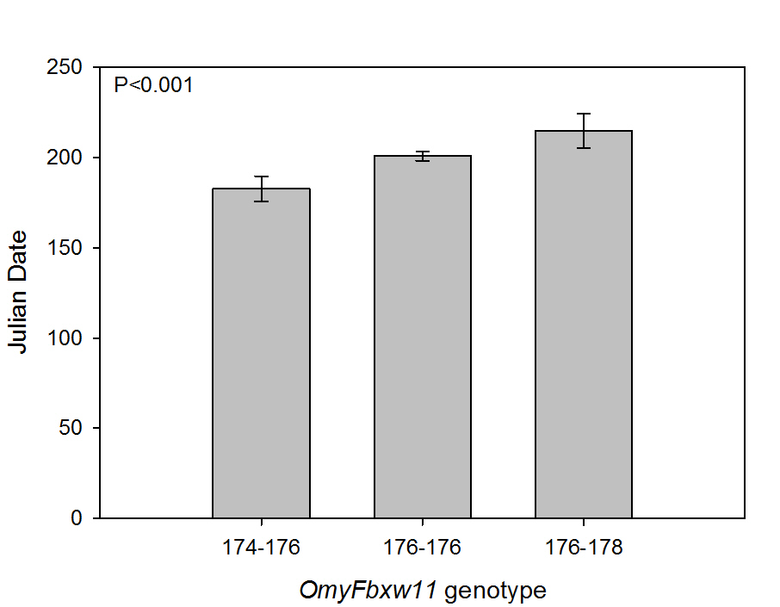
Genotype predictive of arrival time
Arrival time (Julian date)
Arrival time (Julian date)
Otsclock1b genotype
OmyFbxw11 genotype
Evans et al. (submitted), Cons. Genet.
Notes:
The trap-and transport facilities provided us with a really unique opportunity to link the genetic variation we observed within individuals at these circadian clock associated genes to a putative function, that is its influence on timing of arrival to the spawning grounds.
The figure on the left shows Otsclock1b mean allele length of all genotyped individuals plotted against return date, shown here as Julian date during the year on the y axis. For those of you interested, we calculated mean allele length here because the location of the Otsclock1b in the genome as an individual’s alleles are predicted to have an additive effect directly related to length of allele on migratory phenotype. Howeverm as you can see that there was no relationship between allele length at this genes and return time.
In contrast, we saw that genotype at the OmyFbxw11 genes was significantly predictive of return time. Specifically, salmon of genotype 176-178 returned significantly later than salmon of genotype 174-176, or 176-176. This finding indicates that genetic variation at OmyFbxw11 is likely functional and plays a role in determining an individuals return time to the spawning grounds.
Importantly, the fact that there is genetic variation present underlying this trait suggests that salmon will be able to adapt to environmental change that favors indivdiausl that return later or earlier during the spawning migration.

Slide 14
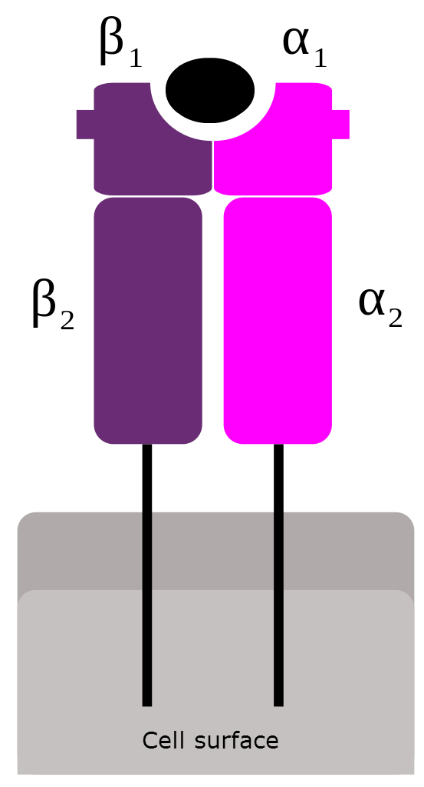
Major Histocompatibility Complex (MHC)
MHC molecules recognize and ultimately initiate the immune response against infectious agents e.g. parasites
Highly diverse genes encode the PBR of MHC molecules
PBR diversity = increased ability to recognize parasites
Parasite-derived peptide
Peptide binding region (PBR)
Notes:
We are also examining diversity at a gene that codes for part of the major histocompatibility complex (MHC). MHC are molecules that recognize and initiate the immune response against infectious agents.
The portion of the MHC molecule that is of particular interest to researchers is the peptide-binding region. This is the part of the molecule that directly interacts with parasites infecting the host and presents that parasite to t-cells, which will then mount the immune response against the infection.
Highly diverse genes encode for this PBR and importantly this diversity has been repeatedly linked to increased ability to recognize a diverse complement of infectious agents.
So, the MHC directly influences the fitness of individuals.
Given this known function, you can imagine that diversity at the MHC may be important to reintroduced salmon persisting in the face of novel above-dam environments, such as the increased copepod infestations that have been documented by Fred Monzyk.

Slide 15
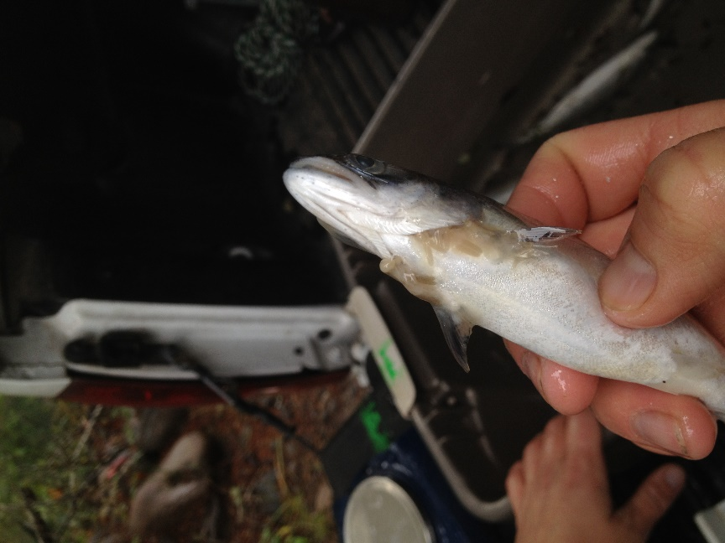
Major Histocompatibility Complex (MHC)
MHC molecules recognize and ultimately initiate the immune response against infectious agents e.g. parasites
Highly diverse genes encode the PBR of MHC molecules
PBR diversity = increased ability to recognize parasites
Parasite-derived peptide
Peptide binding region (PBR)
Notes:
Given this known function, you can imagine that diversity at the MHC may be important to reintroduced salmon persisting in the face of novel above-dam environments, such as the increased copepod infestations that have been documented by Fred Monzyk.

Slide 16
MHC immunity gene
Peptide binding region (PBR)
“Next generation” sequencing of MHC PBR gene in reintroduced salmon, South Santiam River 2008 & 2009
Currently working with 15GB DNA sequence data
MHC genetic diversity and links to fitness
Notes:
We are using an approach called next-generation sequencing to examined diversity at genes that code for the MHC PBR. We are looking at this diversity in salmon reintroduced above Foster dam during 2008 and 2009.

Slide 17
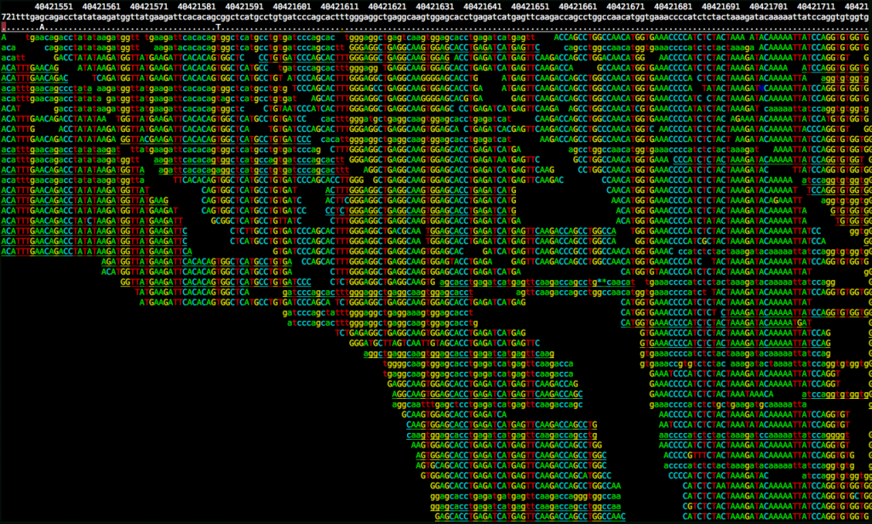
MHC immunity genes
Peptide binding region (PBR)
“Next generation” sequencing of MHC PBR gene in reintroduced salmon, South Santiam River 2008 & 2009
Currently working with 15GB DNA sequence data
MHC genetic diversity and links to fitness
Notes:
The analyses are still in progress as we have over 15GB of sequence data.
This is an example of what those data look like. We have thousands of “reads” i.e. pieces of sequence data from each individual, and we are developing methods of assembling those reads together to determine genotype.
Once all individual genotypes are determined we’ll be able to examine levels of diversity within the reintroduced populations and links to fitness estimates for the individuals, which have been derived from our pedigree work.

Slide 18
Summary and implications
Genetic diversity is required for adaptation
Reintroduced spring Chinook salmon are diverse at genes linked to migration timing
Reintroduced populations may be capable of an adaptive response to ecological shifts that alter relationships between migration timing and fitness
Immunity gene being examined for diversity and associations with fitness of reintroduced salmon
Notes:
Genetic diversity is required for adaptation
Reintroduced UWR spring Chinook salmon are diverse at genes linked to migration timing and we have documented a correlation between genotype at one of the examined genes, OmyFbxw11 and arrival time to the spawning grounds.
These findings suggest that the reintroduced population may be capable of an adaptive response to ecological shifts that alter relationships between migration timing and fitness.
Immunity genes are currently being examined for diversity and associations with fitness of reintroduced salmon. Our finding will also have implications for understanding whether an evolutionary response may be expected or occurring of these populations in response to novel parasites, such as those found during altered life hisotries spent in reservoirs.

Slide 19




Acknowledgements
Dave Griffiths and U.S. ACE
Cameron Sharpe, ODFW
ODFW hatchery and field staff
Banks and O’Malley labs, HMSC

