Slide 1
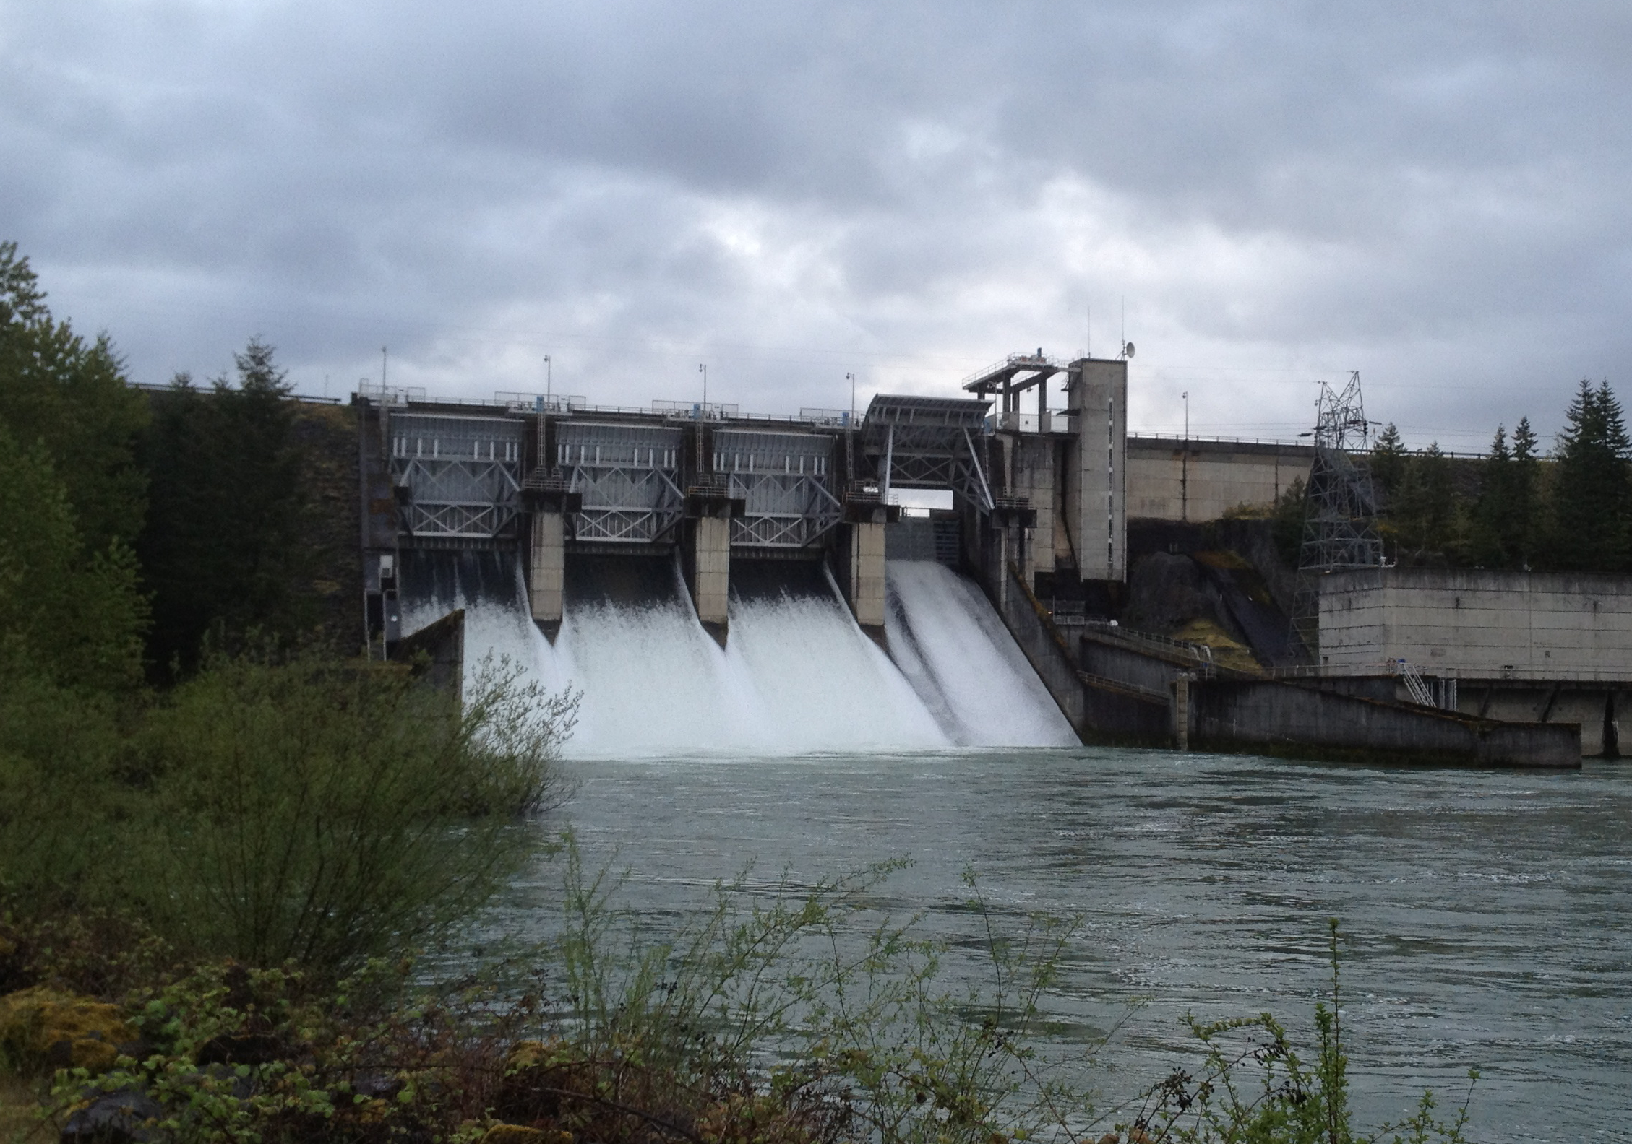
Hydroacoustic Evaluation of Juvenile Salmonid Passage and Distribution at Foster Dam, 2013-2014
Photo by J. Duncan
JH Hughes, J Kim, J Vazquez, and GE Johnson
Willamette Fisheries Science review
^{Portland, Oregon}
^{February 2015}
^{Study code: JPL–11-05-FOS}

Slide 2
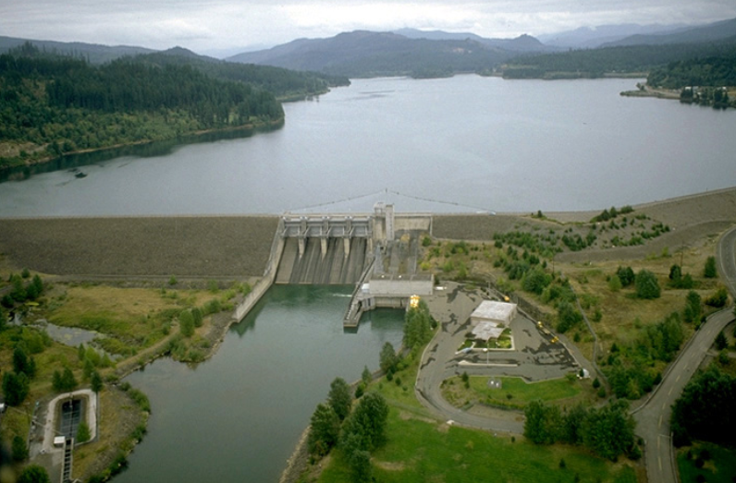




Presentation Outline
Methods
Results
Environmental/Operations
Juvenile-Sized Targets
Adult-Sized Targets
Summary
Management Implications
Results presented herein are from the year-long hydroacoustic evaluation of fish passage at Foster Dam in 2013 and 2014
Notes:
Draft data presented last WSR this is final results

Slide 3
Study Objectives
During the field sampling period at Foster (April 1, 2013 through May 31, 2014), the objectives of the hydroacoustic evaluation of fish passage for juvenile-size targets were as follows:
Estimate passage rates, run timing, and horizontal and diel distributions at the following routes:
Turbines
Spillway
Fish weir
Estimate route distribution and effectiveness for the spillway and fish weir.
Estimate vertical distribution in the forebay near the upstream dam face.
Determine if operating the fish weir decreases turbine passage.
Estimate passage rates, run timing, and distributions for adult-size targets (steelhead kelts) during spring 2013 and spring 2014.
Notes:
Verbally define “juvenile-sized” and “adult-sized” targets
Note that we’re reporting April 2013 thru May 2014 data.

Slide 4
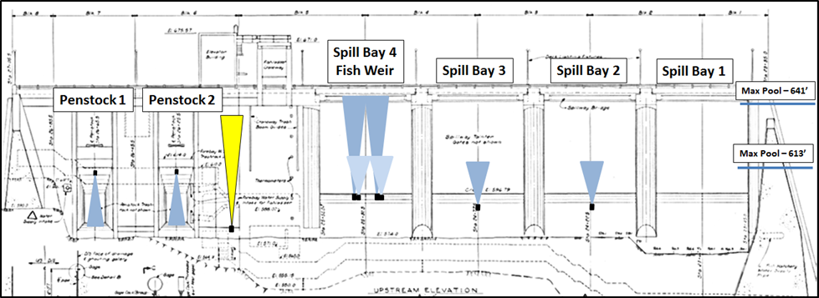
Methods
Fixed-aspect Hydroacoustics
Transducers were deployed to sample fish at penstock intakes, spill bays, vertical distribution, and the fish weir in Spill Bay 4
Notes:
View is upstream to downstream
State that I will explain more shortly about the two sets of xducers at Bay 4 fish weir.
Explain why no xducer at Bay 1.

Slide 5
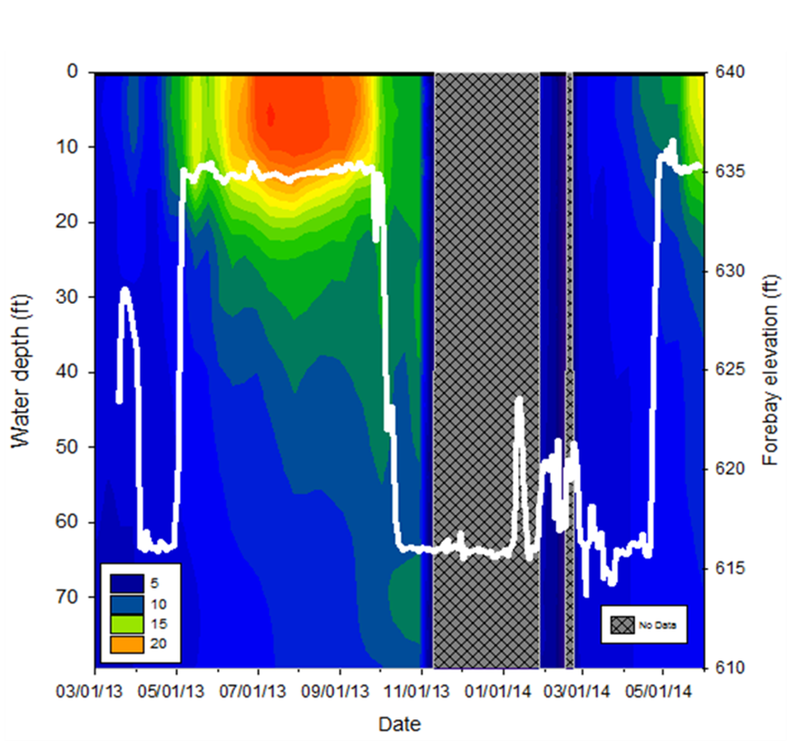
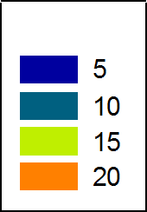
Results: Temperature and Forebay Elevation
Temp °C
Notes:
explain this slide thoroughly. Mention greyed out data
Walk through forebay elevation data by season.
Then note thermocline in summer and its depth.
Daily Average Surface Elevation (solid white line; right y axis) and Temperature (°C) of the Water Column (contour plot; left y axis) of the Forebay at Foster from April 1, 2013 through May 31, 2014. The five seasonal study periods are designated above the graph.

Slide 6
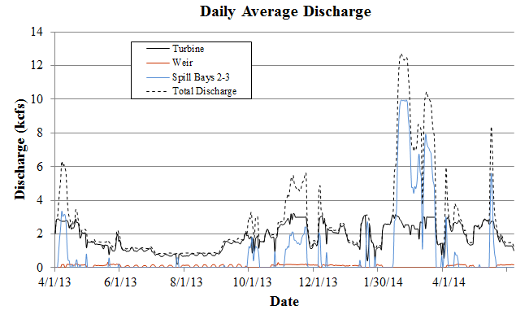
Dam Operations
Notes:
Start w/ explaining overall total project discharge through the study period.
Next, explain spill and why it happened when it did.
Then explain the weir op’s/, e.g., the bumps in summer.
Foster Daily Average Discharge from April 1, 2013 through May 31, 2014. Estimates of discharge over the weir were determined by assuming a linear relationship between forebay elevation and weir discharge.

Slide 7
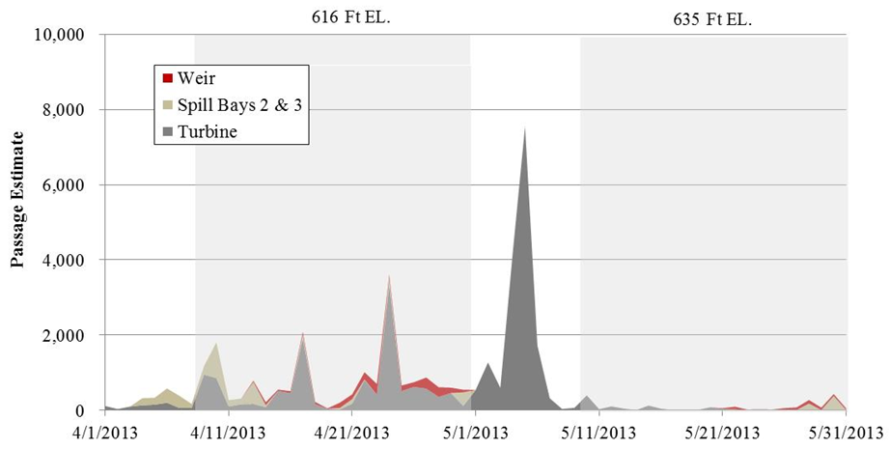
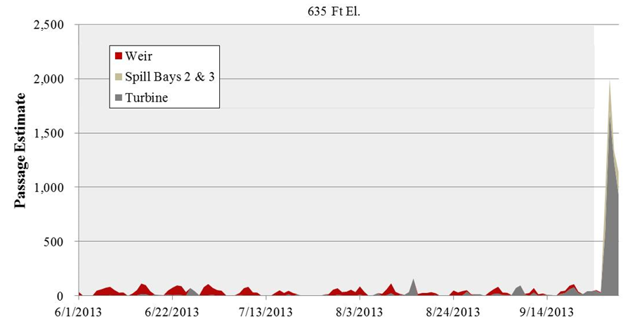
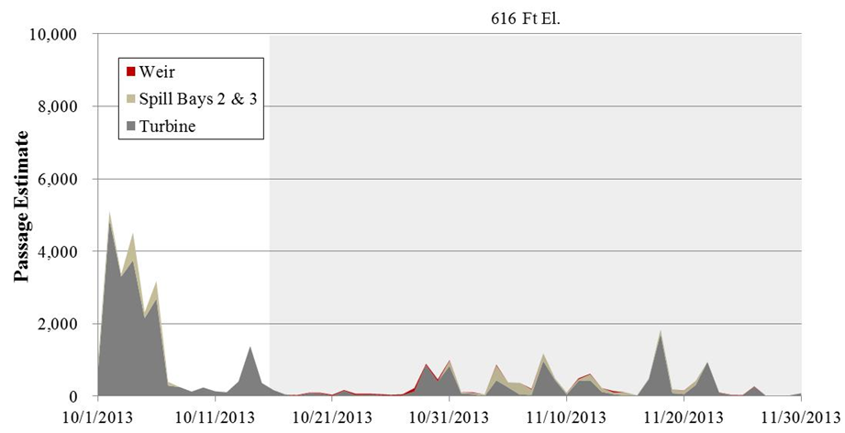
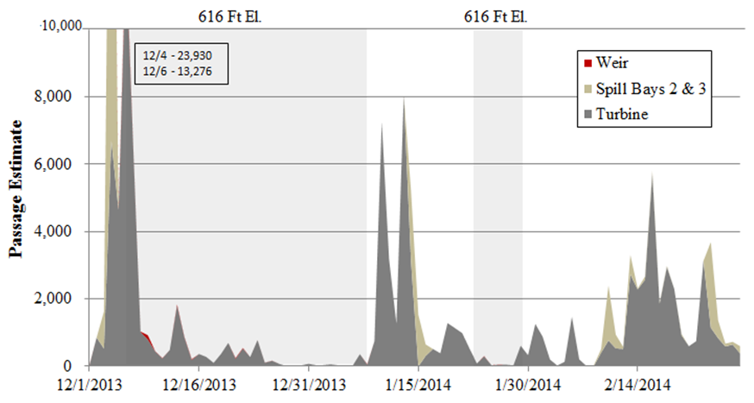
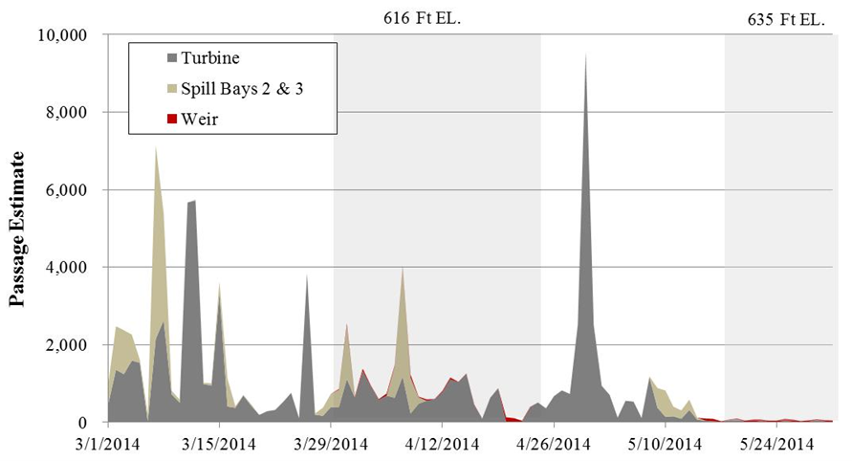
Results: Run Timing for Juvenile-Sized Fish Targets
Spring 2013
Summer 2013
Fall 2013
Winter 2013/14
Spring 2014
Notes:
Discuss fish weir operations in this slide dates that the weir was operated at which elevation, spend a lot of time on this slide

Slide 8
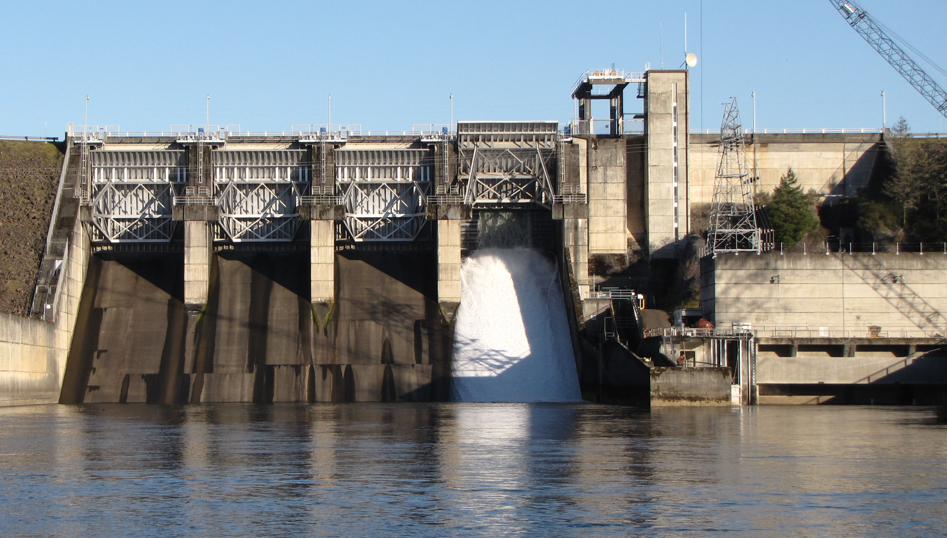
Horizontal Distribution for Juvenile-Sized Fish Targets
Turbines (concurrent operations)
Spill Bays
Unit 1: 220,173 ± 1,172
Unit 2: 27,395 ± 434
1
2
3
4
2
1
Spillway (concurrent operations)
Turbine
Units
Bay 2: 19,027 ± 577
Bay 3: 8,045 ± 430
Notes:
Turbines – Total fish passage by turbine unit during hours when both turbine units were operated simultaneously was skewed toward Unit 1. Unit 1 passed almost eight times as many fish as Unit 2 (89% and 11%, respectively). Each turbine unit was passing about the same amount of water and power generation was similar for both units.
Spillway -- Horizontal distribution of fish passage when both Spill Bays 2 and 3 were operated simultaneously (58 days) indicates Spill Bay 2 passed more than twice the number of fish; Spill Bay 2 − 70% passage proportion and Spill Bay 3 − 30%. Each bay passed about the same amount of water, because the gate openings were similar and each operated for the same amount of time.

Slide 9
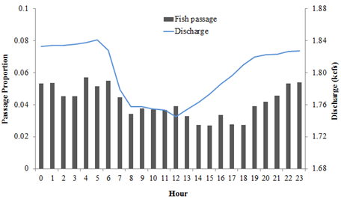
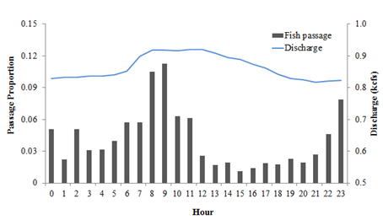
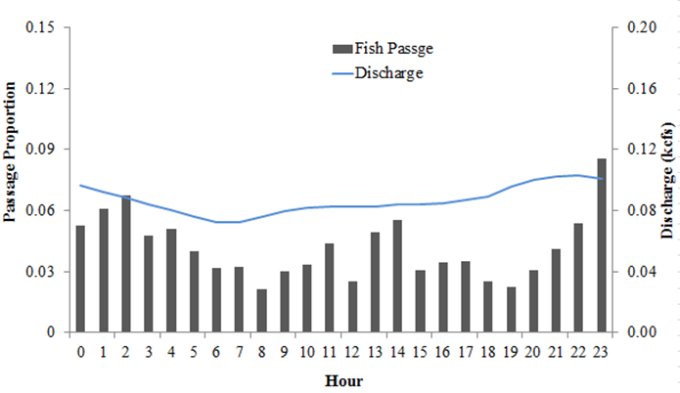
Diel Distribution for Juvenile-Sized Fish Targets
Turbines
Spillway
Fish Weir
Notes:
Turbines -- Diel distribution for juvenile-size targets for all seasons shows a distinct peak in passage between late afternoon and early morning with lower passage midday (Figure 3.9). Separate diel distributions by seasonal periods revealed similar trends of pulses in fish passage in late afternoon and early morning hrs (Figure 3.10).
Spillway -- Diel distribution for juvenile-size targets for all seasons during periods when the spillway (either Spill Bays 2 or 3 or both) was operated 24 h/d and fish passed via that route shows a distinct peak in passage between early morning and noon and lower passage during late afternoon and early evening (Figure 3.13). This peak in fish passage coincided with a peak in spillway discharge, although it was not as wide-ranging.

Slide 10
Route Distribution and Effectiveness for Juvenile-Sized Fish Targets
 | Spillway (Bays 1-3)
Season | Discharge Proportion | Passage Proportion | Effectiveness
Spring 2013 | 0.17 | 0.12 | 0.74
Summer | 0.04 | 0.10 | 2.28
Fall | 0.24 | 0.13 | 0.54
Winter | 0.44 | 0.21 | 0.47
Spring 2014 | 0.39 | 0.22 | 0.56
 | Fish Weir (Bay 4)
Passage Route | Elevation (ft) | Discharge Proportion | Passage Proportion | Effectiveness
Spring 2013 | 616 and 635 | 0.05 | 0.07 | 1.33
Summer | 635 | 0.06 | 0.30 | 4.86
Fall | 616 | 0.04 | 0.02 | 0.42
Winter | 616 | 0.02 | 0.00 | 0.29
Spring 2014 | 616 and 635 | 0.02 | 0.01 | 0.78

Slide 11
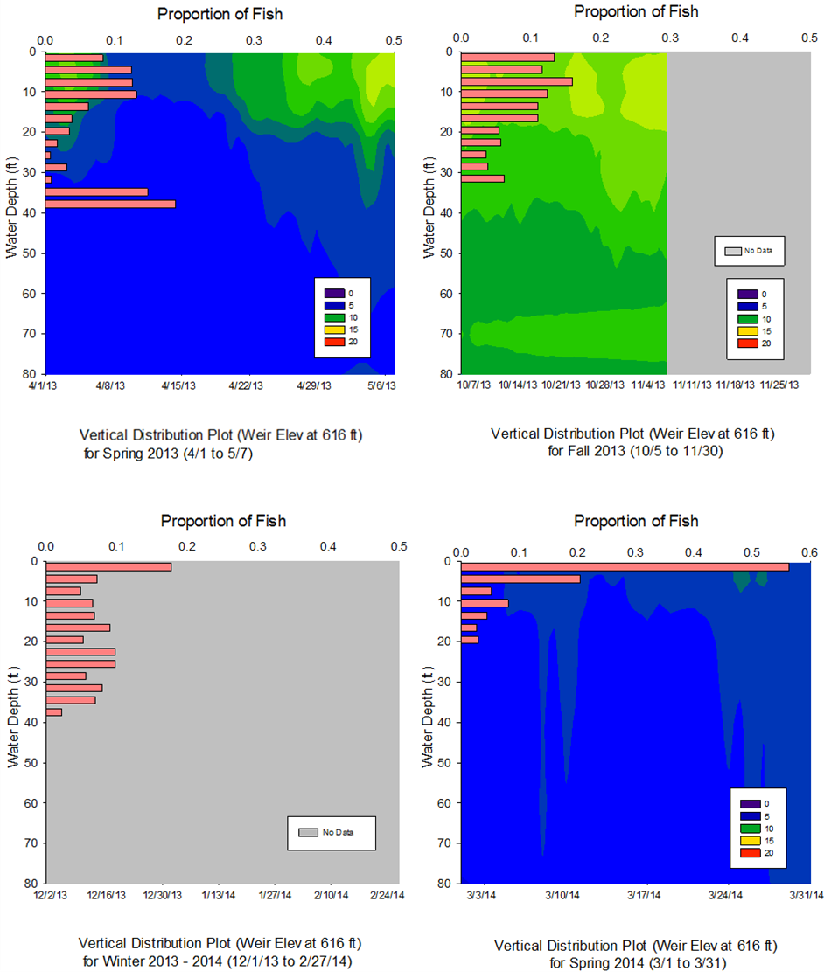
Vertical Distribution for Juvenile-Sized Fish Targets
Notes:
Explain season by season.
Bi-modal in spring 2014.
Temperature string is located .25 km upstream
Vertical Distribution of Juvenile-Size Targets and Forebay Water Temperature (ºC) at the Forebay Dam Face Presented Separately by the Four Distinct Pool Elevation Periods. Red bars represent fish distributions throughout all hours of the day. Gray areas indicate where data were not available. Water temperature data were obtained from the USACE Portland Office. No temperature data were logged deeper than 80 m. All vertical distributions depths are relative to the forebay elevation at the time of detection and therefore depths are standardized relative to the fluctuating forebay elevation.

Slide 12
Weir Operations On/Off Summer Test
The “T+W” treatment indicates operation of the turbine unit(s) with the weir open.
The “T” treatment indicates turbine only operation with the weir closed.
Treatments were conducted from June 3 through September 22, 2013, alternating the T+W and T treatments at 4-day intervals.
Treatment | Passage Route | Days Sampled | Total Passage (½ 95% CI)
T+W | Turbine | 56 | 571 ± 48
 | Weir | 56 | 2,869 ± 49
T | Turbine | 56 | 802 ± 64
 | Weir | NA | NA
No significant difference in turbine passage between the treatments (P = 0.93).
Under the T+W treatment, differences in turbine and weir passage rates were statistically significant (P < 0.001).
Notes:
A special weir test was conducted during summer 2013 to determine whether using the weir decreased turbine passage rates. Passage rates during the turbine plus weir (T+W) treatment, when both the turbines and weir were operated, indicated that 84% of all juvenile-size targets passing under these conditions did so via the weir; 571 ± 48 (95% CI) fish at the turbines vs 2,869 ± 49 (95% CI) fish at the weir (Table 3.8).

Slide 13
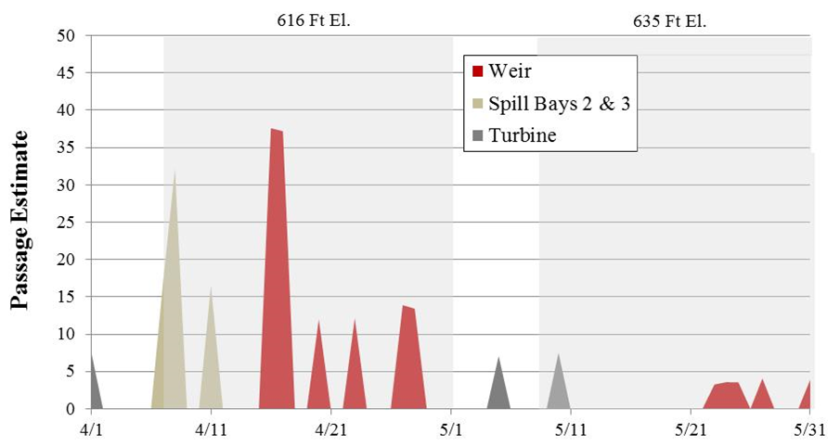
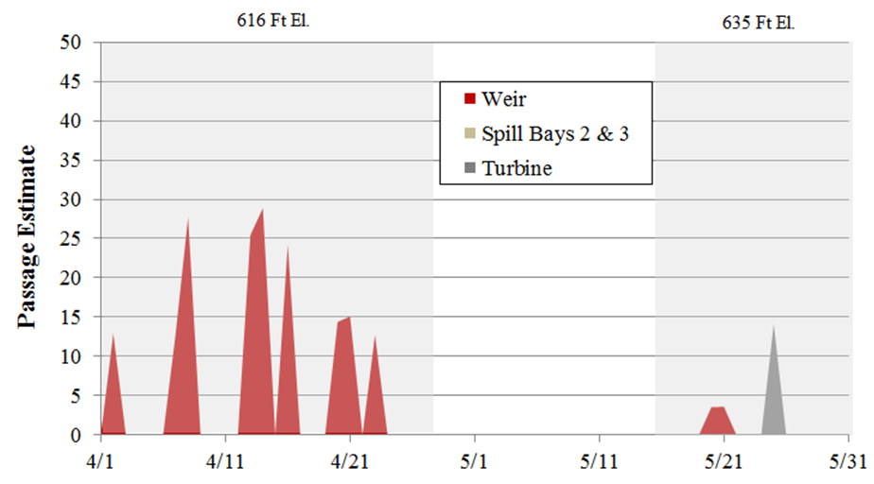
Passage Estimates for Kelt Sized Targets
Spring 2013 (April – May)
 | Passage Estimate (½ 95% CI)
Route | 2013 April 1–May 31 | 2014 March 29– May 31
Turbine Unit 1 | 8 ± 5 | 14 ± 7
Turbine Unit 2 | 15 ± 7 | 0
Spill Bays 2 & 3 | 66 ± 28 | 0
Weir 616 ft | 126 ± 50 | 174 ± 46
Weir 635 ft | 18 ± 6 | 7 ± 3
Total | 233 ± 96 | 195 ± 57
Spring 2014 (April – May)
 | Fish Weir
 | Discharge Proportion | Passage Proportion | Effectiveness
Spring 2013 | 0.05 | 0.62 | 11.57
Spring 2014 | 0.04 | 0.93 | 23.51
Notes:
Mention these are kelts

Slide 14
Summary of Findings – Juvenile-Sized Targets
Run timing -- Turbine passage rates for juvenile-size targets were highest during spring, fall, winter (low pool). Turbine passage was lowest during summer (high pool).
Vertical distribution at the face of the dam -- Varied by season.
Diel distribution -- In general, passage was highest during late evening and into the early morning hours; however, fish were passing at all times of the day.
Horizontal distribution (under concurrent operations) – Turbine Unit 1 passed the vast majority (10X) of fish when compared to Turbine Unit 2. Spill Bay 2 passed more fish (2X) than Spill Bay 3.
Route distribution -- Seasonal passage proportions (out of total project passage) were relatively low: spillway 0.10-0.22 and fish weir 0.005-0.30

Slide 15
Summary of Findings – Juvenile-Sized Targets
Cont’d
Passage effectiveness -- Seasonal spillway and weir effectiveness was usually less than one; however, compared to Turbine Units 1 and 2 the spillway and weir were more effective.
Summer Weir on/off test – Turbine passage rates did not differ whether the weir was open or closed. Weir passage rates were significantly higher than turbine rates.
Caveat -- Yellow perch biased hydroacoustic estimates upward when perch were prevalent in spring, fall, and winter.
Notes:
For bullet 2 state that fish held until weir was opening and not sounding to pass the turbines when weir was closed

Slide 16
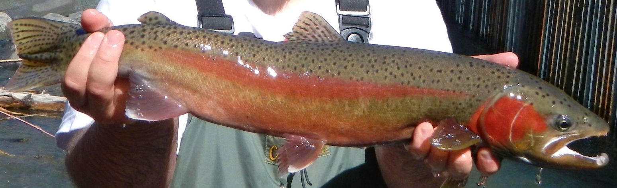
Summary of Findings -- Kelt-Sized Targets
An estimated 233 ± 96 (95% CI) kelt-sized acoustic targets passed Foster Dam in spring 2013.
The majority passed via the weir when at the low pool (616 ft) elevation (126 ± 50 [95% CI]) compared to the high pool (635 ft) elevation (18 ± 6 [95% CI]).
Similarly in spring 2014, 195 ± 57 (95% CI) passed with 174 ± 46 (95% CI) passing via the weir at the 616 ft elevation.

Slide 17
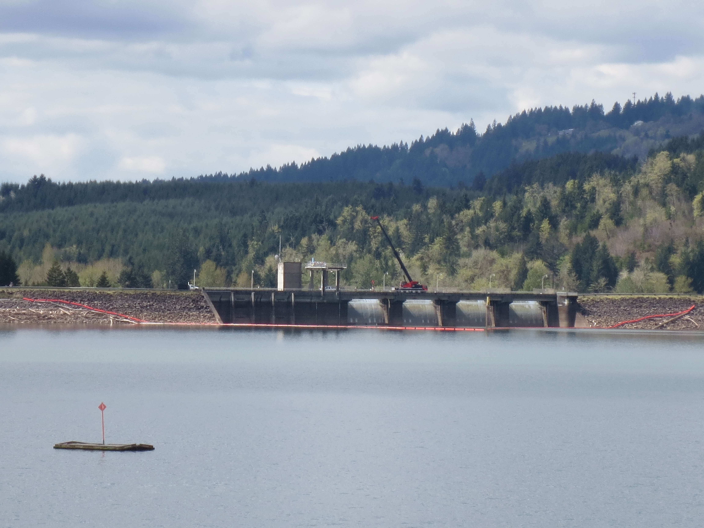
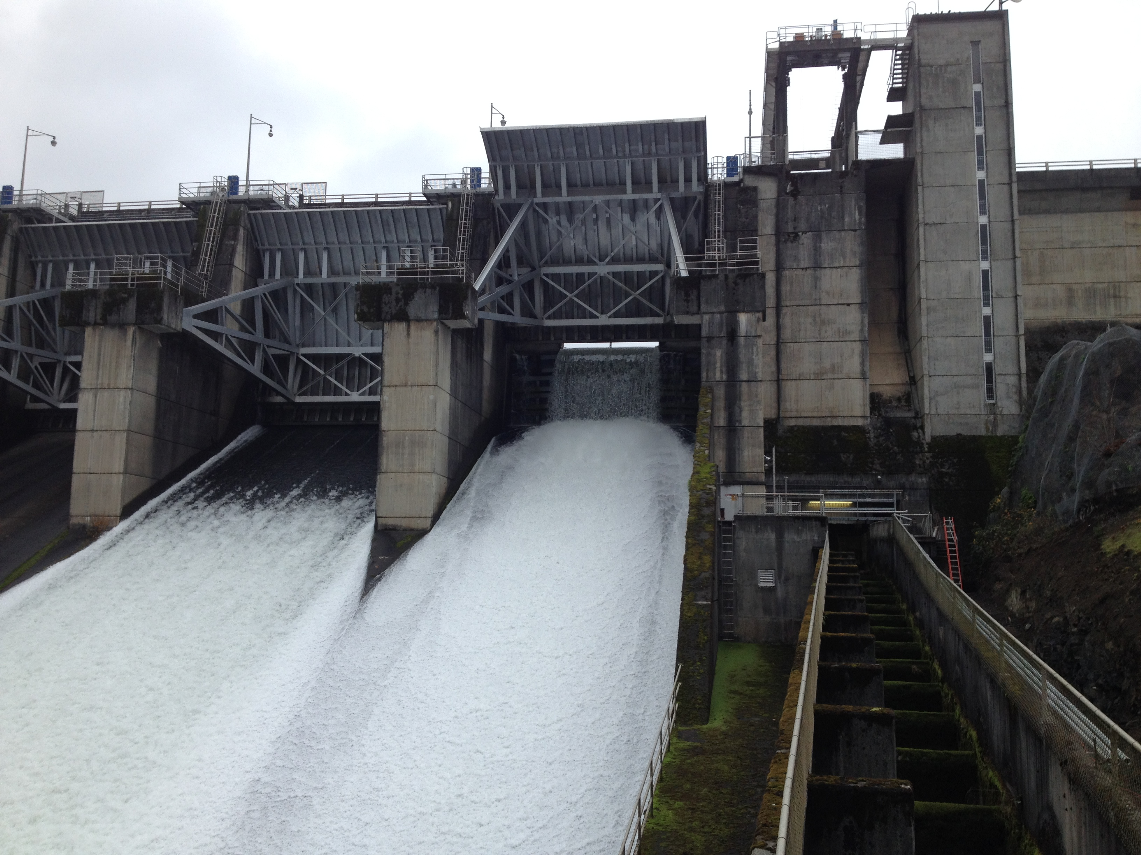
Management Implications
High proportions of juvenile-sized fish targets passing the turbine units in spring and fall (periods of low pool) indicate a need for further investigation of operational and/or structural modifications at Foster Dam to improve fish passage.
Low weir passage proportions indicate a need to consider approaches to increase weir discharge for this non-turbine route.
Passage rates at Spill Bays 2 and 3 indicate further research on operations at this route is warranted.
Notes:
Mention temperature string in lower left figure
State that we recommended an on/off test for spillway passage assessment for FOS RT

Slide 18


Acknowledgments
Army Corps of Engineers
Fenton Khan
David Griffith
Steve Gardner
Thomas Voldbaek
Greg Barrowcliff
Greg Taylor
Chad Helms
Doug Garletts
Foster control room operators,
Engineering and structural staff
PNNL
Mike Greiner
Eric Fischer
Bishes Rayamajhi
ODFW
Fred Monzyk
Brett Boyd
Cameron Sharpe
Jeremy Romer
18

Slide 19
Questions?

