Slide 1
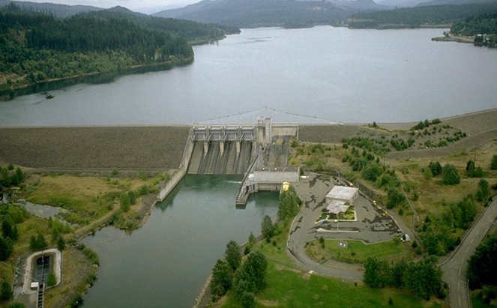
Evaluation of Juvenile Salmonid Passage and Behavior at Foster Dam Utilizing Radio Telemetry, 2014-2015
Photo: J Duncan
JH Hughes, BJ Bellgraph, J Vazquez, and GE Johnson
Willamette Fisheries Science review
^{Portland, Oregon}
^{February 2015}
^{STUDY CODE: JPL-11-05-FOS}

Slide 2
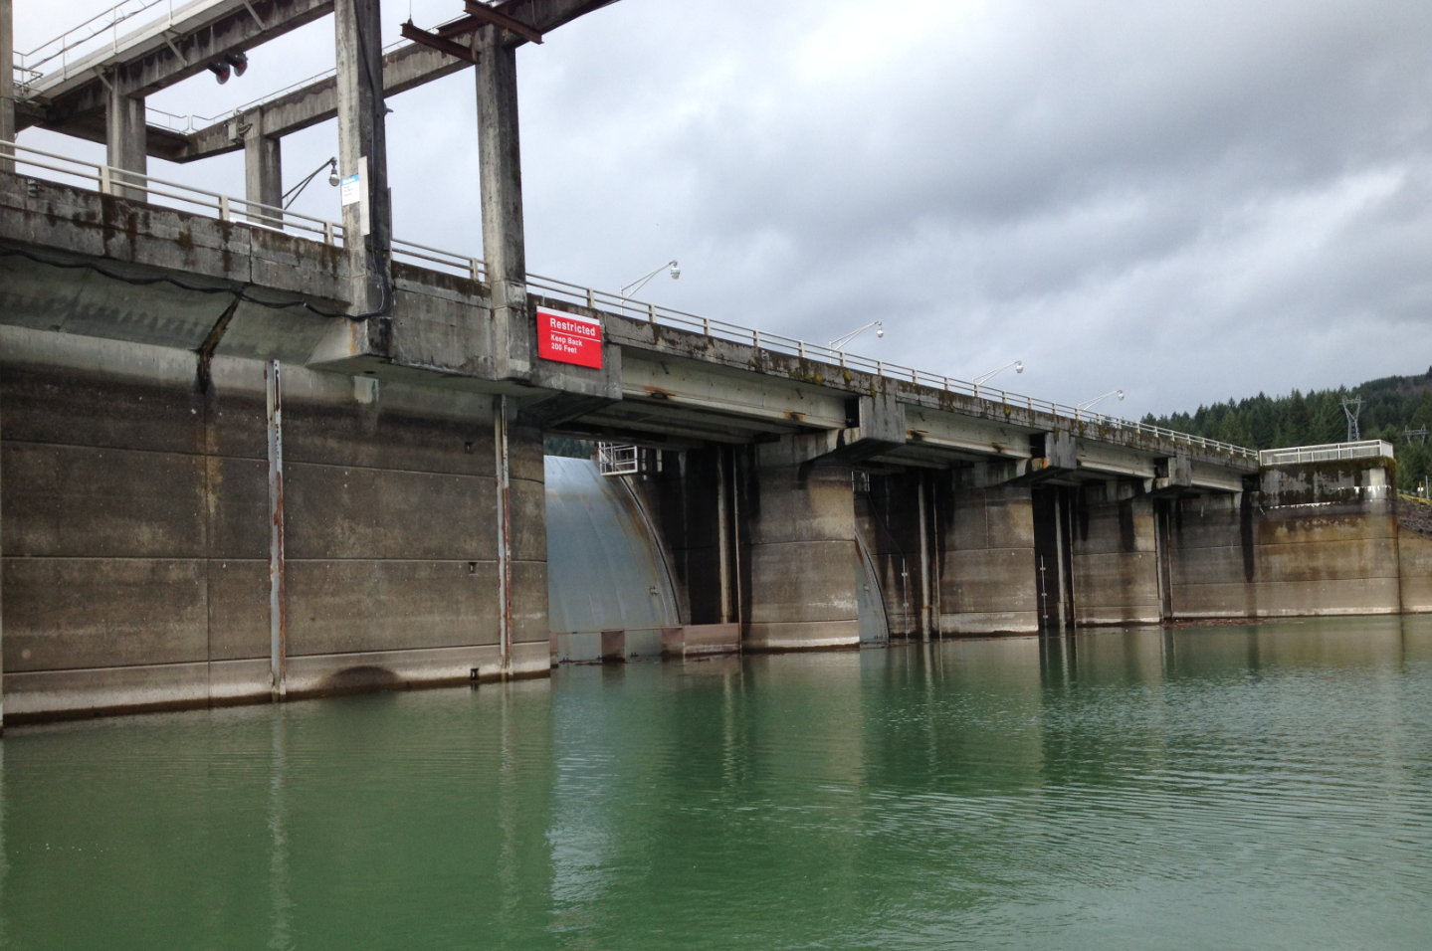
Presentation Outline
Background
Overall research objectives
Fall 2014 optimization
  Methods
  Preliminary Results
    Residence times
    Route distributions
Spring and fall 2015 research plans
    Tagging and release
    Spill test

Slide 3
Background
Information is needed that characterizes Chinook salmon and steelhead passage efficiencies; survival; temporal and spatial distributions; and behaviors and movement patterns in the reservoir, near forebay, through the dam, and downstream of Foster.
Past research includes full project hydroacoustic assessment paired with run-timing and species composition (2013–2014).
  Indicated the majority of fish are passing via turbine units
  Identified spill as an optimal non-turbine route of passage for downstream migrants.
Hatchery, auxiliary, and forebay water supplies are screened for debris but not for juvenile fish.

Slide 4
Overall Research Objectives
For yearling and subyearling Chinook salmon (O. tshawytscha ) and steelhead (O. mykiss ):
1) Determine diel distribution, behavior, and movements in the forebay
2) Estimate the following:
  Reservoir and forebay residence times
  Dam passage efficiency
  Route specific, project, and dam passage survival.
3) Evaluate alternative operations; “block/treatment” (on/off) test with spillway versus turbines operations.
4) Evaluate entrainment in the forebay water supply (FWS), auxiliary water supply (AWS), and hatchery water supply (HWS).
5) Evaluate detection efficiency of the fish weir PIT antenna.
6) Ensure adequate tag battery life and radio receiver configuration (Optimization task–fall 2014).

Slide 5
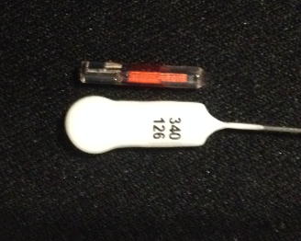
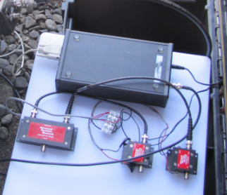
Optimization Study
October 21 – December 8, 2014 :
Telemetry Equipment
  Autonomous Orion Receivers (Sigma Eight Inc., Newmarket, Ontario, Canada)
  Tags
    Five frequencies; 166.5 –167.5 MHz
    LOTEK NanoTag model NTC-M-2
    Burst Rates: 4.5 - 5.2 sec
    Tag life
      Manufacturer specs: Guaranteed – 25 days, 27 day average
      Tag life study – 35.6 day average.

Slide 6
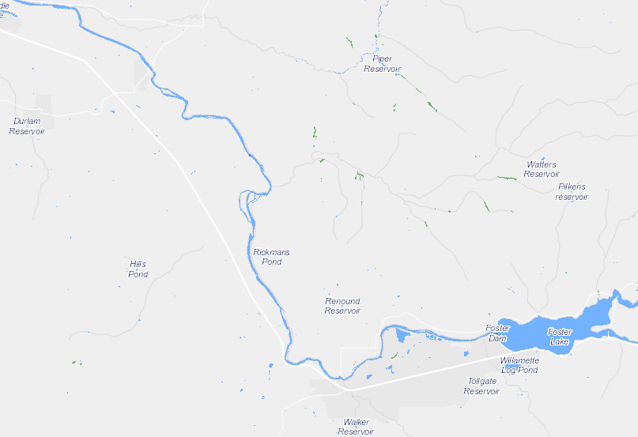

Study Area
Release Locations
  Head-of-Reservoir (HOR); 4 km
  Mid-Reservoir (MOR); 2 km
Receiver Arrays
  Foster Dam
  Downstream arrays
    Egress: 2.5 km
    Primary: 10 km
    Secondary: 13 km
Lebanon
Secondary
Primary
Egress
Foster
MOR
HOR
Sweet Home
Notes:
Array location based on land access – private land
Survival will include through Foster and 13 km of tail waters, single release estimates

Slide 7
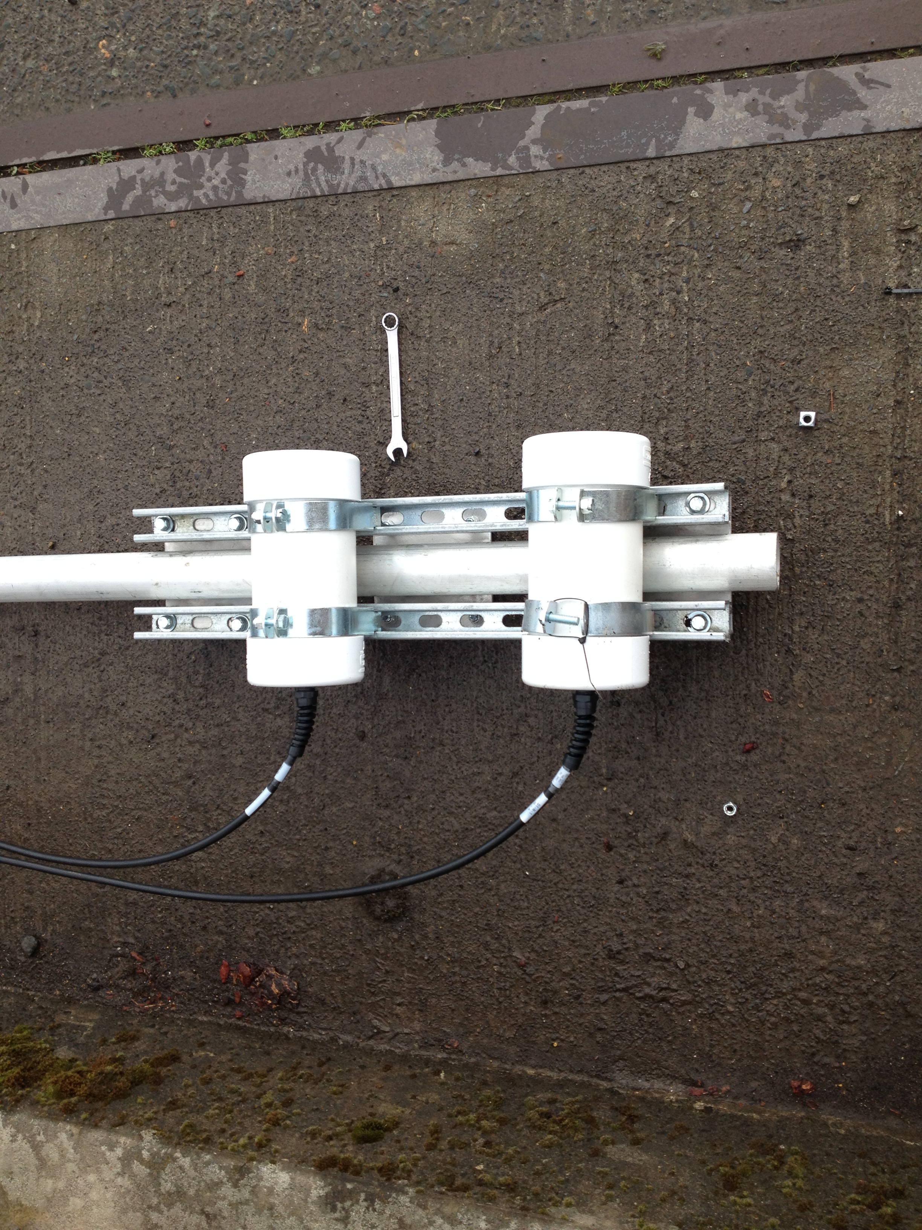
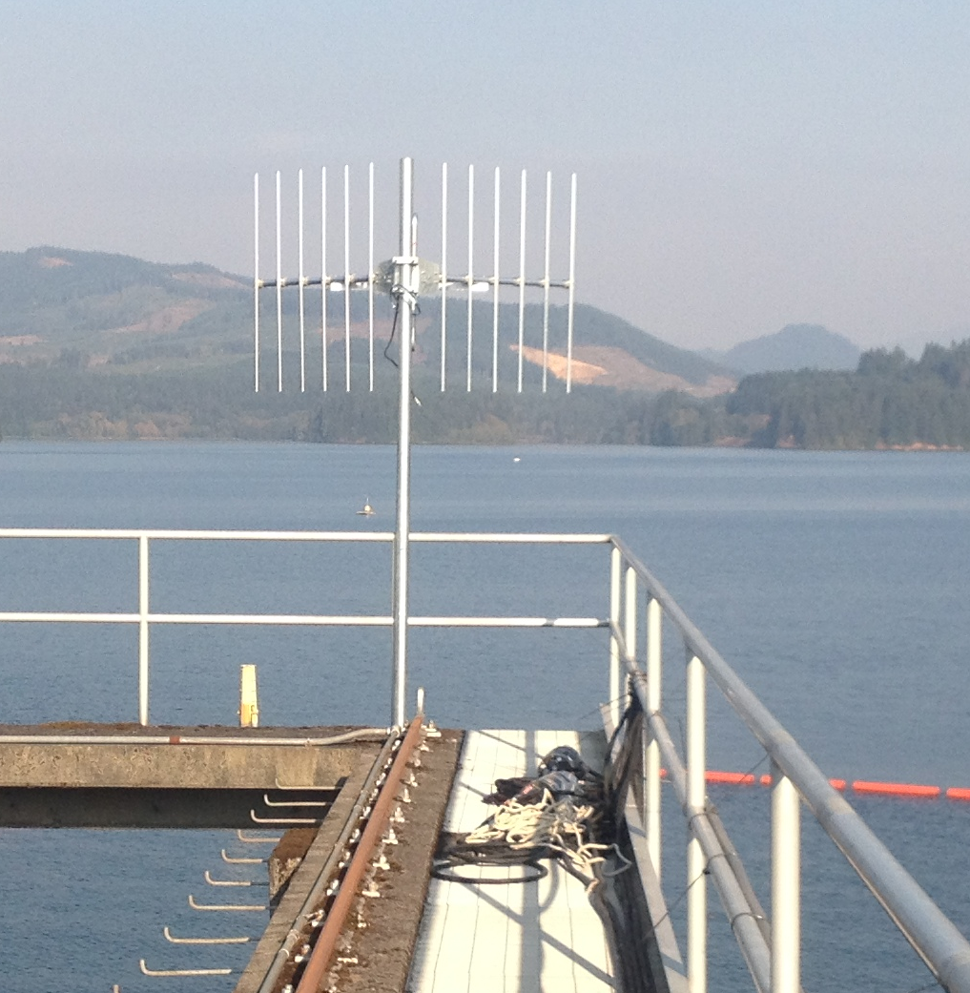




Deployment
  Underwater Balanced Loop-Vee Radio Antennas (Gingerich et al. 2012):
  2 turbine units
  3 spill bays
  Fish weir – Spill Bay 4
  FWS, AWS, and HWS
Ariel Yagi Antennas:
  Forebay
  Egress, primary, and secondary arrays
Notes:
underwater balanced loop-vee radio antenna

Slide 8
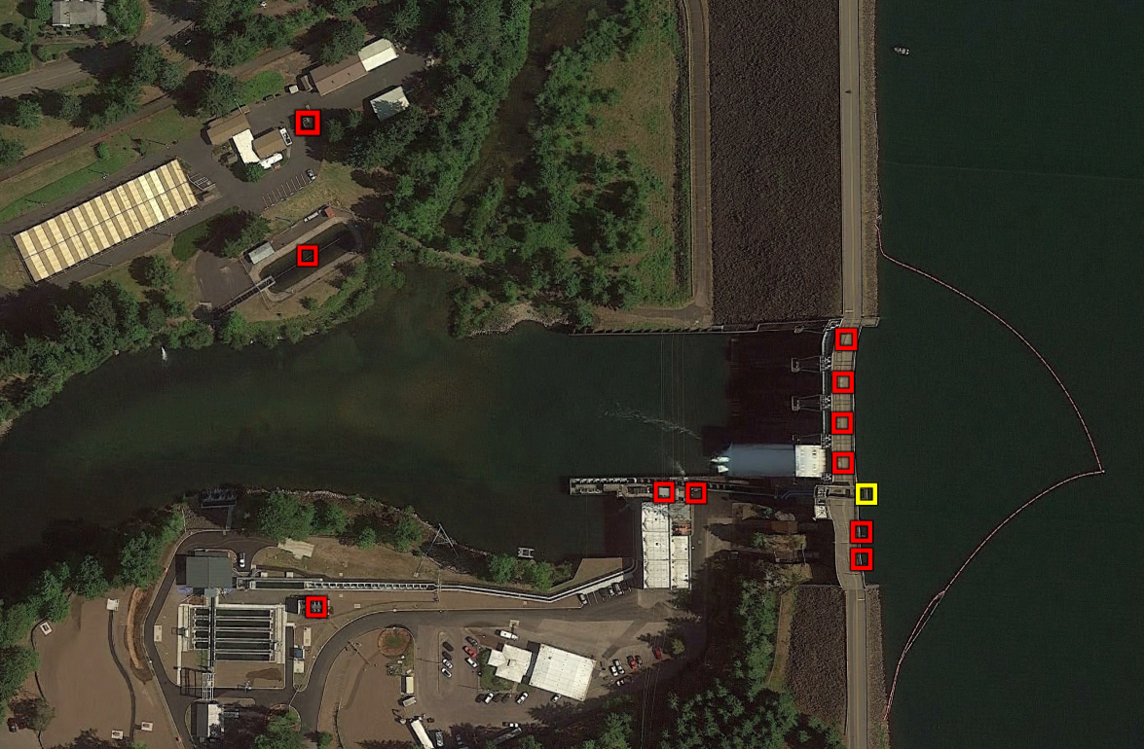
Deployment
Hatchery Water
Supply (HWS)
Forebay Water
Supply (FWS)
Auxiliary Water
Supply (AWS)
Spillway
Forebay
Penstock

Slide 9
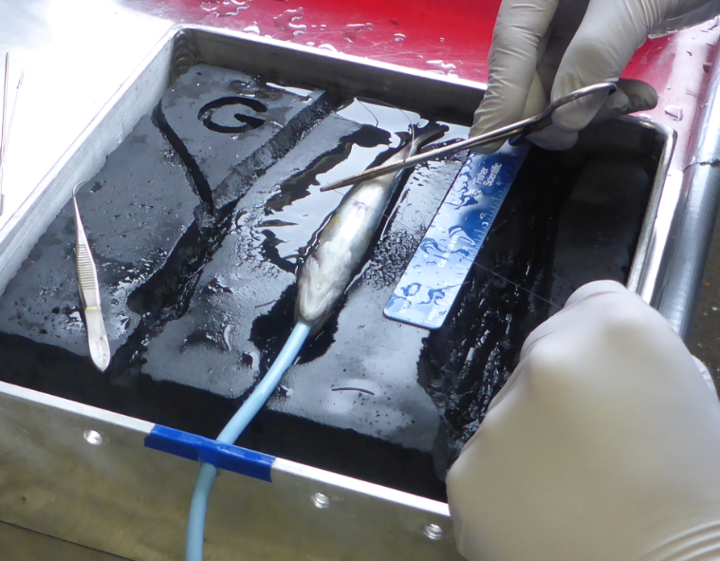
Optimization Tagging and Release
OSU surrogate program
October 21–23, 2014
Tagging and Release
  Chinook salmon; n=94
  Steelhead; n=97
  24-hr mortality = 0.52%
Species/Age Class | Release Location | n | Size (Mean FL) | Size Range
Chinook salmon | HOR | 48 | 184 mm | 170–205 mm
 | MOR | 46
Steelhead | HOR | 49 | 151 mm | 122–188 mm
 | MOR | 48
Dead Fish Release | Foster | 11 | – | –

Slide 10
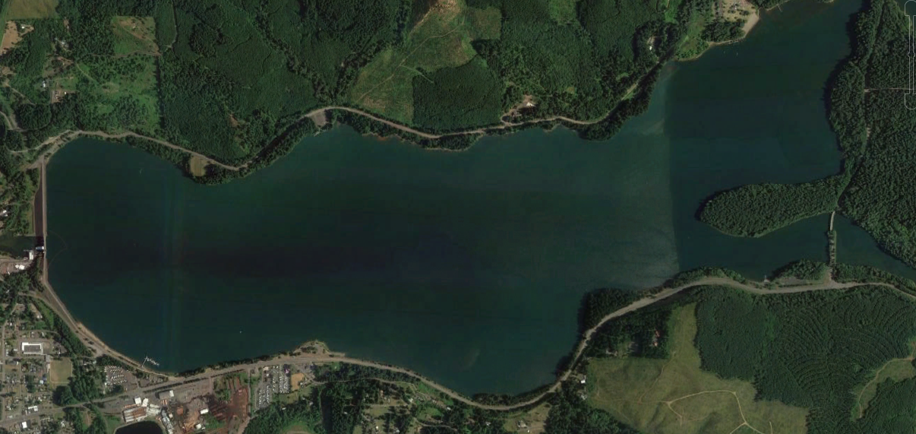
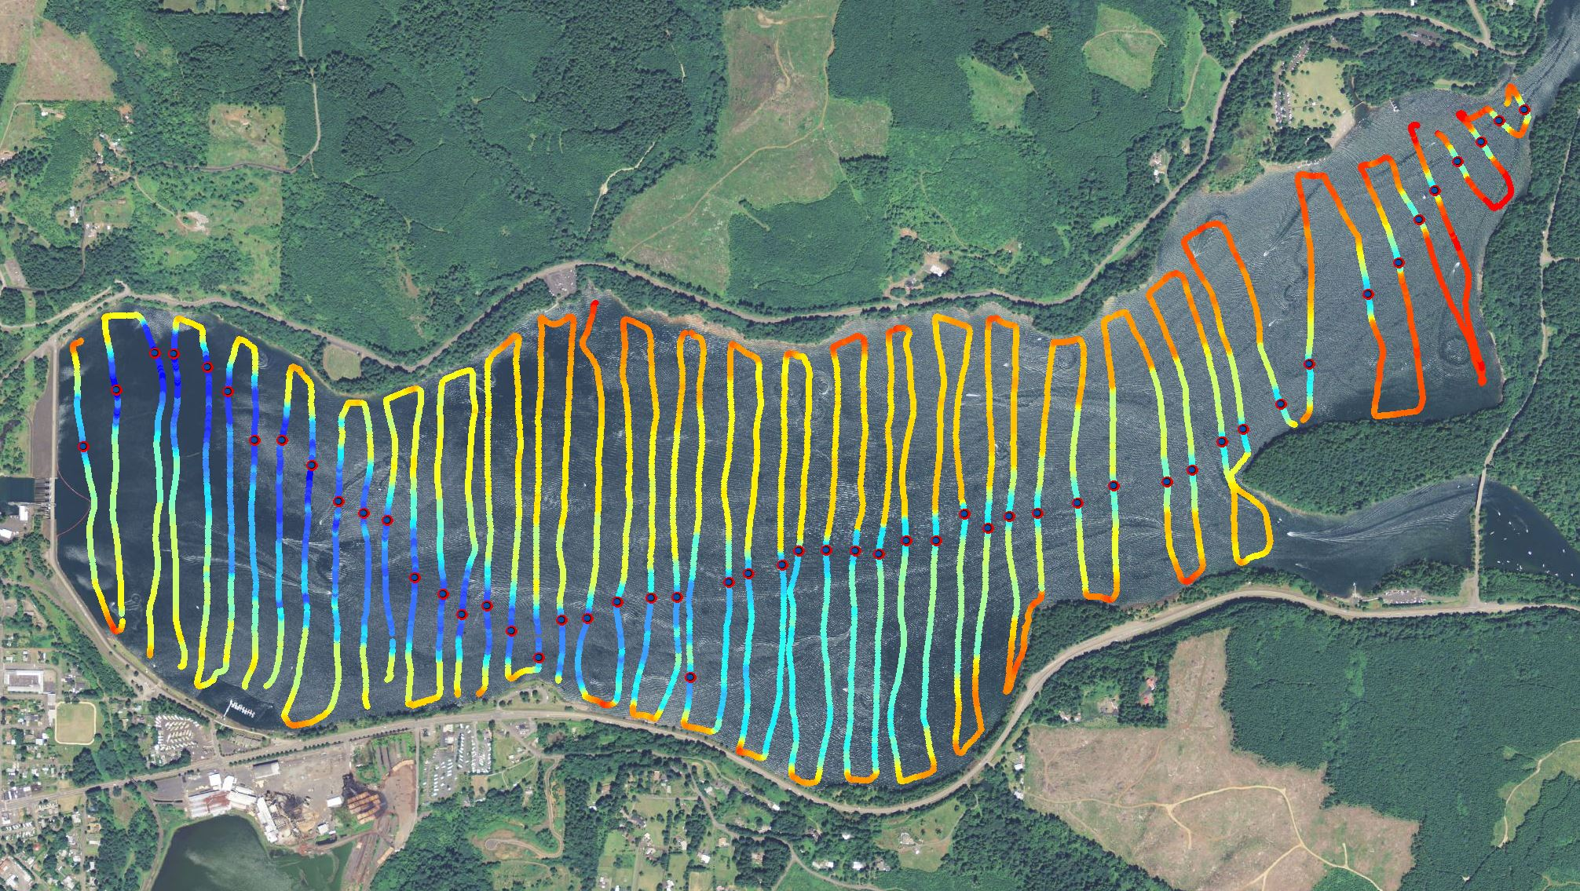
Optimization Tagging and Release
Chinook, n=48
Steelhead, n=49
Chinook, n=46
Steelhead, n=48
HOR
MOR
Notes:
Relate release location to bathymetry

Slide 11
Preliminary Optimization Results:
Reservoir Residence Times (hrs)
All | Mean | Median | SE | n
Chinook | 69.9 | 34.0 | 13.2 | 82
Steelhead | 268.3 | 241.4 | 121.8 | 7
HOR | Mean | Median | SE | n
Chinook | 66.8 | 18.1 | 19.0 | 45
Foster
MOR | Mean | Median | SE | n
Chinook | 73.6 | 34.8 | 18.3 | 37
HOR
MOR
Notes:
Steelhead not presented by release location as n is too small, errors ridiculous, combined is more informative

Slide 12
Preliminary Optimization Results:
Detections at Foster
 | Chinook salmon |  | Steelhead
 | Proportion | n | Proportion | n
Total Released | – | 94 | – | 97
Never Detected | 0.085 | 8 | 0.742 | 72
Detected at Dam | 0.915 | 86 | 0.258 | 25
Passed Downstream | 0.954 | 82 | 0.280 | 7
Moved Back Upstream | 0.046 | 4 | 0.720 | 18
Notes:
Will verbally explain this thoroughly, point is most Chinook were detected at dam and passed, opposite with steelhead

Slide 13
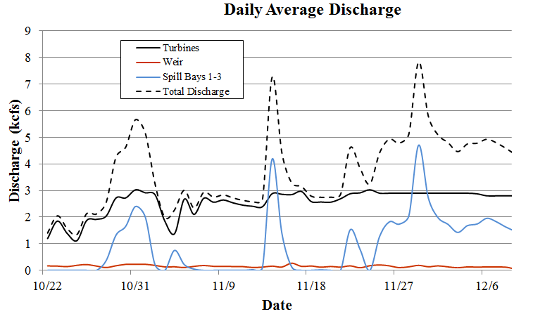
Preliminary Optimization Results: Dam Operations
Notes:
Start w/ explaining overall total project discharge through the study period.
Next, explain spill and why it happened when it did.
Then explain the weir op’s/, e.g., the bumps in summer.
Foster Daily Average Discharge from April 1, 2013 through May 31, 2014. Estimates of discharge over the weir were determined by assuming a linear relationship between forebay elevation and weir discharge.

Slide 14
Preliminary Optimization Results:
Passage Proportions
Chinook salmon (n=82)
Steelhead (n=7)
 | Proportion | n
Turbine | 0.768 | 63
Unit 1 | 0.603 | 38
Unit 2 | 0.397 | 25
Fish Weir | 0.134 | 11
Spill Bays 1–3 | 0.098 | 8
 | Proportion | n
Turbine | 0.571 | 4
Unit 1 | 0.75 | 3
Unit 2 | 0.25 | 1
Fish Weir | 0.286 | 2
Spill Bays 1–3 | 0.143 | 1
Notes:
Most chinook passed PH, skewered towards P1 similar to hydroacoustics, P1 and P2 both operated almost continuously during study period, P2 only operated ~8hr less than P1

Slide 15
Preliminary Optimization Results:
Travel Times (hr) Chinook Salmon
Lebanon
Secondary
Primary
Mean | Median | SE | n
4.9 | 1.1 | 1.0 | 69
2.5 rkm
Egress
Egress
Foster
MOR
HOR

Slide 16
Preliminary Optimization Results:
Travel Times (hr) Chinook Salmon
Lebanon
Secondary
Mean | Median | SE | n
8.3 | 4.3 | 2.2 | 68
Primary
10 rkm
Egress
Egress
Foster
MOR
HOR
Notes:
More informative than anything

Slide 17
Preliminary Optimization Results:
Travel Times (hr) Chinook Salmon
Lebanon
Mean | Median | SE | n
1.8 | 1.3 | 0.3 | 68
Secondary
3.0 rkm
Primary
Egress
Egress
Foster
MOR
HOR
Notes:
More informative than anything

Slide 18
Preliminary Optimization Results:
Travel Times (hr) Chinook Salmon
Lebanon
Mean | Median | SE | n
15.2 | 7.4 | 2.4 | 68
Secondary
Primary
13 rkm
Egress
Egress
Foster
MOR
HOR

Slide 19
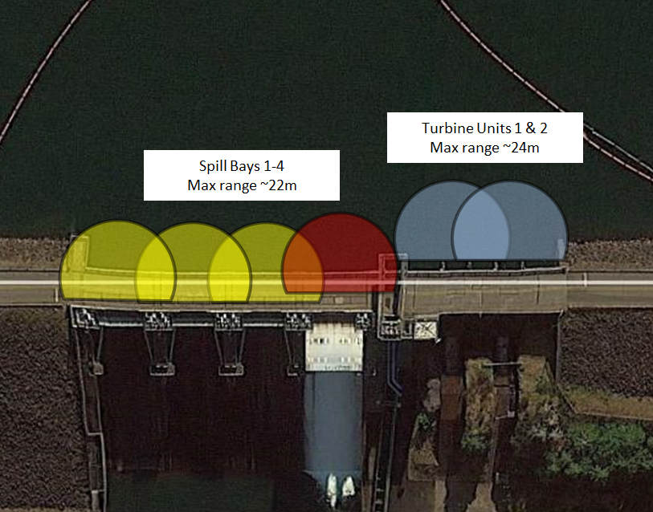
Preliminary Optimization Results:
High probability of detection at all arrays
No dead fish detected on
survival arrays
No study fish detected in
the FWS, AWS, or HWS.
Notes:
Confirm 1

Slide 20
Optimization Summary and Conclusions
Burst rate/tag life is adequate for spring and fall 2015 studies
  Will use similar frequencies, burst rates, and tag model
Code collision was minimal at dam-face and downstream autonomous arrays
Detection efficiencies were adequate for forming “events” at all telemetry arrays.
Optimization results validate reasoning for not tagging steelhead in fall 2015
Notes:
Mention that we consulted with ODFW to life history strategies of STH in the fall of 2014, received confirmation from them that STH would more than likely hold until spring

Slide 21
Spring and Fall 2015 Study
Tagging and Release
Season | Species | Release Location | n | Size Range (mm)
Spring 2015 | Chinook salmon | HOR | 375 | 100–155
 |  | MOR | 375
 | Steelhead | HOR | 400 | 140–200
 |  | MOR | 400
 | Dead fish release | Foster | 30 | -
Fall 2015 | Chinook salmon | HOR | 675 | 170–230
 |  | MOR | 675
 | Dead fish release | Foster | 30 | -

Slide 22
Spring 2015: On/Off Spill test
Treatments
  Fish Weir in Spill Bay 4 continuously operated
  Treatments include manipulating turbine and spill operations
Tagging and Release
Treatment | Name | Turbine | Spill
1 | “Both-on” | On | On
2 | “Turbine-on” | On | Off
3 | “Spill-on” | Off | On
Release | Forebay Elevation | Date (2015) | Chinook | Steelhead
R1 | 613 ft | March 2 | 175 | 200
R2 | 613 ft | March 16 | 175 | 200
R3 | 613 ft | March 30 | 175 | 200
R4 | 635 ft | May 10 | 175 | 200

Slide 23


Acknowledgments
Army Corps of Engineers
  Fenton Khan
  David Griffith
  Steve Gardner
  Thomas Voldbaek
  Chad Helms
  Doug Garletts
  Greg Taylor
  Foster control room operators,
  Engineering and structural staff
PNNL
  Mike Greiner
  Eric Fischer
  Bishes Rayamajhi
  Chris Vernon
  Jina Kim
  Ricardo Walker
  Kate Deters
  John Stephenson
ODFW
  Brett Boyd
  Fred Monzyk
  Cameron Sharpe
  Jeremy Romer
  Staff at SSH
OSU
  Karen Cogliati
23

Slide 24
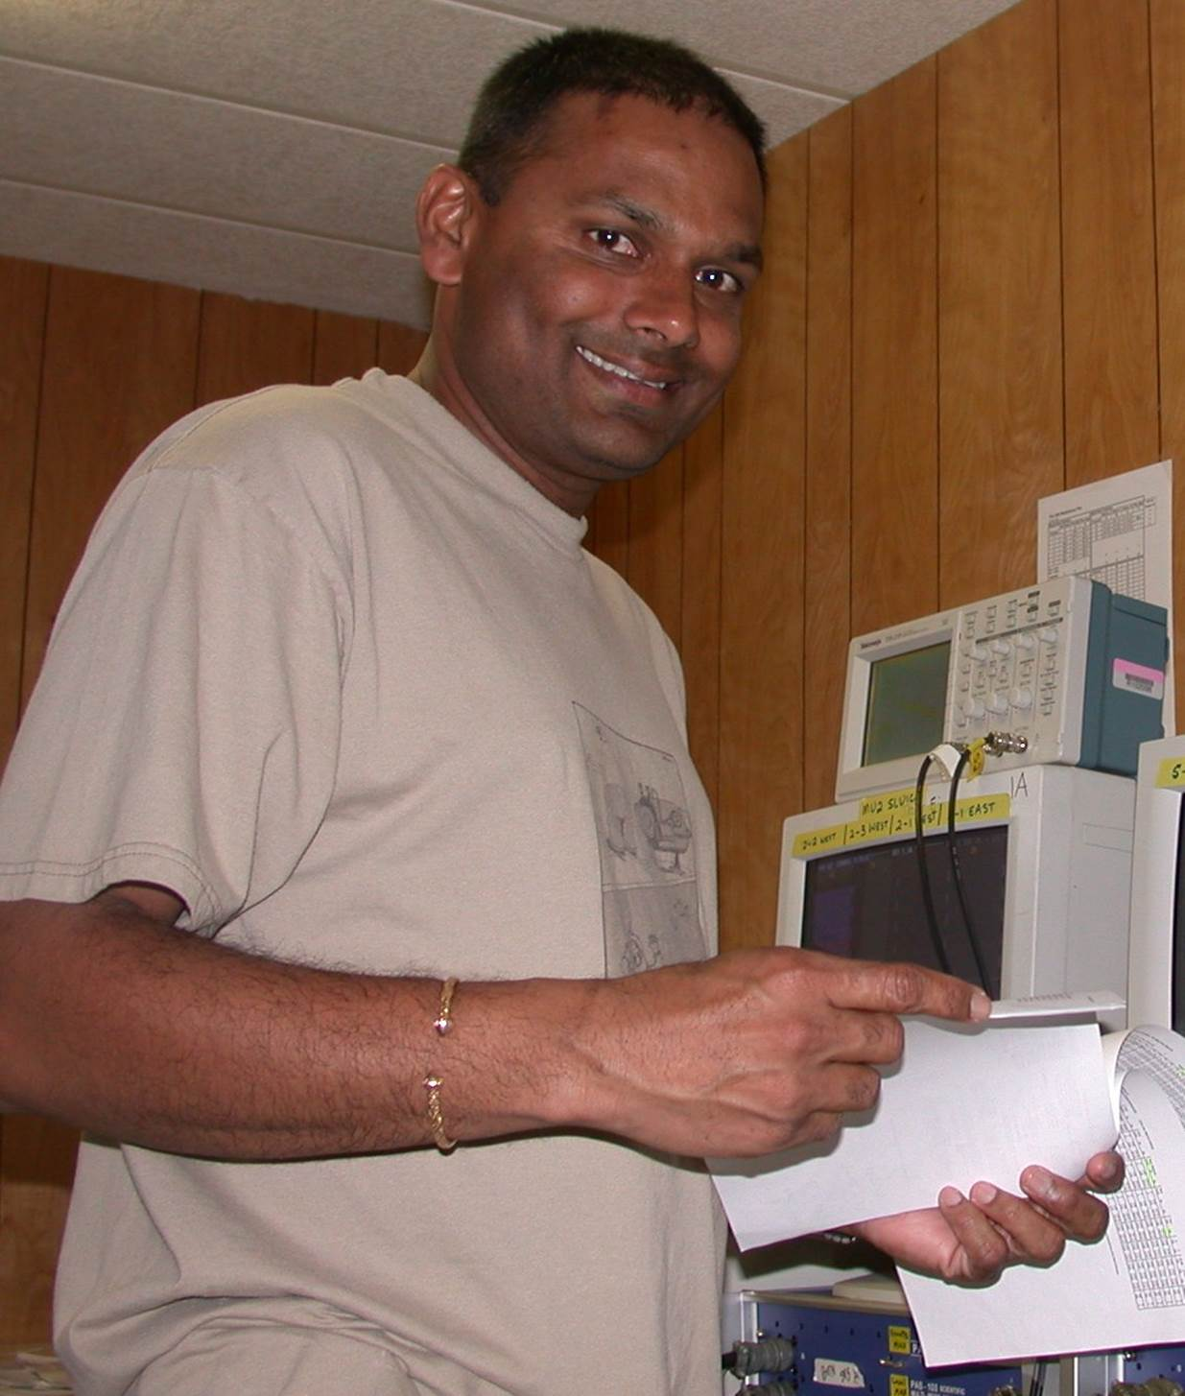
Questions?

