Slide 1


Update on the Sustainable Rivers Project: Monitoring framework and insights from the Middle Fork Willamette
Rose Wallick (USGS)
Leslie Bach (The Nature Conservancy)

Slide 2
Overview
Sustainable Rivers Project
Monitoring framework
Application to the Middle Fork Willamette
Next steps

Slide 3
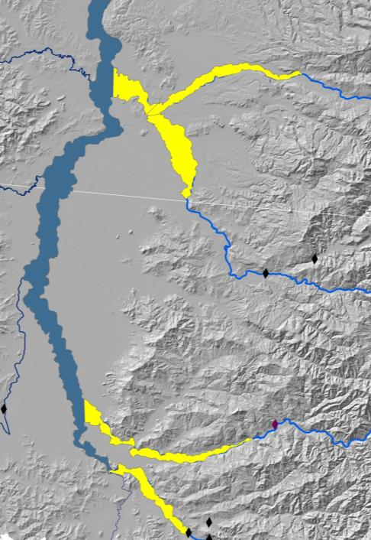
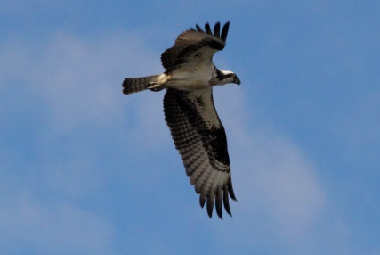
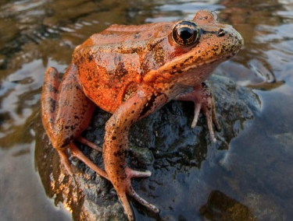
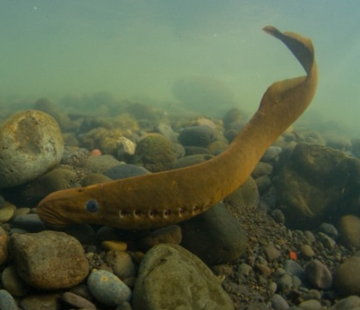
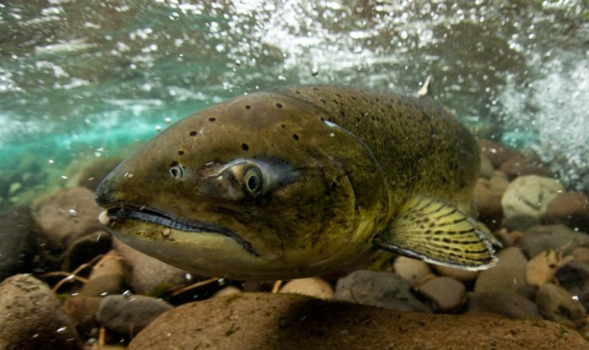
Sustainable Rivers Project
Willamette River
Study Area
Santiam
North Santiam
Partnership between USACE and TNC to identify opportunities for providing more ecologically sustainable flows while still meeting human needs and congressionally authorized purposes
South Santiam
Green Peter Res.
Foster Dam
Leaburg Dam
McKenzie
Middle Fork Willamette
Fall Creek
Freshwaters Illustrated photos

Slide 4
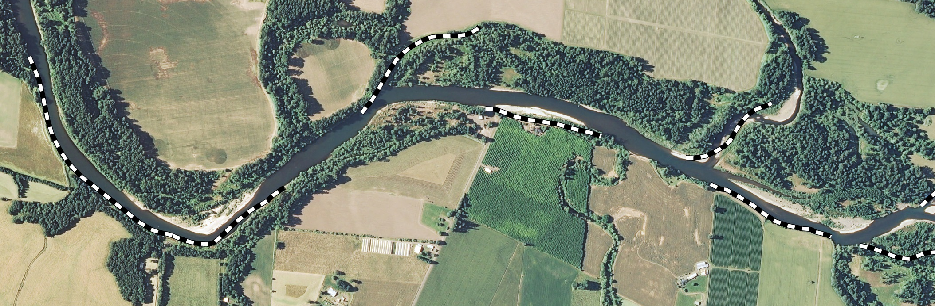
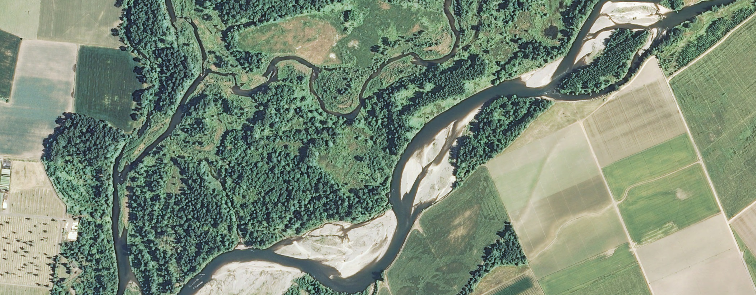
South Santiam River
Revetments
Given present-day conditions, how can flow enhance habitats?
North Santiam River
In more dynamic places, how can flow be used to sustain complex habitats?

Slide 5
SRP Recommendations
Winter high flows
SRP Small Flood
SRP Bankfull
Spring flows
Fall flows
Spring transition
Summer flows

Slide 6
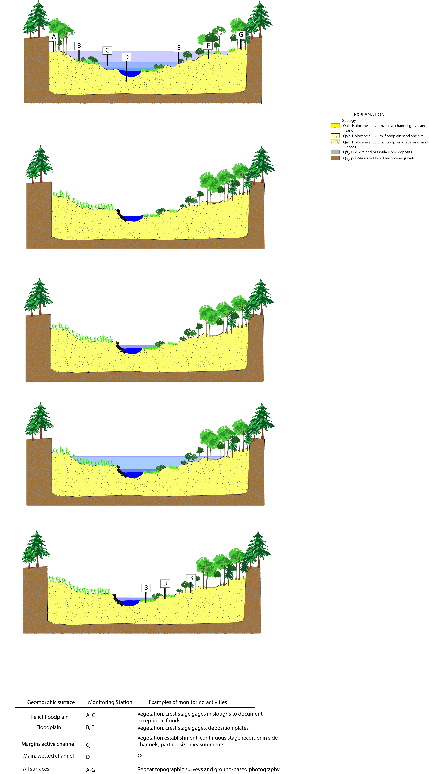
Monitoring links Hydraulic, Geomorphic and Vegetation Responses with Flows
SRP objective for spring flows:
Connect lateral habitats, gradual decline to base flows
D
A
B
C
Sample monitoring transect to track inundation at different flows

Slide 7
Monitoring links Hydraulic, Geomorphic and Vegetation Responses with Flows
SRP objective for small floods :
Create new floodplain surfaces through migration
Do high flows trigger incision?
Do high flows exacerbate aggradation in relict side-channels?
Notes:
For example, the SRP objective for small floods is to create new floodplain surfaces through migration. Assuming that banks are erodible, and that sediment is available, new floodplain surfaces can be created by the combination of lateral accretion through migration and vertical accretion by overbank deposition.
However, all of the SRP study reaches are influenced to varying degrees by revetments and diminished sediment supply from upstream dams. So it’s possible that instead of meander migration and floodplain creation, high flows could trigger incision.
Another possibility is that SC can fill with fine sediment – and bc many of these important habitats are not being replaced due to channel stability; excess fine sediment can hasten their demise.
Also, vegetation…
Can answer some of these questions through site-scale monitoring, but to fully understand how these processes are playing out across entire river corridor, need to employ combination of reach and site-scale monitoring.

Slide 8
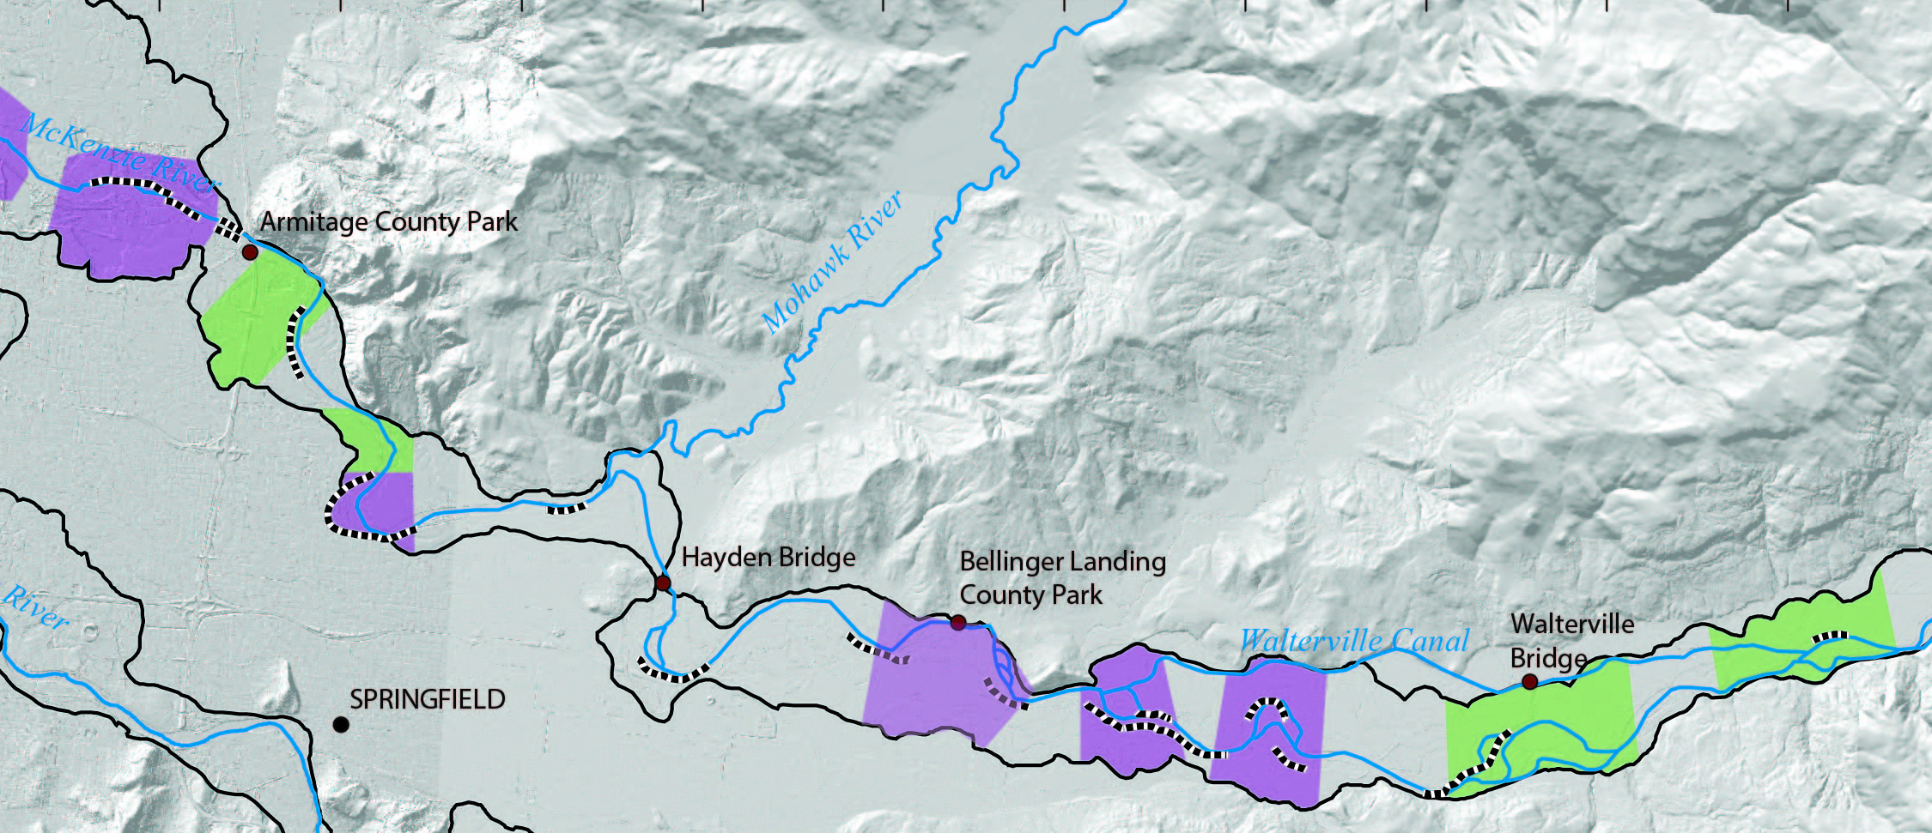
Sample Monitoring Plan for McKenzie River
Monitoring Zones
Presently dynamic
Presently stable
Monitoring transect
Transects
(< 1 year)
Crest stage gages
Vegetation plots
Repeat photographs
Monitoring Zones
(1-5 years)
Mapping active channel
Reach-scale tasks
(5-10 years)
Geomorphic mapping
Vegetation mapping
Thalweg survey
Notes:
We outline a monitoring framework that utilizes a blend of site and reach-scale measurements to track hydraulic, geomorphic and vegetation responses to year-round environmental flows.
Annual implementation to document which flow targets were met
Site-scale msmts at transects to document inundation for different flows, track veg establishment and succession at veg plots; document bank erosion and geomorphic changes thru repeat photographs
At monitoring zones, repeat mapping of active channel every 2-5 years or after floods to track changes in active channel
Every 10 years, or after a large flood, track geomorphic and veg changes along entire reach through lidar or air photo mapping; also survey thalweg to track incision
Premise here is that we’ll never have enough $ to track everything, so focusing on a few key metrics that will enable us to track status and trends of key habitats and how they are changing in relation to flows.

Slide 9
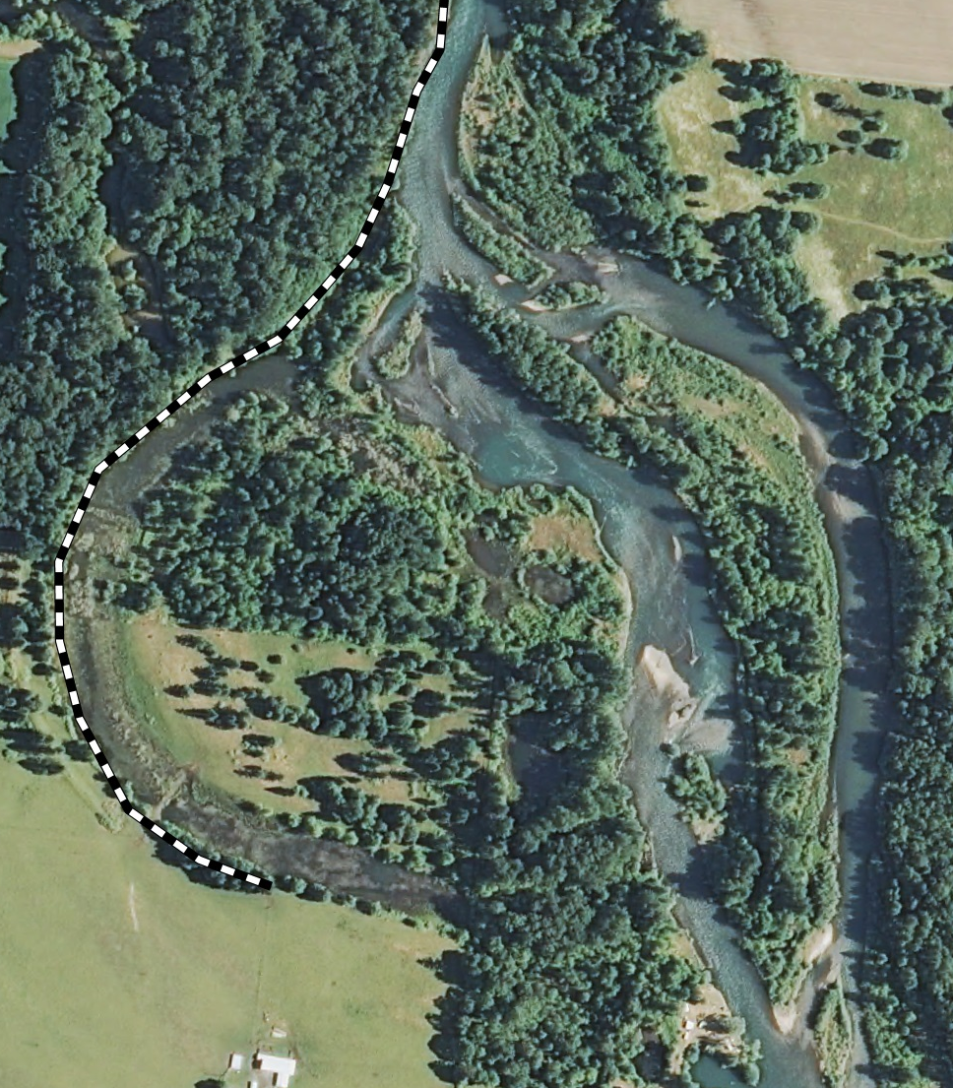
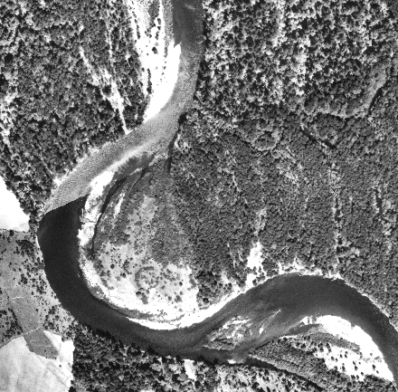
Middle Fork Willamette 1939-2011
Given present-day channel stability, how can flow be used to enhance riparian ecosystems?
1939
Peak flows 40,000-90,000 cfs
Lots of gravel and large wood
2011
Post-dam peak flows <~20,000 cfs
>95% decrease in gravel supply
Small gravel patches
Diverse vegetation mosaic
Mature forest
Large gravel bars
Notes:
The MFK Willamette is the river corridor that is farthest along in the SRP adaptive management process, so now I’m going to shift gears and describe the monitoring approach we’ve applied to the MFK and some insights we’ve gained from this monitoring.
Now the MFK is perhaps the most altered of all the major Willamette tribs. Floods here have been substantially diminished, there is essentially no gravel inputs to the lower river below Dexter Dam. In response, the river is much more stable than historically, and mature forest now extends to the low water line. The side channels that you see here are relict features from the pre-dam era.
So a key question for the MFK is: how can SRP use flow to enhance aquatic and riparian ecosystems?

Slide 10
Middle Fork Peak Flows 1906-2013
Peak Annual Discharge from USGS gage at Jasper, 14152000
Flood control dams fully operational
What happens during bankfull floods?
SRP Bankfull

Slide 11
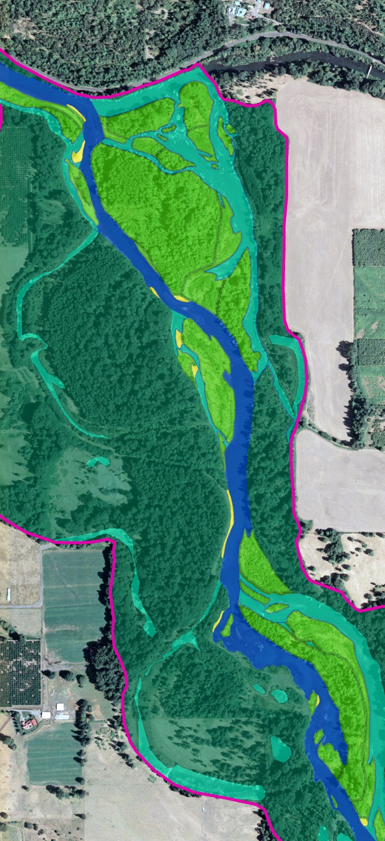
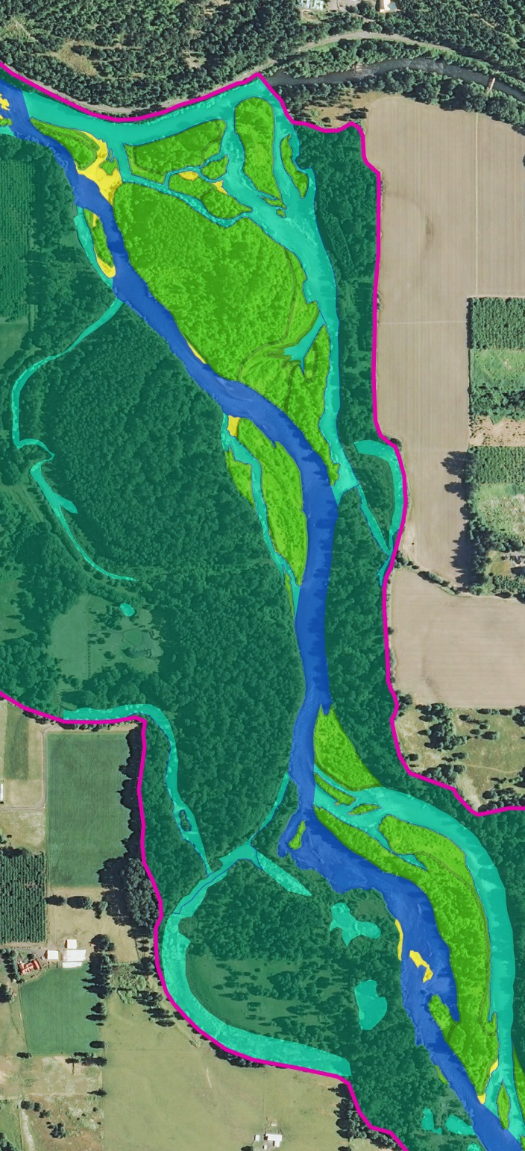
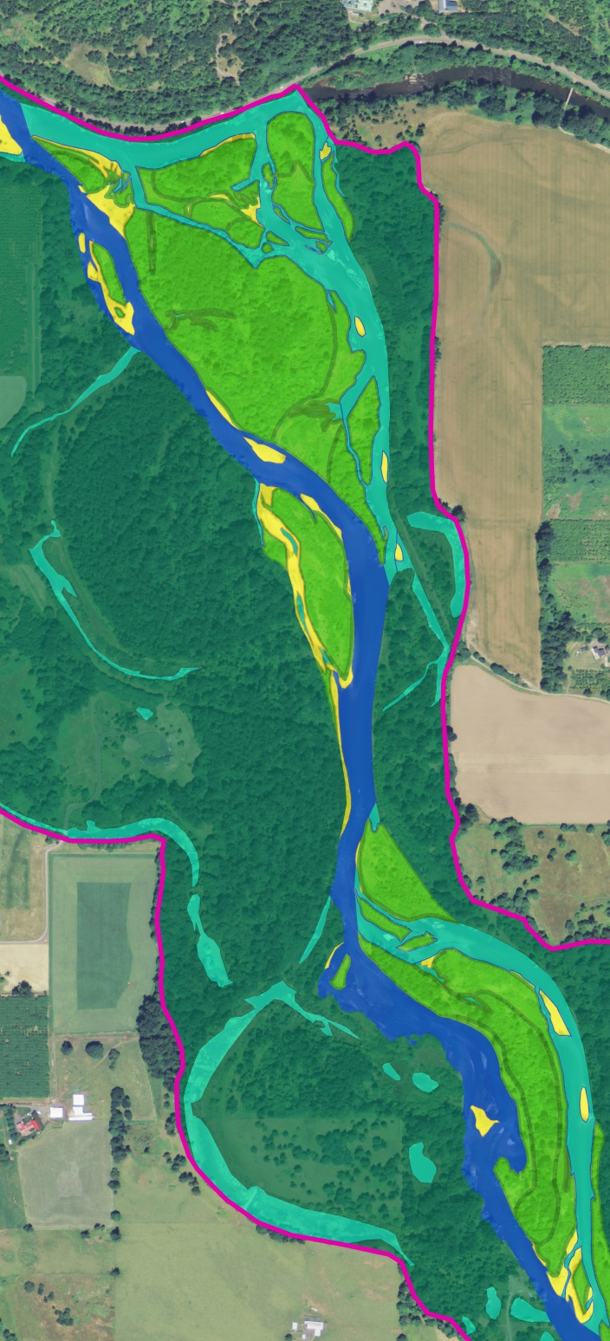
2005
2011
2012
Photo Q= 2,290 ft³/s
Photo Q =3,430 ft³/s
Photo Q =1,840 ft³/s
Fall Creek
Vegetated bars
Avulsion and bar growth
Bare gravel
Shifting patches of gravel
Increases in bare gravel
Floodplain
Geomorphic mapping by USGS and UO from NAIP air photos

Slide 12
Middle Fork Streamflows and Channel Change 2005-2012
Mean Daily Discharge from USGS Gage at Jasper, 14152000
2005 Photo analyses
2011
2012
Fall Creek sediment release
SRP Bankfull
High flows 2005-2011:
Large increases in bare bars
Low flows 2000-2005:
Vegetation encroachment onto bare bars
2011-2012
More bar building?

Slide 13
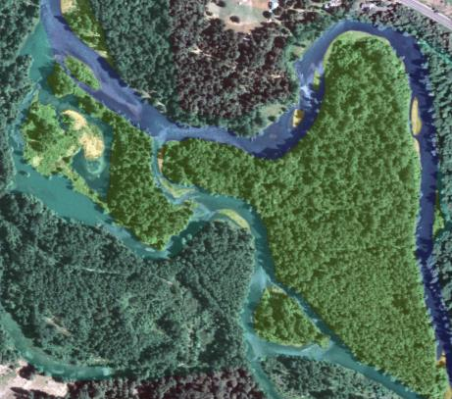
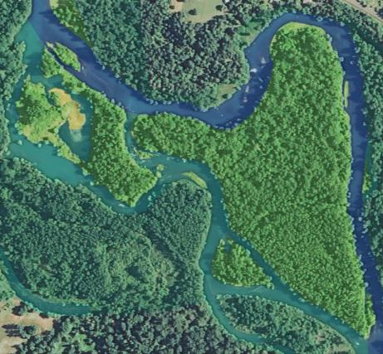
Middle Fork Preliminary Findings: 1) Primary channel, side channels and vegetated bars predominantly stable during bankfull flows
2005
FPKM 20, below Dexter Dam.
Geomorphic mapping overlain on NAIP air photos
2011

Slide 14
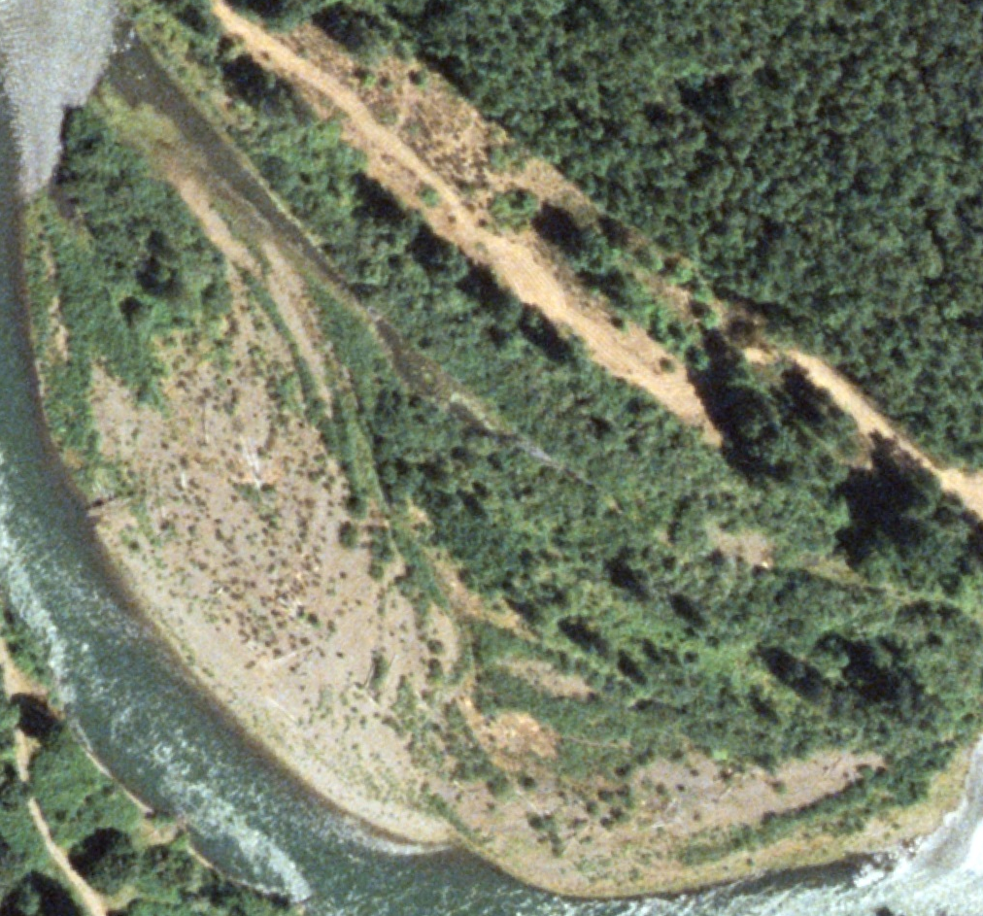
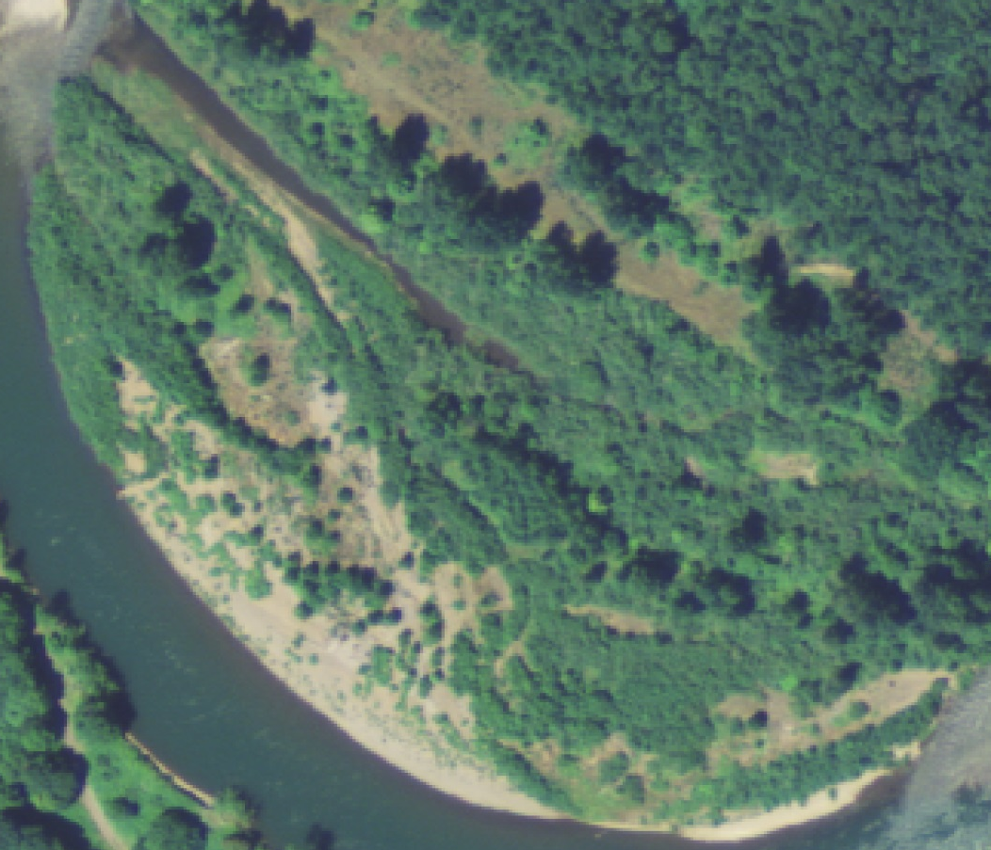
Middle Fork Preliminary Findings: 2) Even sparsely vegetated bars are stable in bankfull flows
2005
NAIP air photos from FPKM 6, near TNC’s Willamette Confluence Preserve
2011
Scoured by floods 1996-97
Vegetation recruitment 1997-2005
Stable 2005-2011

Slide 15
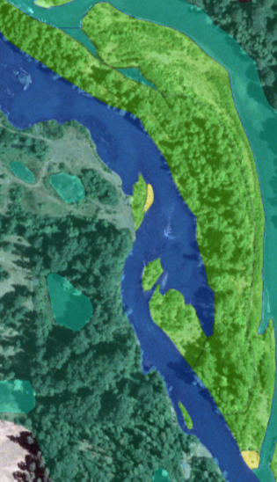
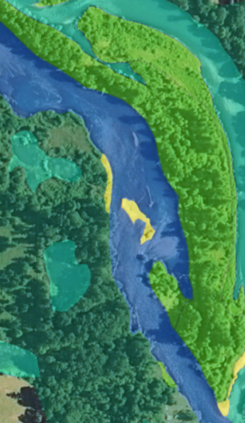
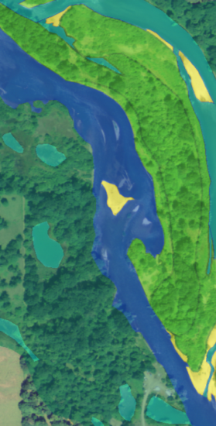
Middle Fork Preliminary Findings: 3) Actively shifting bare bars small and sparse, but area of bare bars increased ~85% 2005-2011
2005
2011
2012
Sparsely vegetated bars
Erosion and re-deposition
Bar shifting

Slide 16
Three Bankfull Flow Events 2006-2011 Associated with local scour and 85% increase in bare bars
Instantaneous discharge from USGS Gage at Jasper, 14152000
December 2008
January 2006
June 2010
SRP Bankfull

Slide 17
One (small) Bankfull Event 2011-2012 Continued mobilization of previously scoured surfaces?
Instantaneous discharge from USGS Gage at Jasper, 14152000
January 2012
December 2008
January 2006
June 2010
SRP Bankfull
Threshold for mobilizing bare gravel?

Slide 18
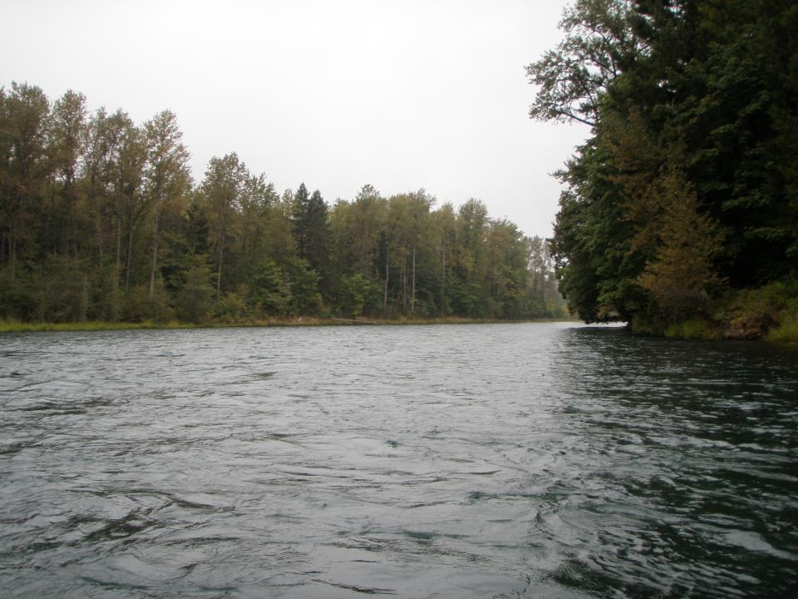
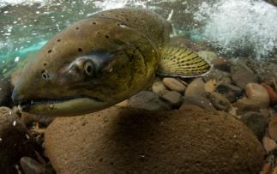
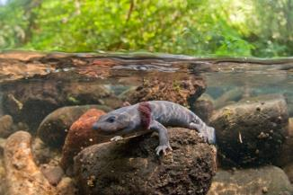
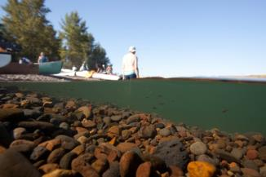
Outstanding Questions:
Vegetation recruitment?
Channel incision?
Bed coarsening?
Future trajectory of side channels?
Status of McKenzie, Santiam Basins?
Implications for ecosystems?
Freshwaters Illustrated photos

Slide 19
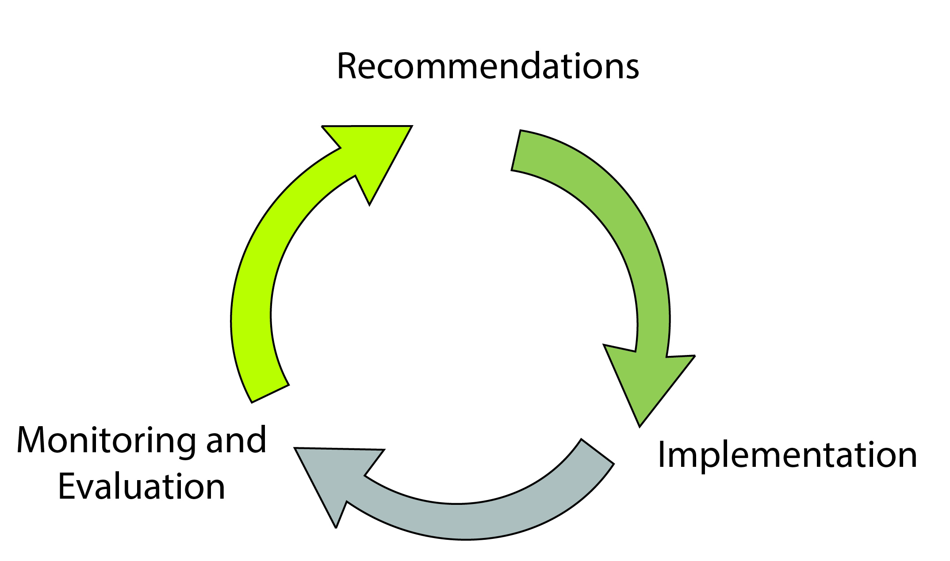
Steps Toward a Basinwide Adaptive Management for the Willamette SRP
Document implementation
Monitor responses
Refine SRP objectives
Repeat
Recommendations
Monitoring and Evaluation
Implementation

Slide 20
Upcoming Work for 2015
Monitoring framework
(planned publication, late summer 2015)
Middle Fork geomorphic assessment
(planned publication, fall 2015)
Assessment of flow -vegetation relationships for Middle Fork and McKenzie
(Fieldwork summer 2015; planned publication fall 2015)

Slide 21
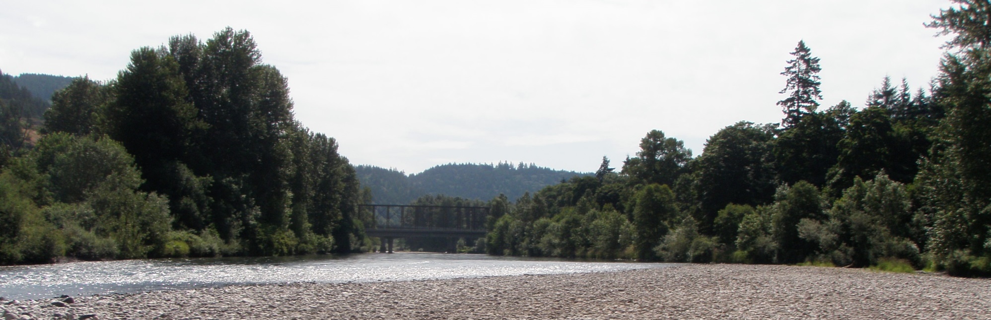
Acknowledgements
Chris Budai, Keith Duffy, John Hickey, Mary Karen Scullion, Greg Taylor (USACE)
Melissa Olson, Emilie Blevins (TNC)
JoJo Mangano, Mackenzie Keith (USGS)
Jeremy Monroe (Freshwaters Illustrated)
Questions? Rose Wallick rosewall@usgs.gov Leslie Bach lbach@tnc.org
McKenzie River, Armitage Park

